Slide 1

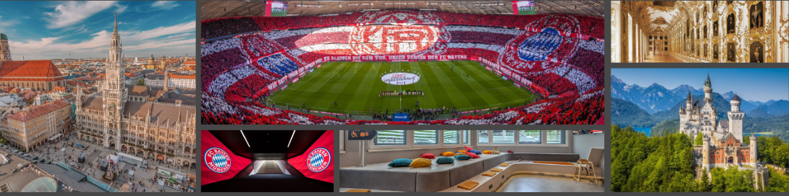


Downlands Community School
Football Development Tour
FC Bayern Munich
October 2025 – 5 days 4 nights

Slide 2
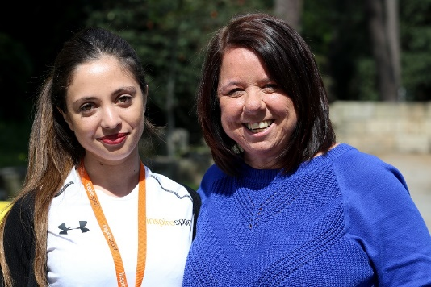
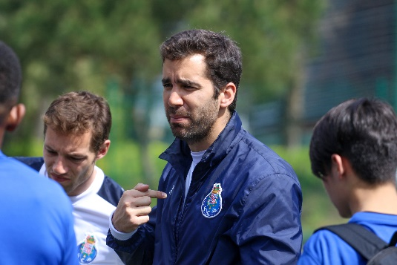
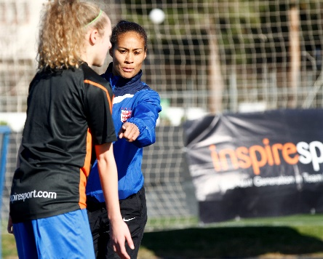
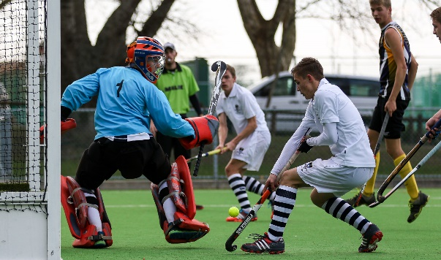
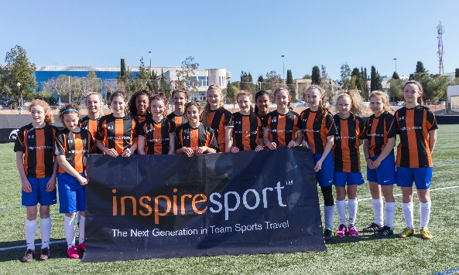
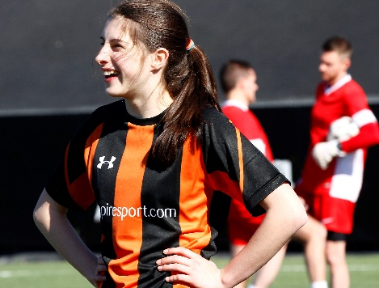


Who are inspiresport: company overview
Youth Team Sports tour operator
Established in 2004
Took over 20,000 students in 2023 (approx. 450 different groups)
Endorsed by leading sports governing bodies and federations
Downlands School multiple previous tours
Offices throughout the UK (Manchester, Brighton)
Operating in 4 continents at over 30 locations
ABTA / ATOL bonded ensuring both financial security and high standard of professionalism
Assured member of the STF (School’s Travel Forum)

Slide 3
Health & Safety
All coaches are suitably screened as determined by the relevant Technical Control Board – Safeguarding checks
All transportation must adhere to health and safety regulations
All accommodation has been visited and approved by Health and Safety auditors and risk assessments completed
Rapid access to qualified medical expertise
Students are under supervision 24/7 for the entire duration of the tour
An inspiresport representative available 24-hours a day to assist with your trip
Insurance included

Slide 4













Our Chosen Partners: Governing Bodies

Slide 5












Our Partners: European Exclusive and Preferred
Real Madrid
Manchester City
Valencia CF
Villarreal
PSV Eindhoven
Vitesse Arnhem
SL Benfica
FC Porto
Inter Milan
FC Bayern Munich

Slide 6
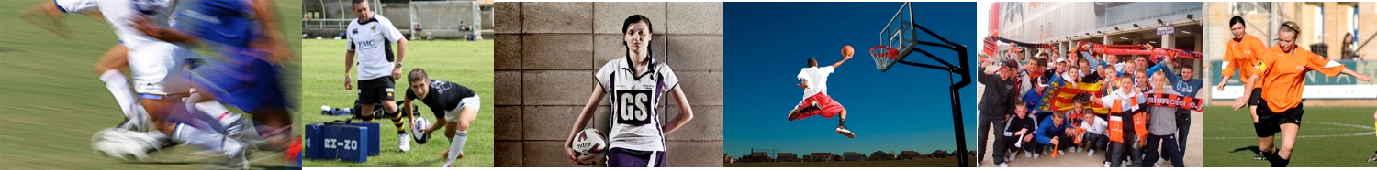
Objectives of InspireSport
To provide Access For All to the leading football clubs in the world
To provide comprehensive football coaching delivered by club professional staff
Create an environment where all students are given an unforgettable sports and travel experience
‘Inspire’ young players to continue playing sport

Slide 7

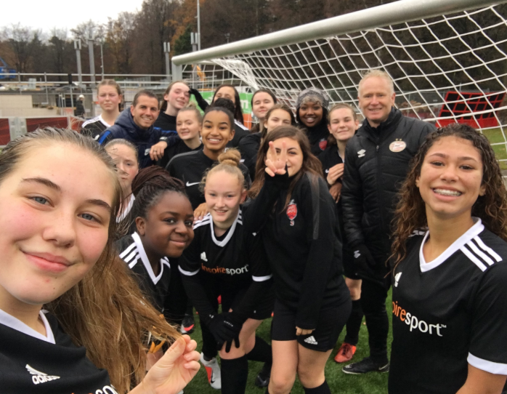




Benefits of Football Development Tours
Better skills
Improved performance
Renewed Passion
Education and Culture
Life experience
Team Building
Reputation

Slide 8
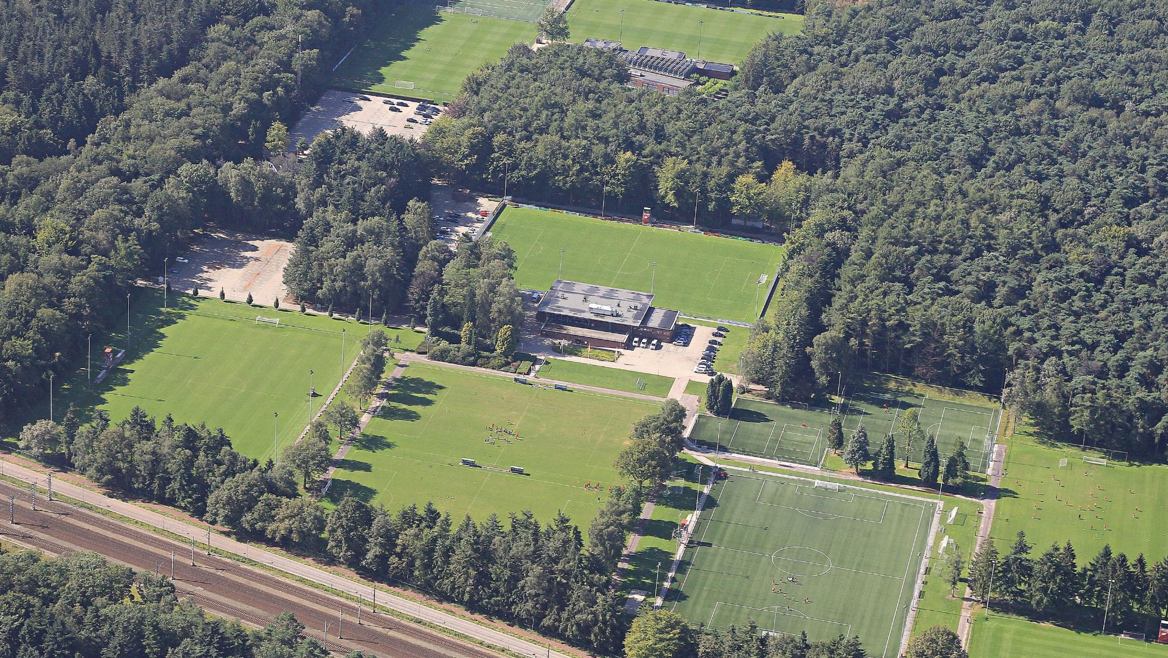
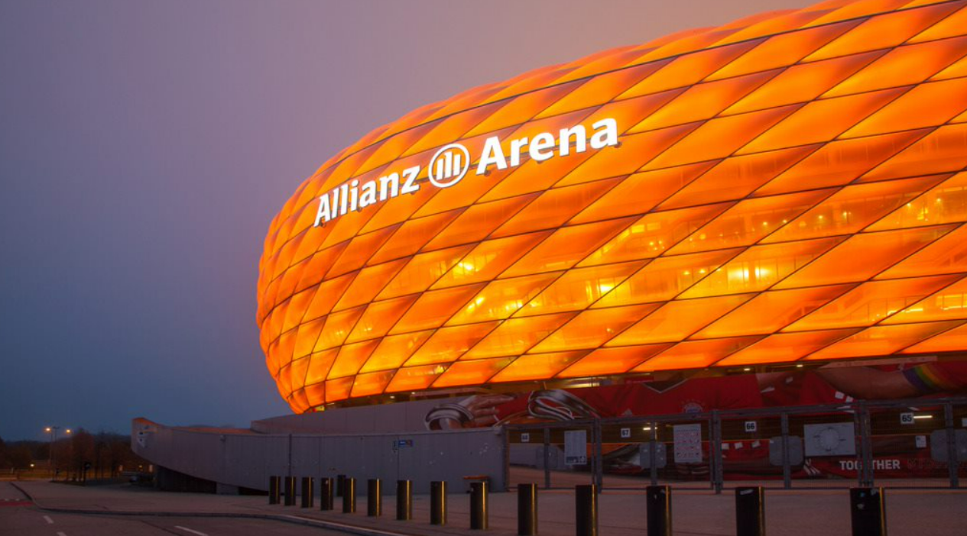
Your once in a lifetime tour
to Bayern Munich

Slide 9
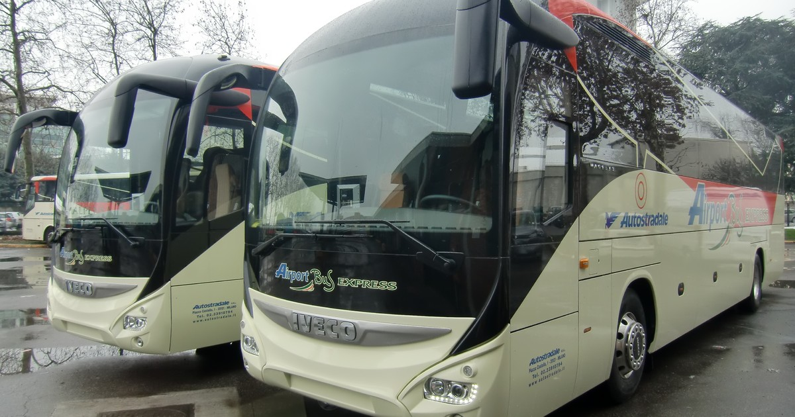
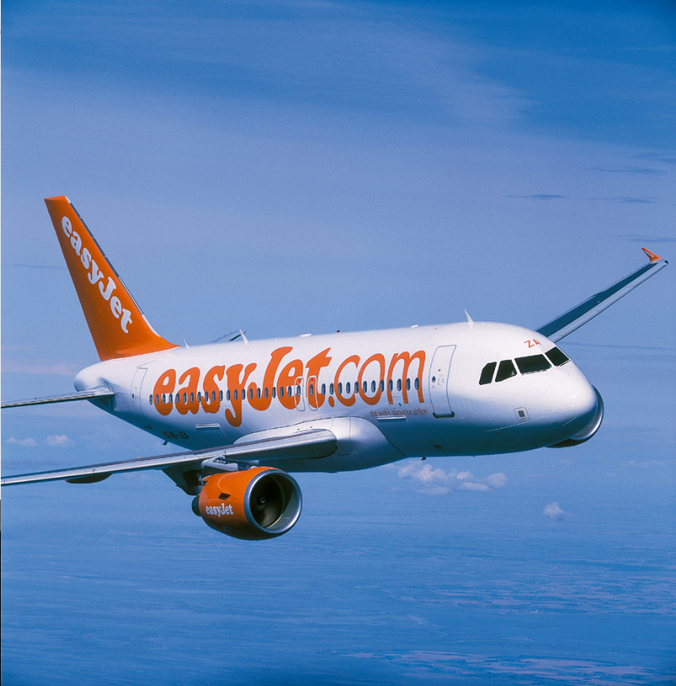
Travel
Return flights to Munich (including all airport, airline and Government taxes)
Flights from London airport
Early out late back
Minimum of 10kg per person hold luggage plus one carry-on bag
All coach transfers as required in Germany

Slide 10
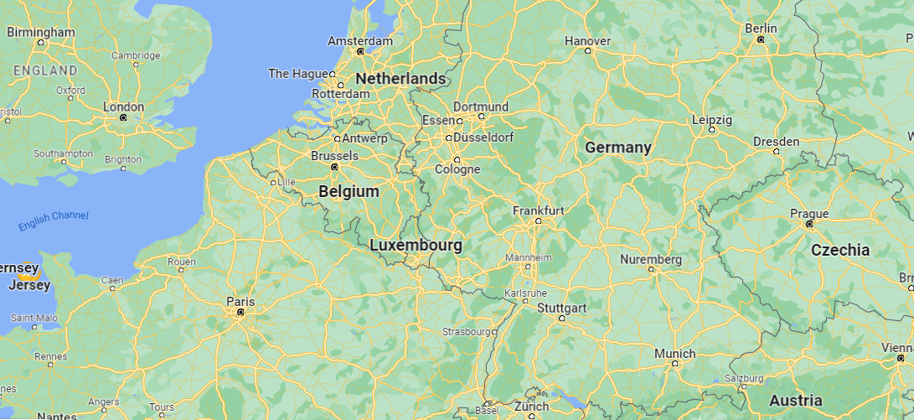
Where is Munich ?

Slide 11
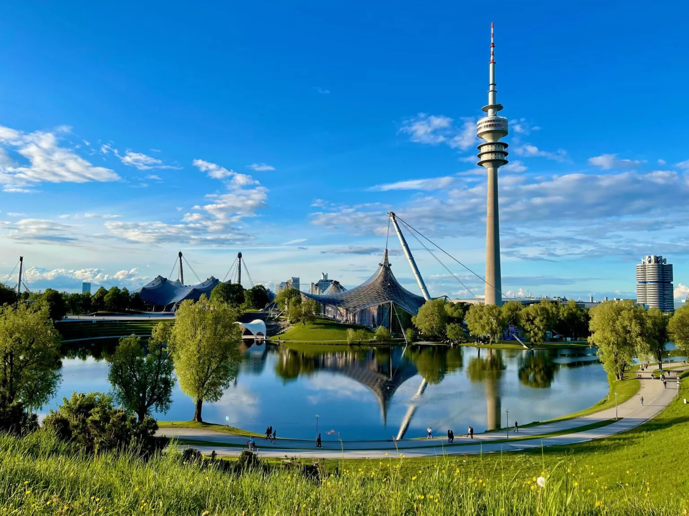
About Munich
Capital of Bavaria
German powerhouse
Cosmopolitan & innovative city
Home to largest beer festival in the world
BMW’s home
Sights – Olympiapark, Marienplatz
1.6 million people
Passion for football

Slide 12
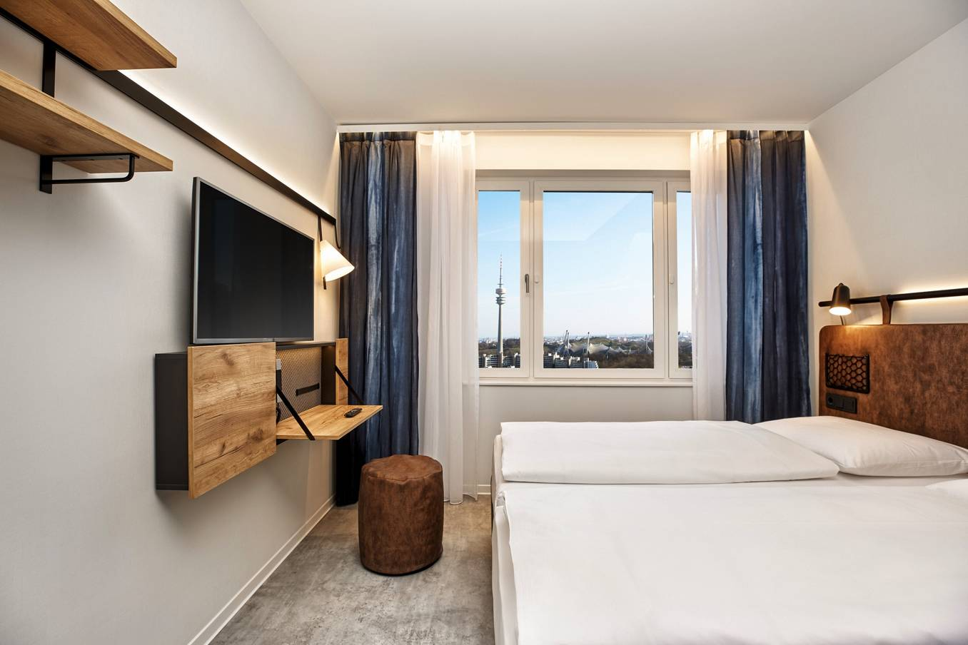
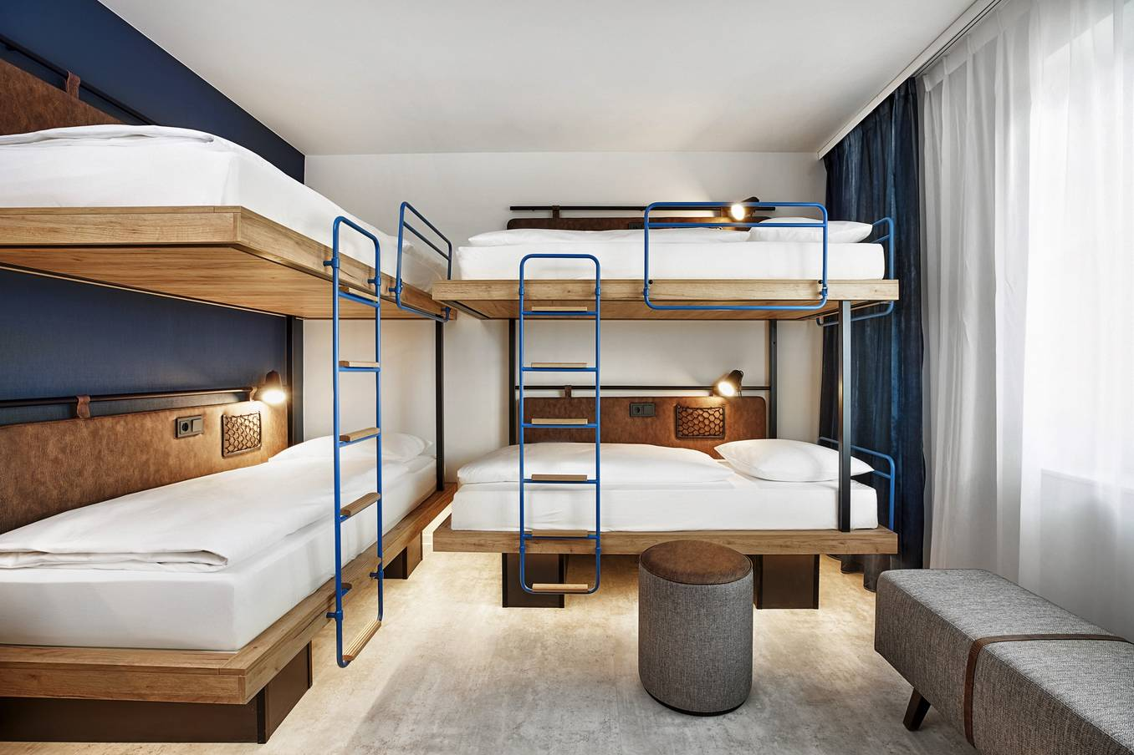
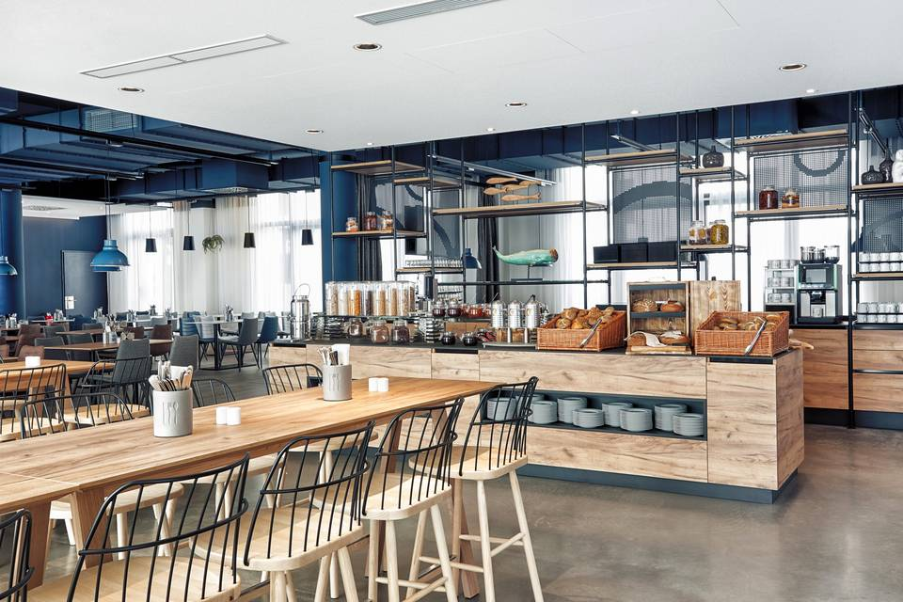
Example Hotel - H2 Hotel Olympiapark (3*)
Multi share rooms for students
All private en-suite rooms
Located near the Olympia Park
Views of the whole city
5 days 4 Nights
Full Board Basis
On-site restaurant

Slide 13
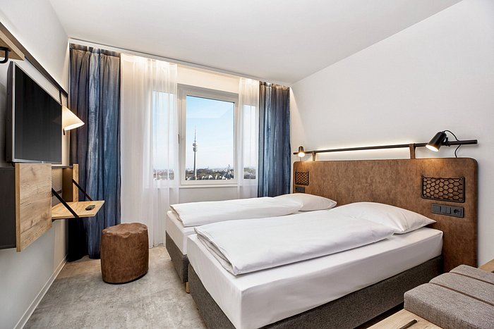
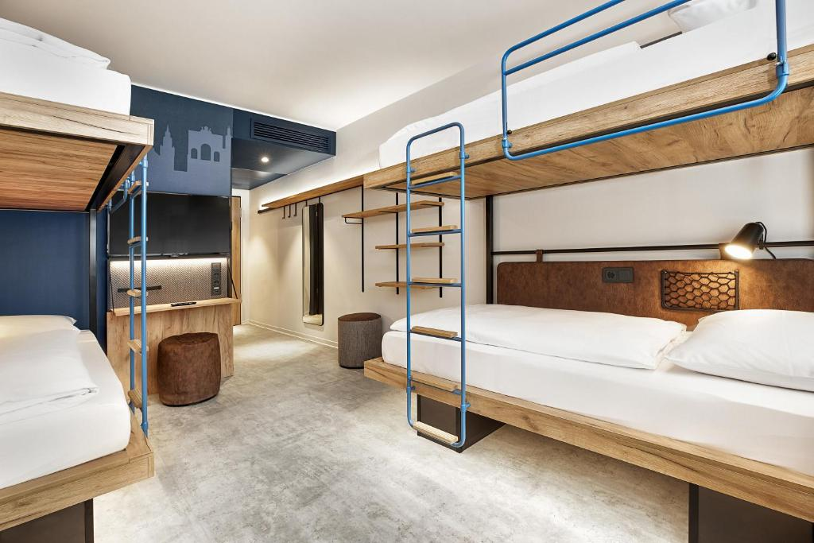
Example Hotel - H2 Hotel Olympiapark (3*)

Slide 14
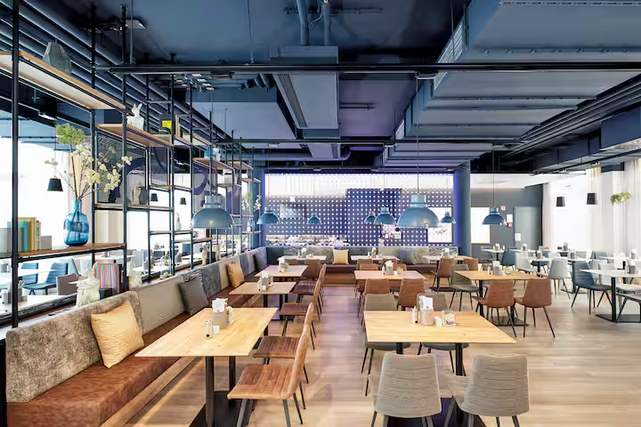
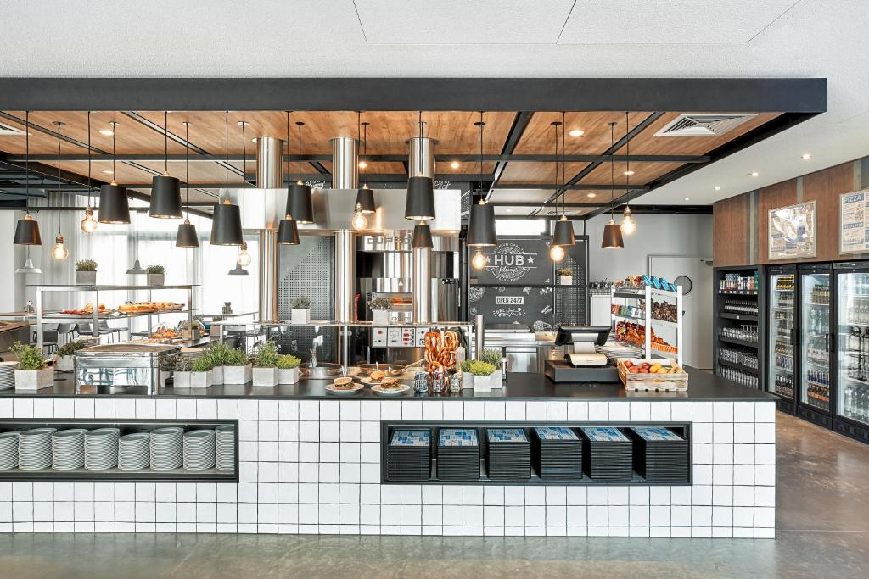
Example Hotel - H2 Hotel Olympiapark (3*)

Slide 15
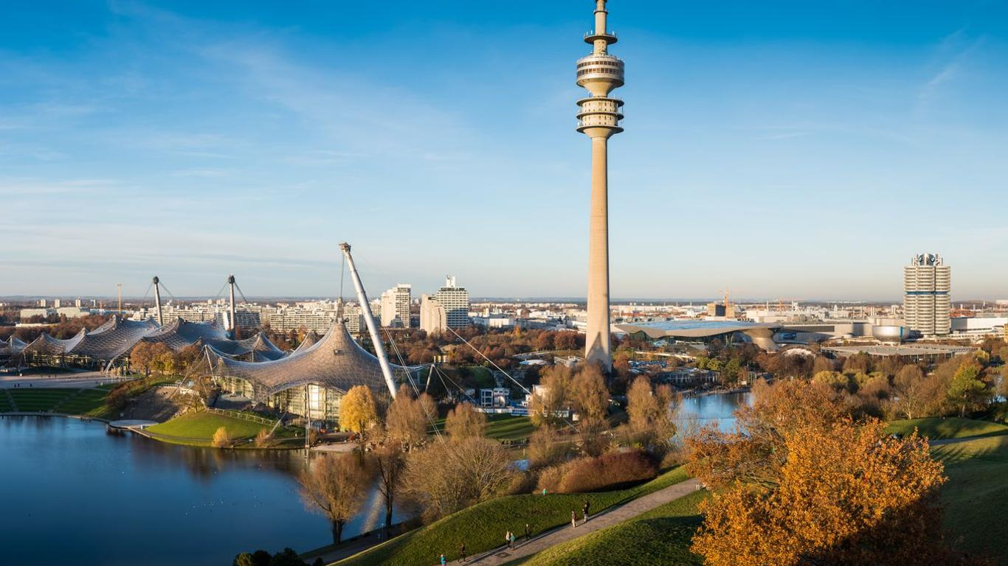
Example Hotel - H2 Hotel Olympiapark (3*)

Slide 16
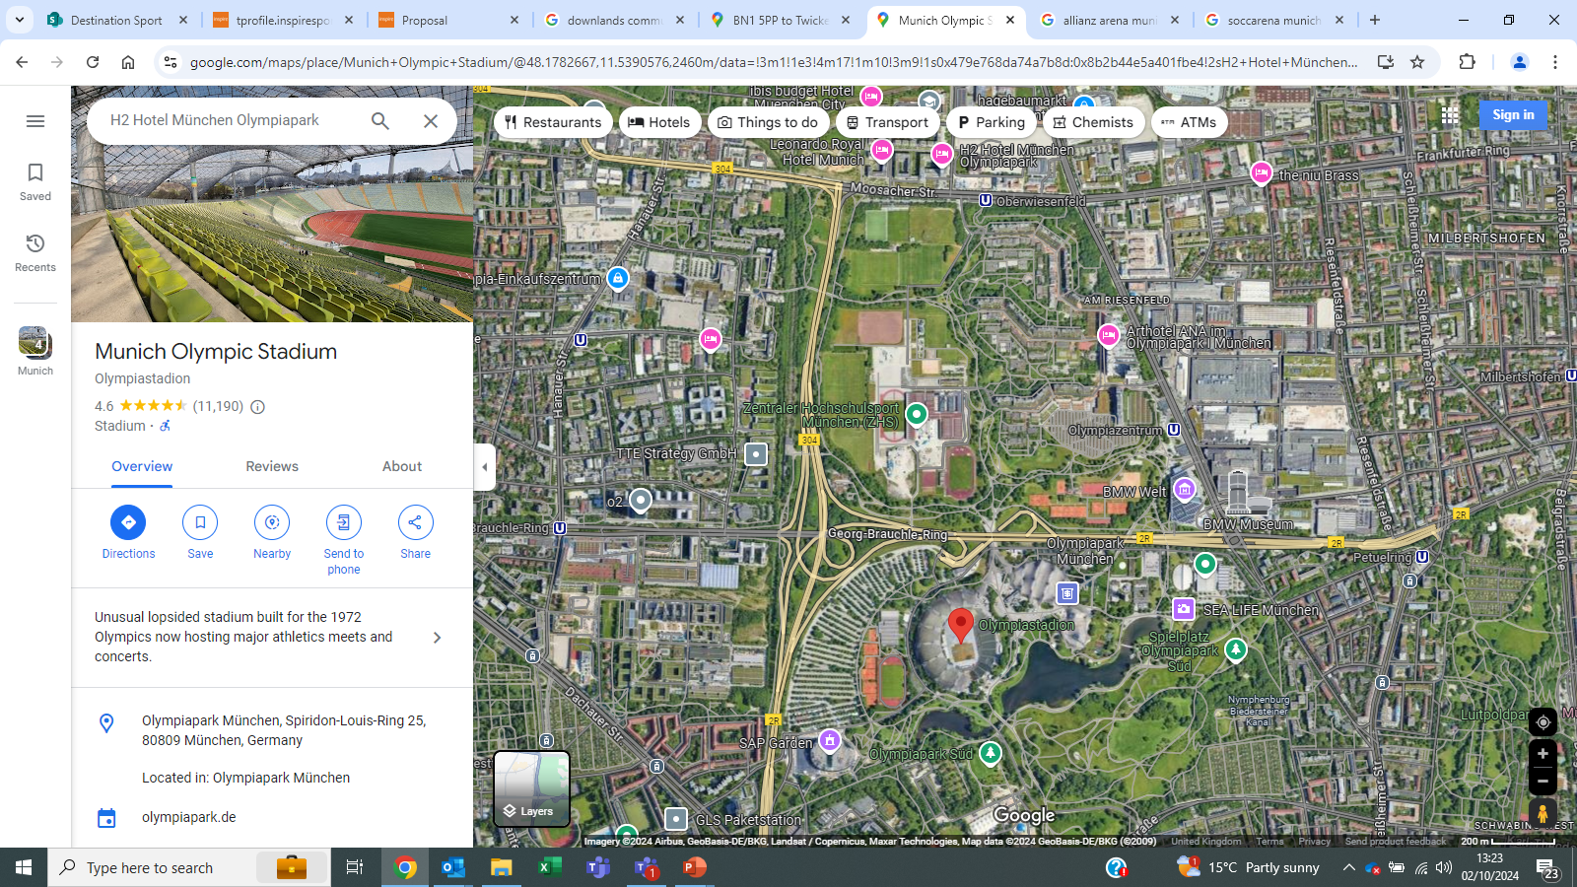
Example Hotel – Olympic Park

Slide 17
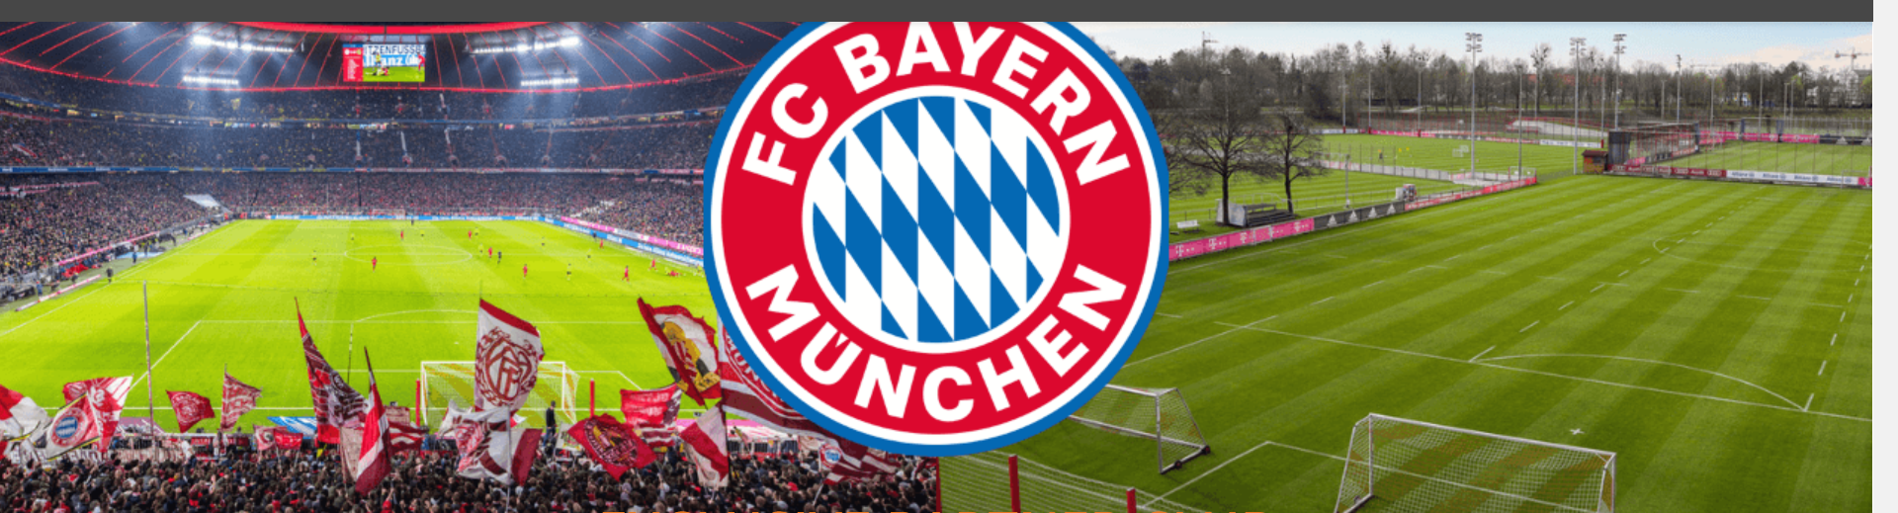


The Club
FC Bayern Munich was founded in 1900
Most successful German Club in History
33 League Wins, 20 Cup Wins and 6 European Cups
FC Bayern Munich (Women) – 5 times Bundesliga champions
Play their home games at Allianz Arena, capacity 75,000 (always sold out)
Current & Former players include Manuel Neuer, Leroy Sane, Serge Gnaby, Sadio Mane, Matthijs de Ligt, rising German starlet Jamal Musiala, Harry Kane and Georgia Stanway!

Slide 18
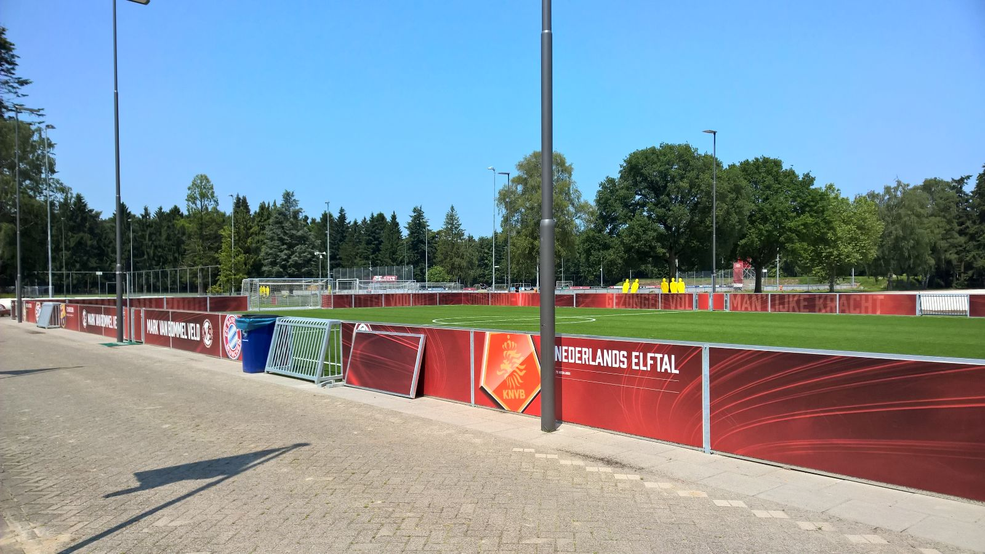
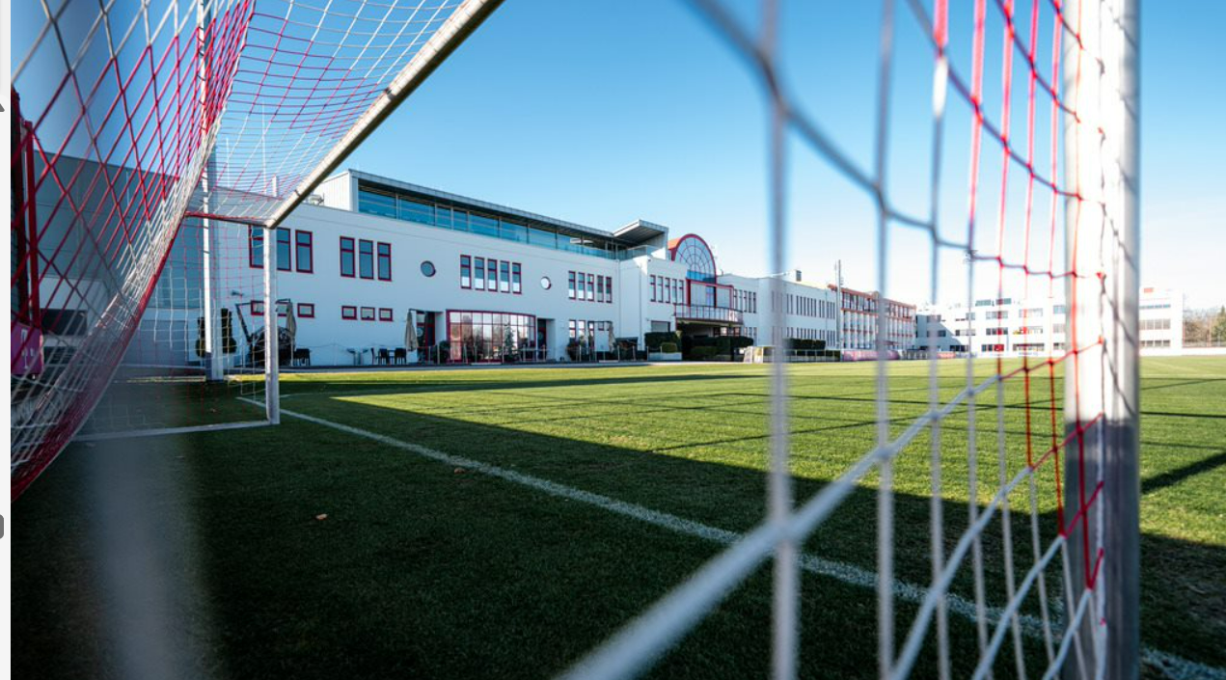
The Training Facilities
Bayern Munich Teams are split over two sites
Säbener Straße
Home of the Bayern 1st Team – located in the South of the City
5 Grass Pitches, a beach volleyball court and a multi use Sports Hall
FCB Campus
Home of the Academy & Women
Opened in 2017 at a cost of €70 Million
Located in the North of the City near the Olympic Park and Allianz Arana
8 Football Pitches including a 2,500 capacity stadium where the U17 & U19 play their fixtures
Accommodation for youth players who live outside Munich

Slide 19
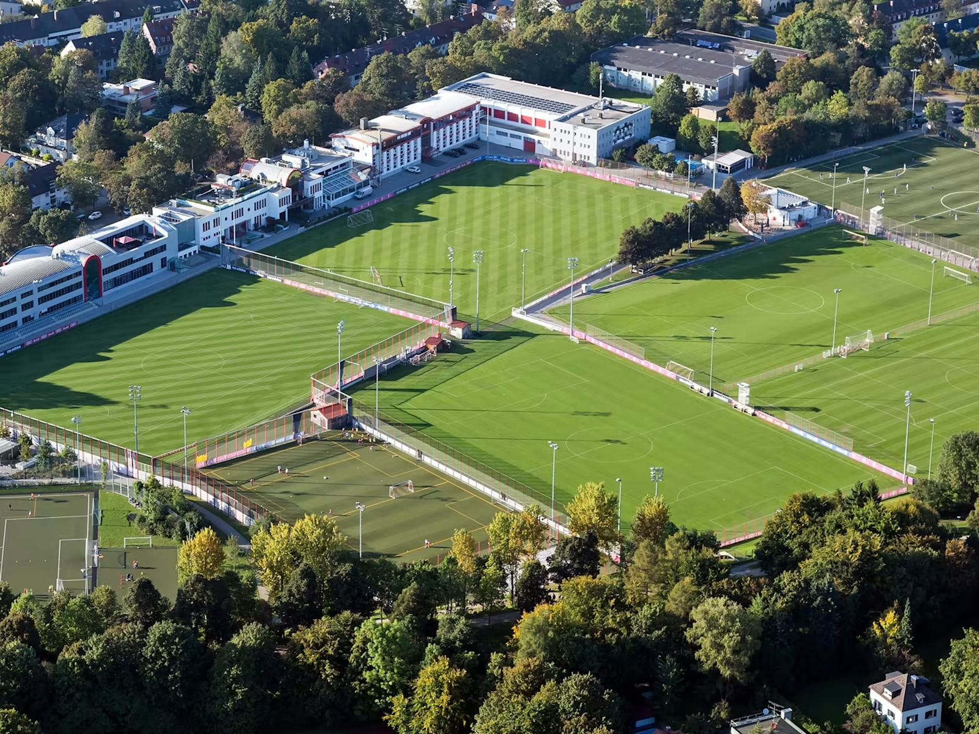
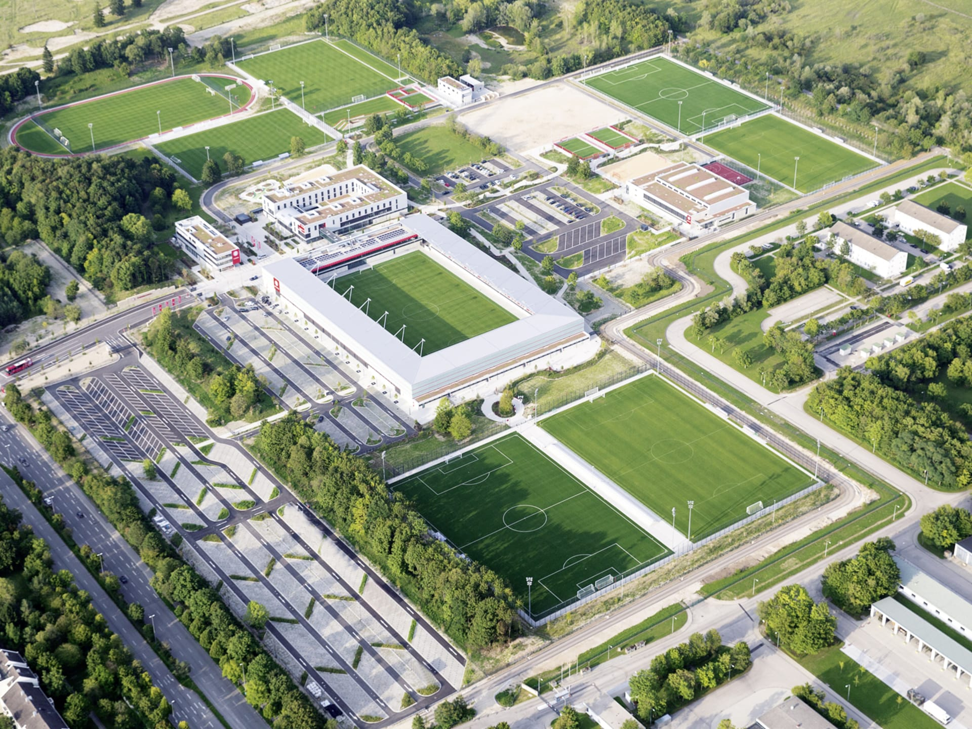
The Training Facilities
Training Facilities – Säbener Straße

Slide 20
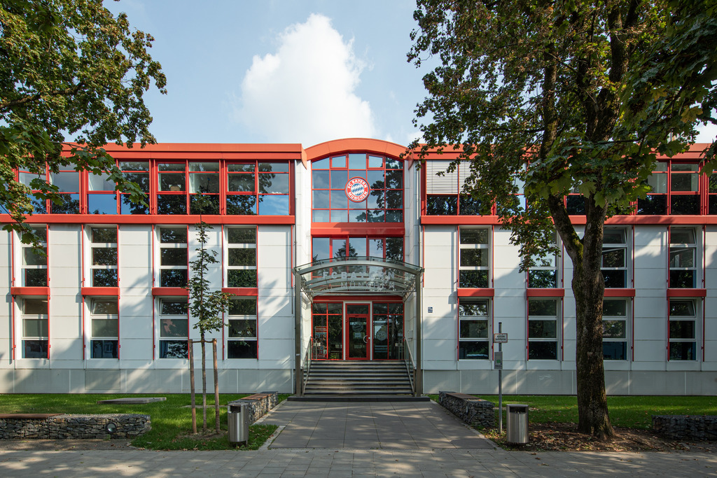
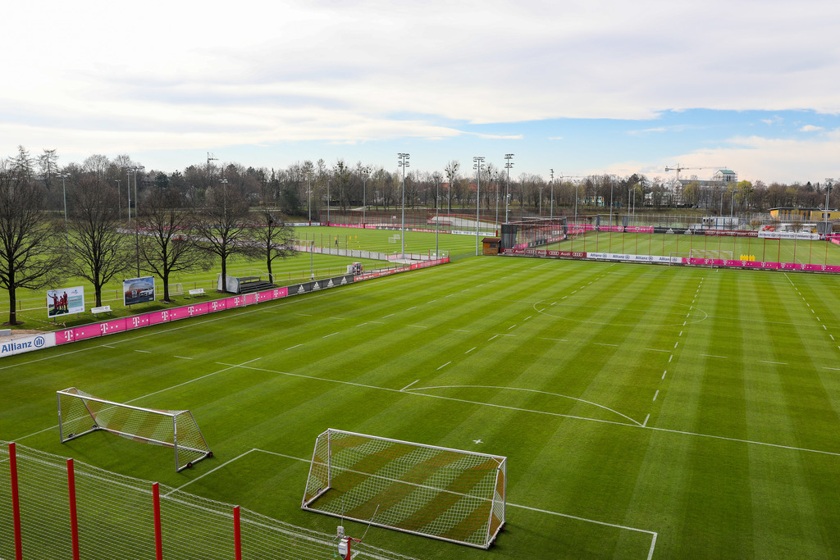
The Training Facilities
Training Facilities – Säbener Straße

Slide 21
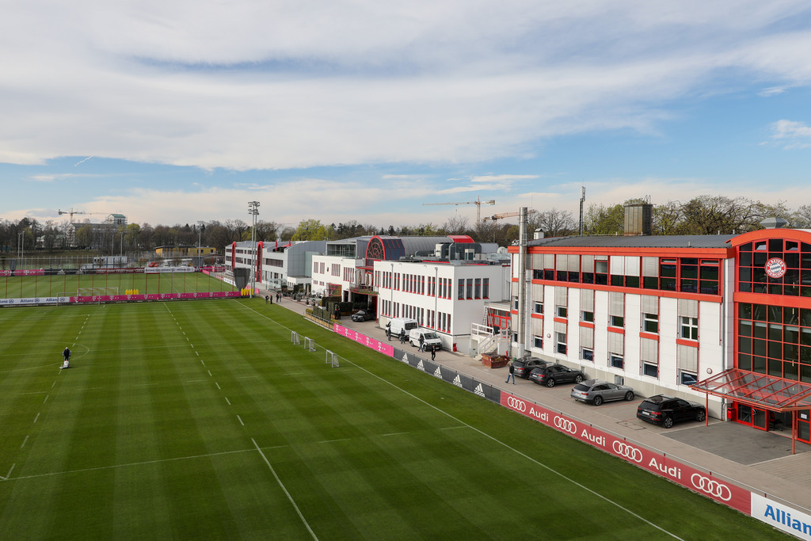
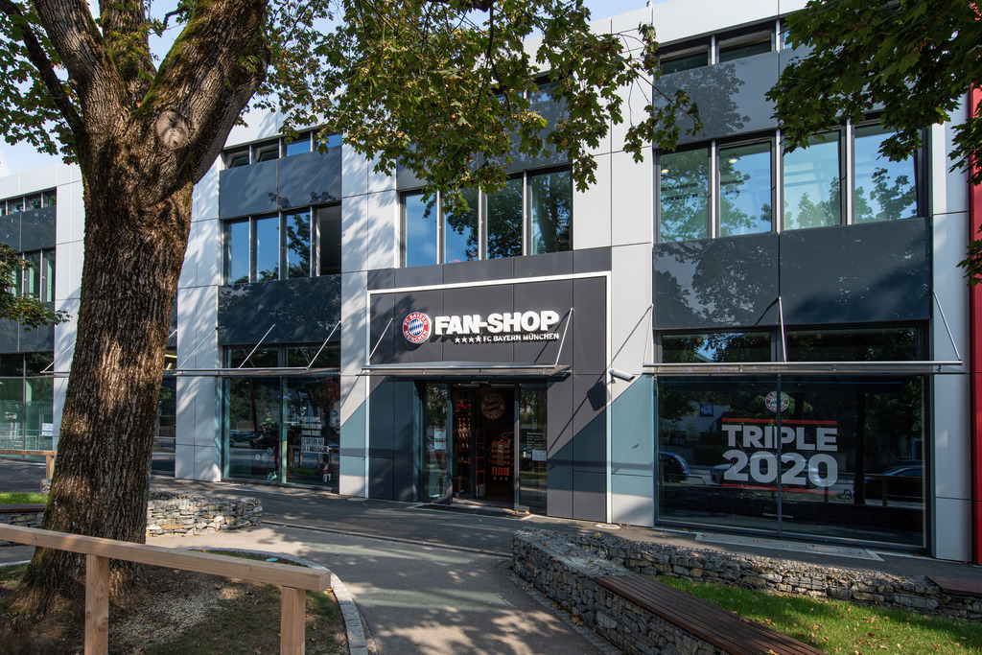
The Training Facilities
Training Facilities – Säbener Straße

Slide 22
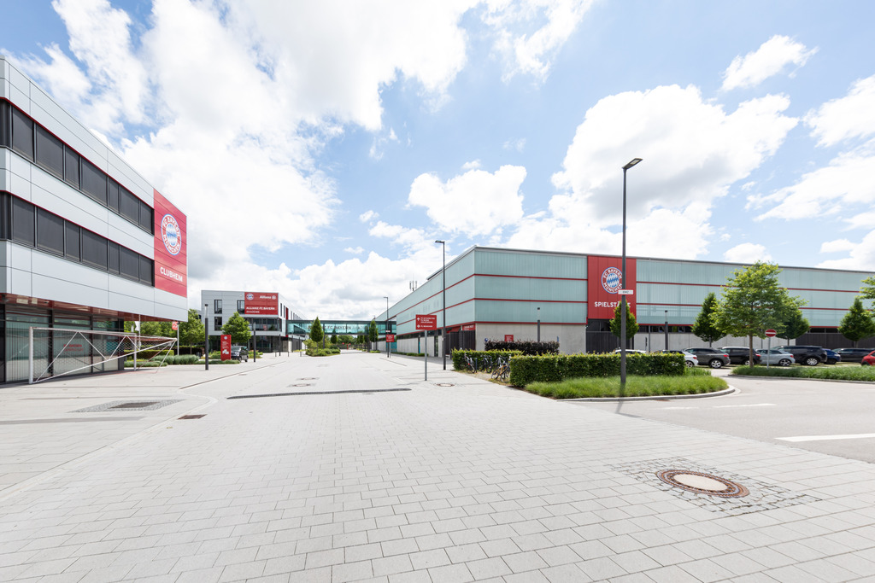
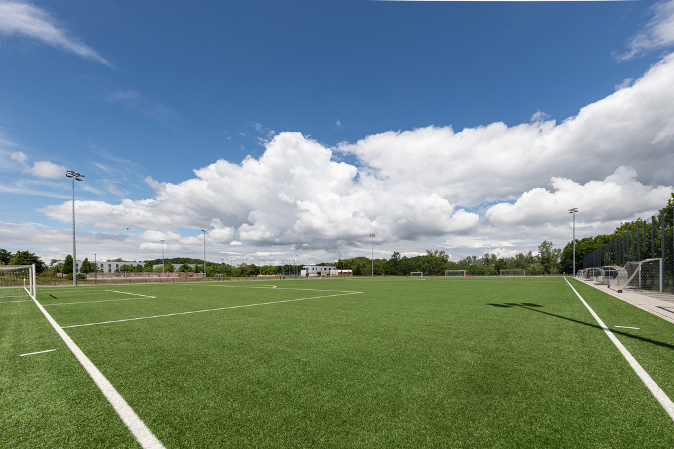
The Training Facilities
Training Facilities – FCB Campus (Academy & Women)

Slide 23
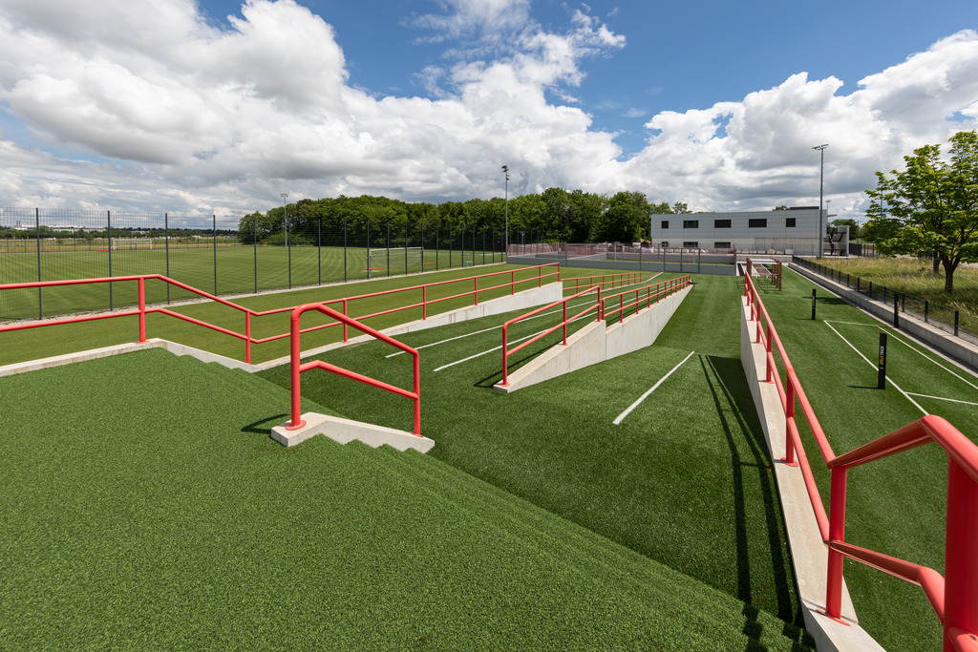
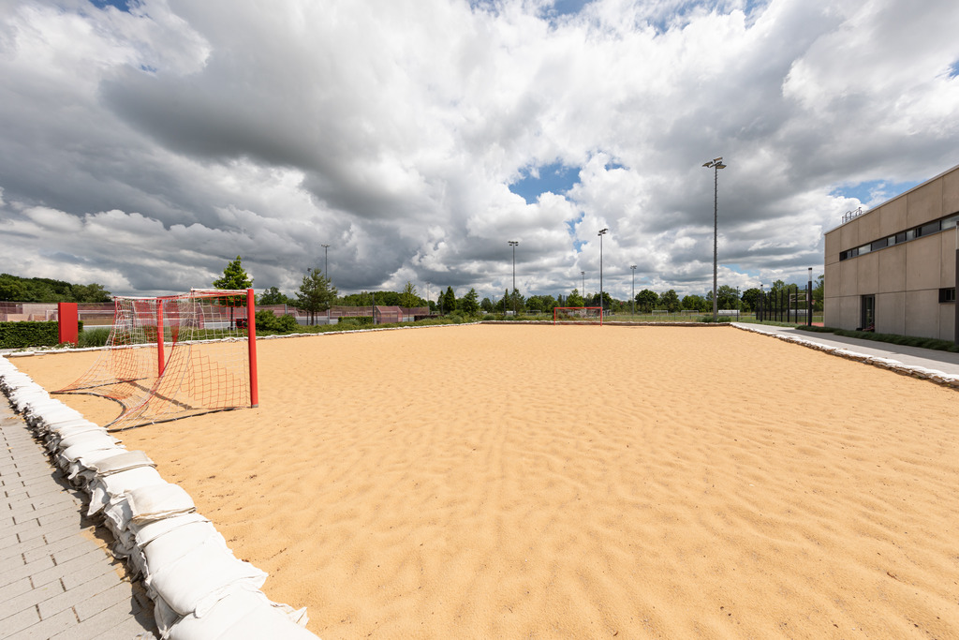
The Training Facilities
Training Facilities – FCB Campus (Academy & Women)

Slide 24
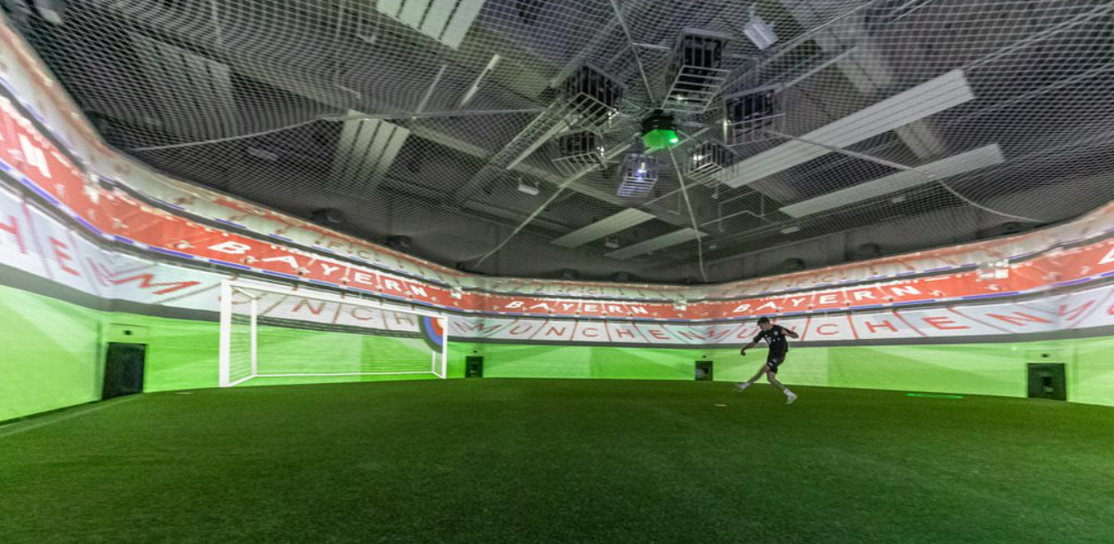
The Training Facilities

Slide 25

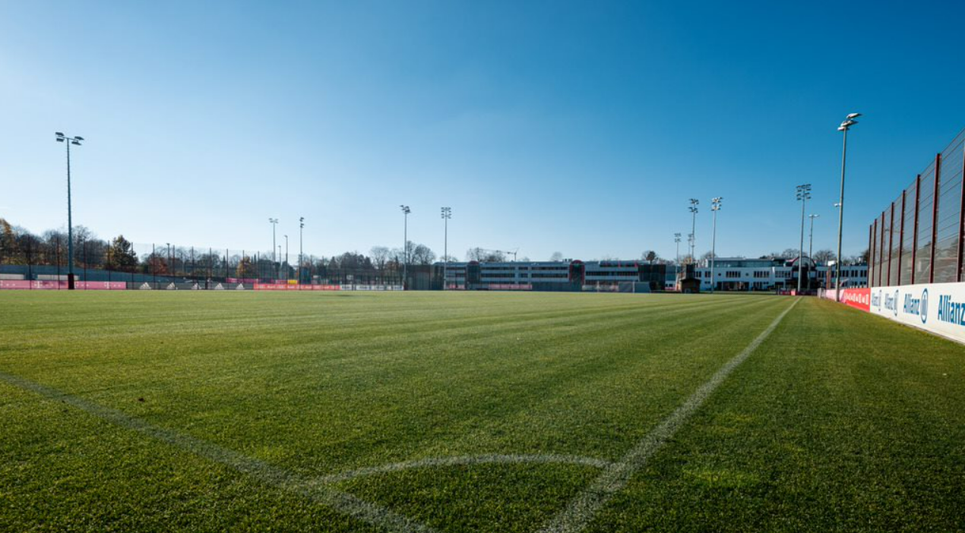
Professional Coaching
4 x Coaching Sessions
Devised & Delivered by Bayern Munich Staff
Specialised coaching (subject to request)
Sessions at Säbener Straße or FC Bayern Campus
FC Bayern Training Kit for each participant

Slide 26
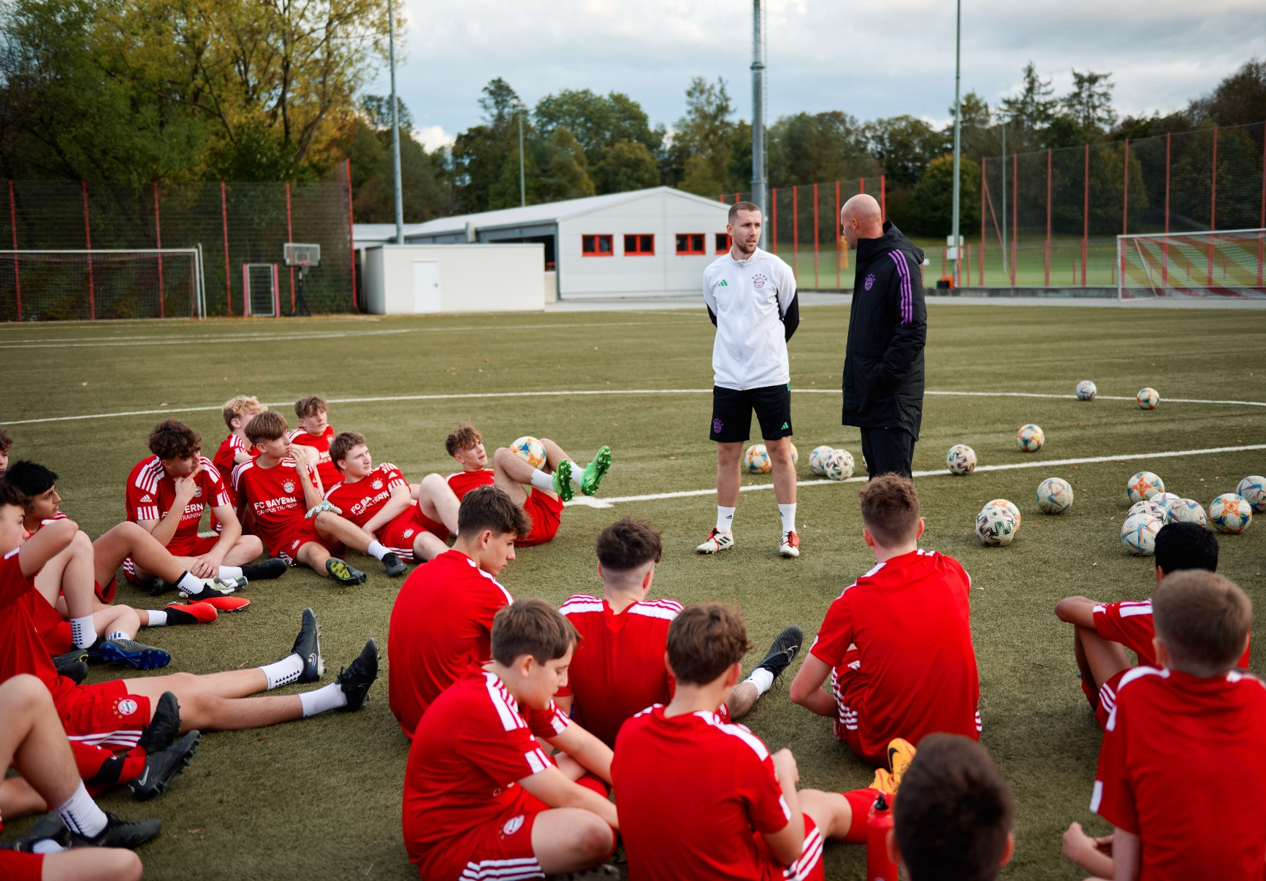
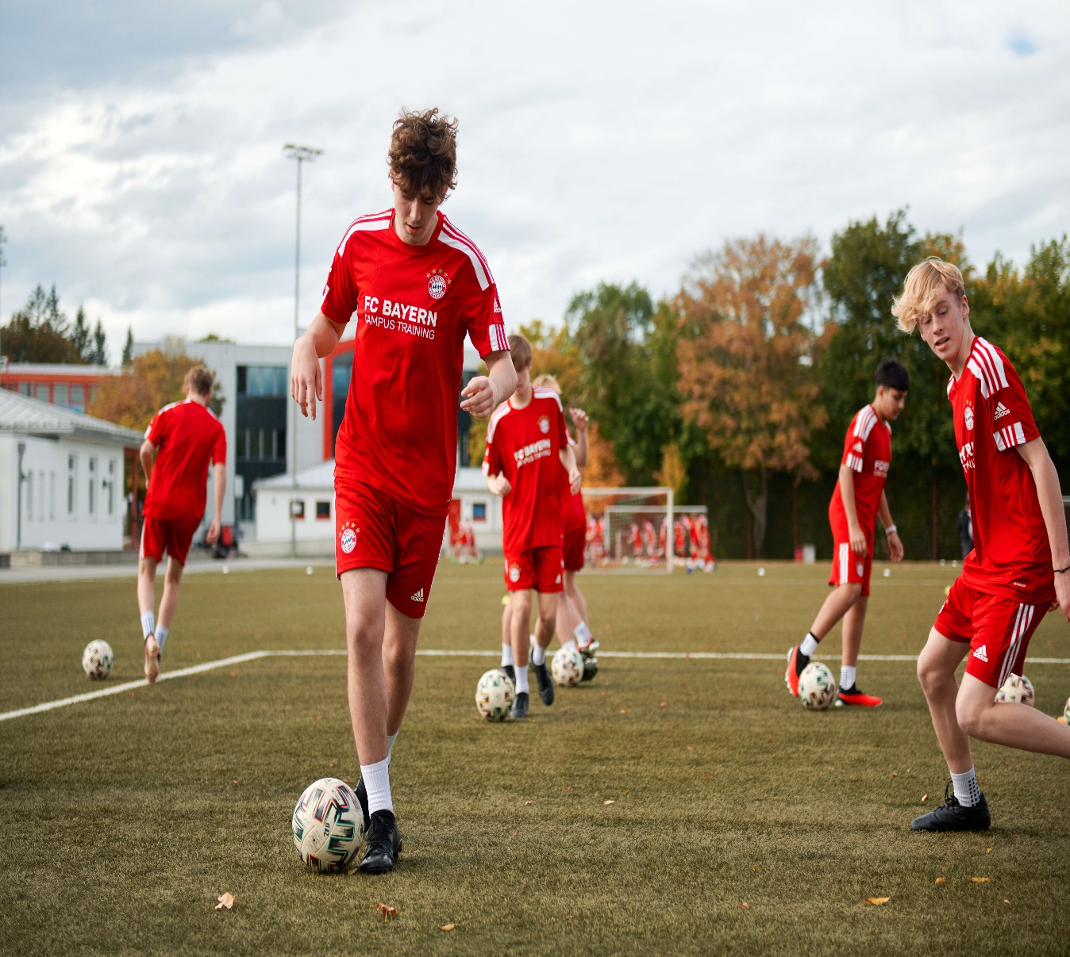
Professional Coaching

Slide 27
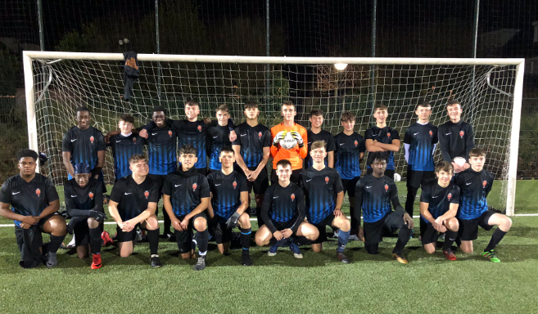
Fixtures
Fixtures Per Team Against Local German Opposition

Slide 28
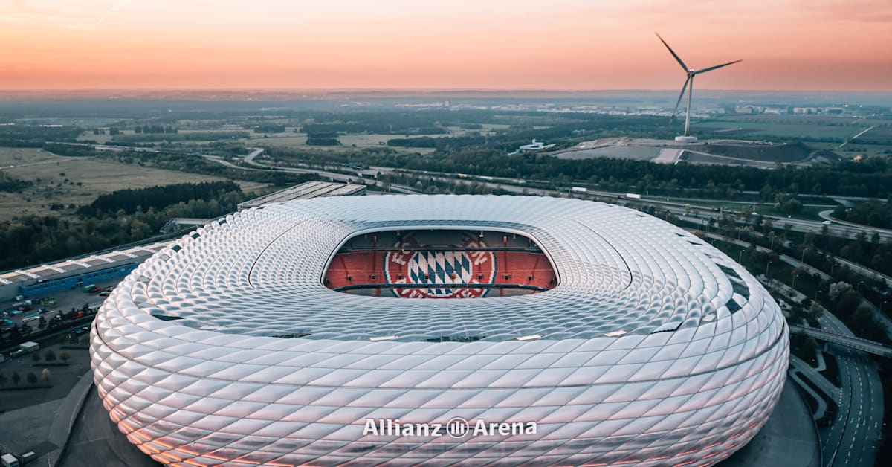
Sightseeing – Stadium Tour

Slide 29
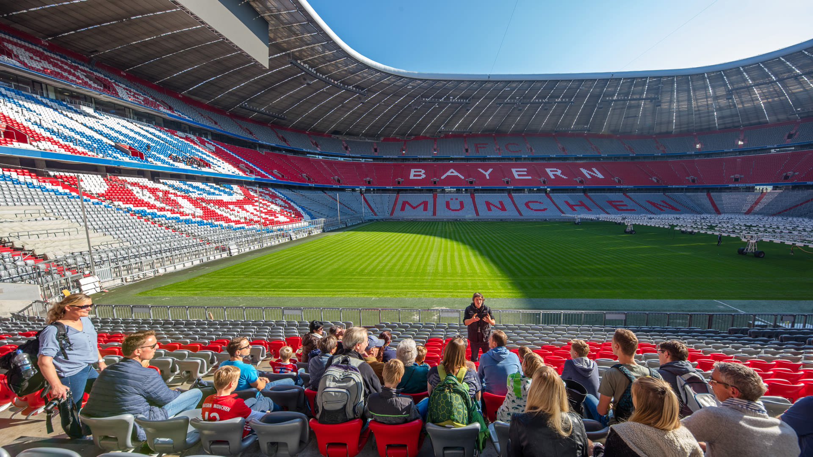
Sightseeing – Stadium Tour

Slide 30
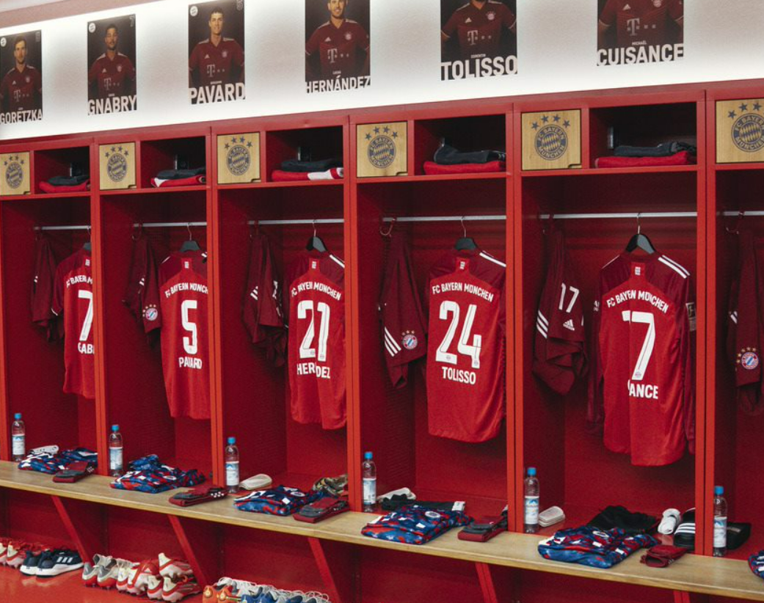
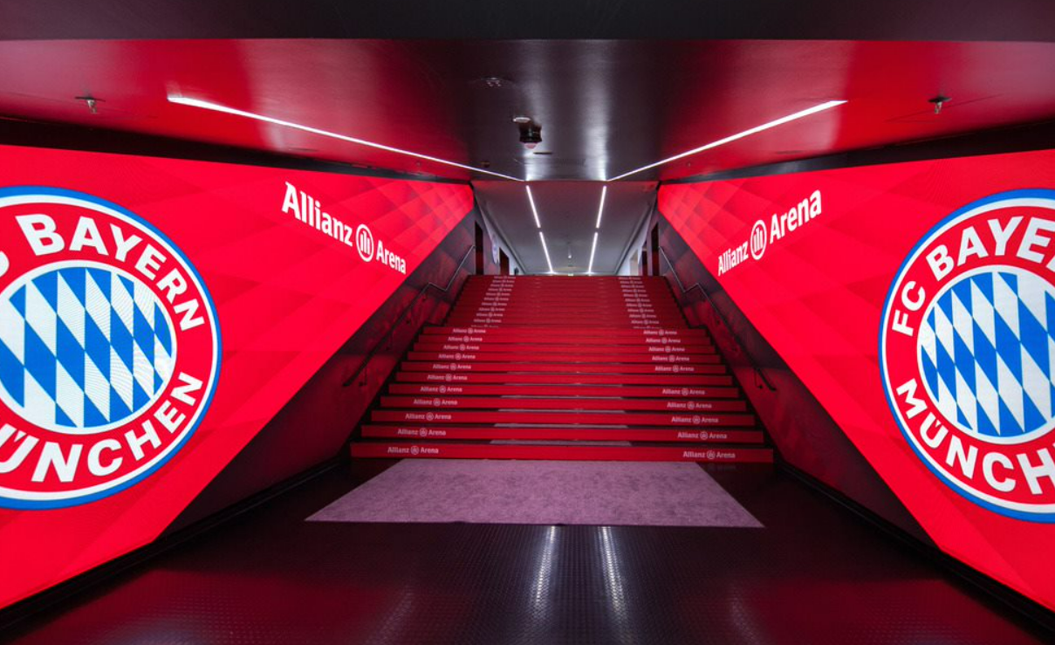
Sightseeing – Stadium Tour

Slide 31
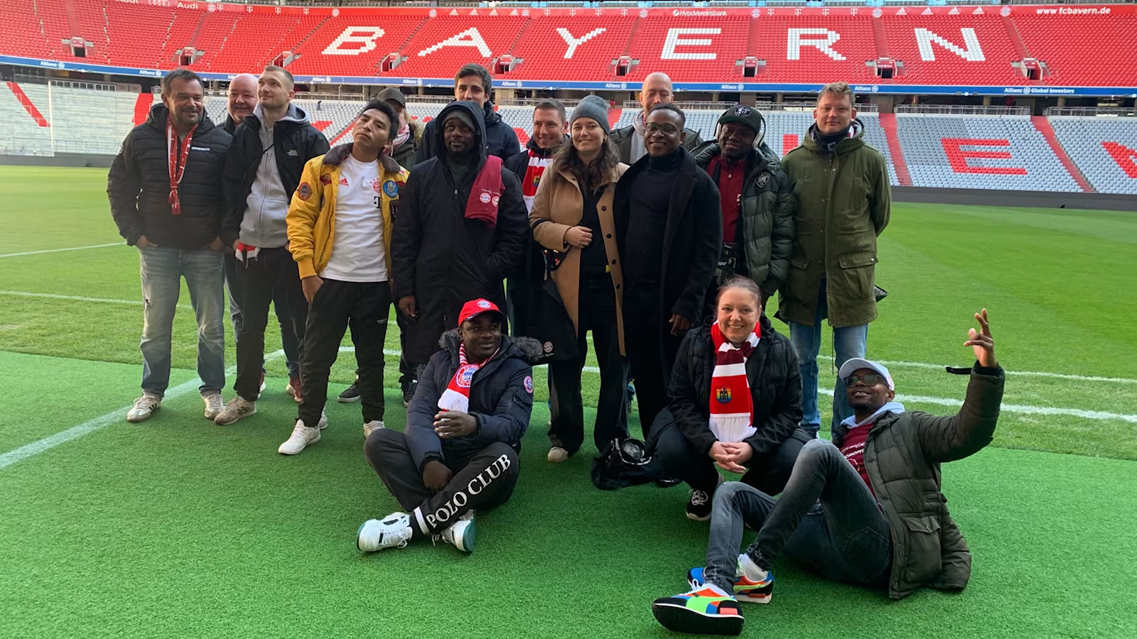
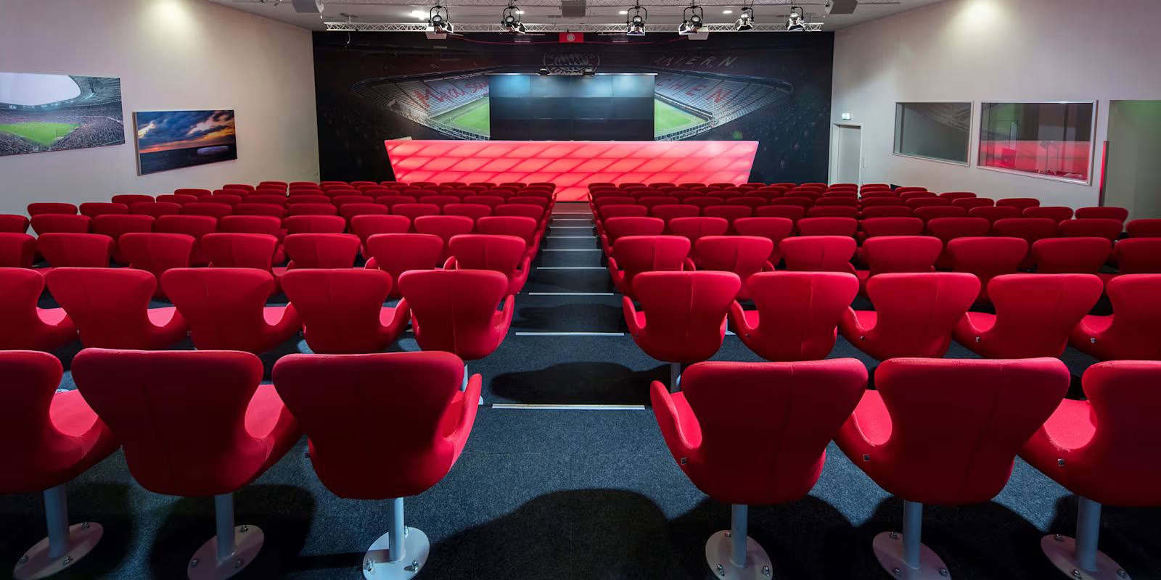
Sightseeing – Stadium Tour

Slide 32
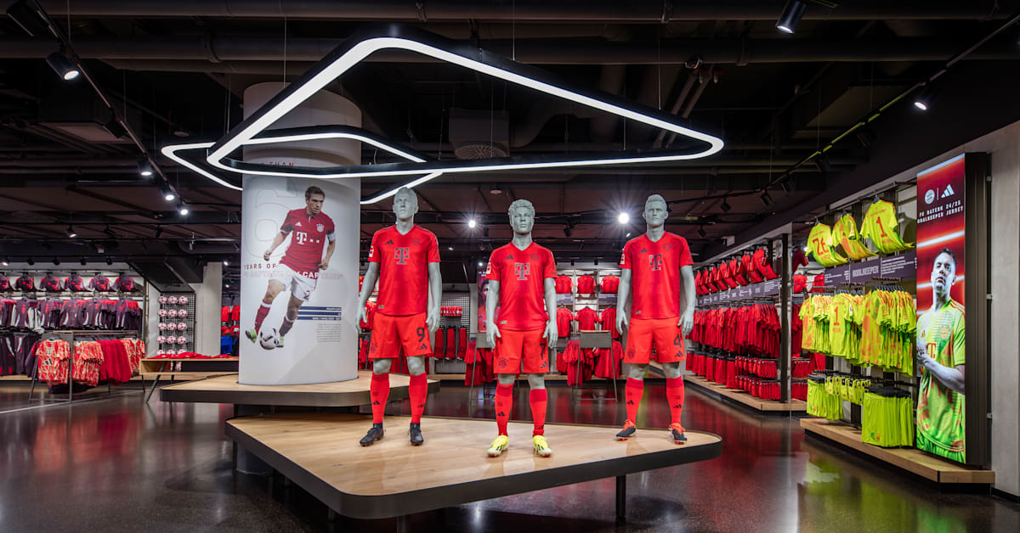
Sightseeing – Stadium Tour club shop

Slide 33
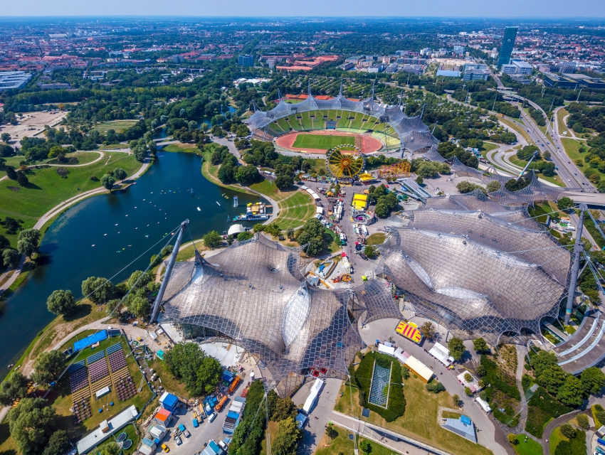
Excurions – Olympic Park

Slide 34


Included Excursions – Olympic Park / BMW Museum

Slide 35

Excurions – Munich City Sightseeing

Slide 36


Included Excursions – Soccarena

Slide 37

Attend a live FC Bayern Munich match (tbc)

Slide 38


Slide 39

What's included?

Slide 40

What’s included?
Return flights from London to Munich
All taxes and baggage allowance included
All overseas transport in private coach for all listed activities and excursions
5 days 4 nights hotel accommodation in minimum 3* hotel (rooms share for students)
Full board Meal basis (first meal is dinner on day 1; final meal is lunch on Day 5)
4 x 90minute/2hr high quality training sessions on all aspects of play from the FC Bayern Munich full-time coaching staff
Use of the FC Bayern Munich 1st team & academy training facility for all training sessions

Slide 41

What’s Included?
FC Bayern Training Kit for each student
Pre-arranged fixtures per squad against local opposition
Behind the scenes tour of the Allianz Stadium, including visit to official club shop
Sightseeing in Munich
Tour of Olympic Park / BMW Museum
Use of pitches for own sessions / mini tournament (5-a-side)
Services of an inspiresport representative throughout the tour
Fully comprehensive sports tour travel Insurance

Slide 42



Optional Extras
UK airport transfers (TBC)
Lunch on day of arrival (if applicable)
Tickets and transport to a professional fixture
Additional meals and drinks
Additional activities / excursions
Personal Expenditure
Presents for Mum & Dad?! – not optional

Slide 43




Why travel with inspiresport?
Quality of facilities and training
Quality of accommodation
Experienced and knowledgeable staff
Consistent customer relations
Attention to health & safety issues

Slide 44

Why Tour?
Opportunity
Representing
Personal Development
Improve Game
Experience

Slide 45



Next Step?
Deposit Due: £250 per person
(Final balance due 12 weeks before departure)
Deadline: TBC (2 weeks)
***Names and Dates of Birth As Per Passport***

Slide 46

Any Questions?
Inspiresport
4th Floor, Churchgate House, 56 Oxford Street, Manchester, M1 6EU
02920 390747
info@inspiresport.com
@WDInspiresport
www.inspiresport.com

