Slide 1
Year 11 2024-25
Downlands Revision and Exam booklet
How and what to revise
Track your revision

Slide 2
Revision….Where do I Start??
You already have already started this….!
Over the last few years everything has been building up to this with your GCSE coursework, assessments and mocks. You will have already been revising even if you haven’t realised it. Use this handbook to help you to plan your time to revise effectively.
To make a START use the DTTR approach…..
Diagnostic- identify the gaps in your learning
Therapy- fill in those gaps (using flashcards/ past papers)
Testing- checking your understanding eg using quizzes
Revisit- Go back over any gaps still in your learning

Slide 3
Contents
Contents
Revision​ Power Tools
Planning Your Revision
Spacing and Interleaving
How to plan a revision timetable
Revision Timetable
Revision Timetable
Revision Checklist
Revision Process
Tracker sheet
A plan for retrieval practice
Using Flashcards Do’s and Don’ts
Leitner System,Flashcards
Alternatives to flashcards
GCSE POD information and test
Create your own improvement plan
Template of an improvement plan
Wellbeing, managing stress,busy schedule blog
GCSE POD mindfulness and positive mind
​

Slide 4
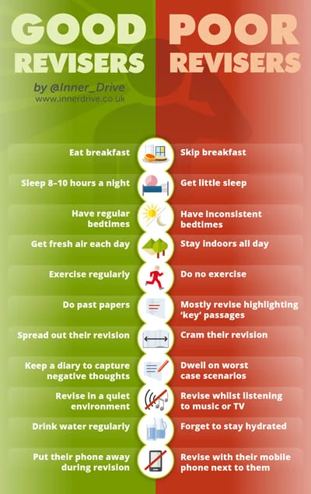
Read the following list. Be honest, Self Awareness, make a note of what you do or don’t do.
Challenge yourself
Pick a couple of items of the Good Revisers list and implement them into your routine.

Slide 5
Revision​ Power Tools
Have a revision plan, one that spaces out topics and subjects and allows you to revisit them​
This avoids leaving revision to the last minute, known as cramming. Cramming is not an effective way to study for long-term memory. A study found that those who spaced out their revision scored higher on their exams (74%) than students who crammed their revision (49%).​
Don't use ineffective strategies​
Students who study independently tend to opt for learning strategies that require less effort. The path of least resistance leads them to settle for ineffective revision strategies. Such as re-reading notes, excessive highlighting or copying out notes
Recent research reported that 55% of students use re-reading their notes as their number one revision technique, despite countless studies proving that it does not help learning.​
Set regular deadlines
Frequent but small deadlines have been found to help students manage their time and energy over the course of the academic year, as well as improve overall grades. Set yourself deadlines and reward yourself when you meet them.​
Use evidence based strategies to help your learning​
Retrieval Practice is very effective for long-term learning. This means any activity that requires you to recall facts from memory (without notes) this could be testing yourself with flashcards, quizzing or past paper questions​
Use the key strategies that have the greatest impact on enhancing learning: Retrieval Practice, Spacing (planning your revision), and Elaborative Interrogation.(past paper questions) Use this guide to effective study skills​
Use the Revision Process on the Yr11 TEAMS Site
Don't Listen to music when studying​
Students may think that listening to their favourite songs helps them study.​
However, research has found that students who revise in quiet environments performed up to 60% better in an exam than their peers who revised listening to music that had lyrics.​
​

Slide 6
GCSE Revision Suggestion and Guide
What Difference can I make?
In the Easter Holiday you have 17 days holiday
2 hours revision per day = 34 hours revision (almost 7 school days)
3 hours revision per day = 51 hours revision (over 10 school days)
You make a big difference to your exam results and your overall revision by doing this.
In the 3 weeks back at school: 3 full weeks
1 hour of revision per day = 21 hours of revision
2 hours of revision per day = 42 hours of revision
Lesson time in a normal school day = 5 hours
If you do the lesser options you will do 55 hours of revision by the time you sit your exams
If you do the longer options you will do 93 hours revision by the time you sit your exams
How can I do it
Think about your days off and structure your revision around them.
Do 1 hour at a time- this is the maximum time your brain can focus on one subject, and hold information.
Aim to have finished your revision by early evening, as the later it gets, the less effective your memory is.
Make this hour count- remove distractions such as phones etc, make sure you have eaten and drunk, set a timer to go off when the hour is up.
Most importantly, be absolutely clear on what you are going to do in the hour- having no plan ends in flaky revision that doesn’t have a focus.

Slide 7
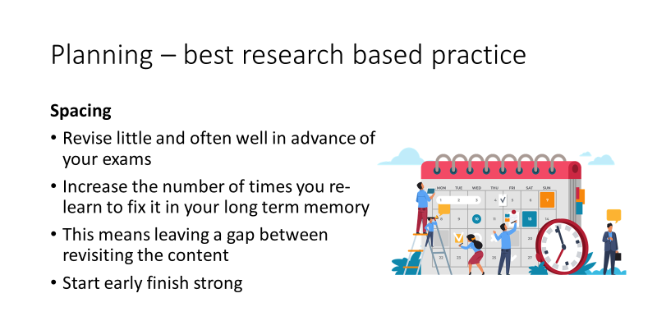
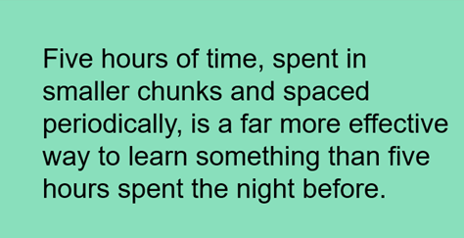
Planning Your Revision
Spacing and Interleaving

Slide 8
Revision timetable
Look at your subjects and identify where your strengths and weaknesses are, use a RAG sheet
Categorise subjects Easy, Medium, Hard
Create a timetable with 30-45 minute sessions, with a start and finish time (maybe use a timer to remind you), start with a hard subject, followed by a medium subject and end on an easy subject. Make sure to give yourself a break in between subjects
Be clear in what topic you are going to revise
Evenly spread out revision between subjects
Schedule review session on what you have already revised
Tick off or keep a tracker of what you do revise to help maintain motivation and see your hard work pay off
Be kind to yourself and make a reward system and treat yourself at the end of a revision session
Hard | Medium | Easy
Biology Chemistry Maths | Physics Geography | History RS English
Time | Monday
4-4.45 | Science Biology Cells and osmosis
4.45-5.00 | Break
5.00-5.45 | Maths Solving Equations
5.45-6.00 | Break
6.00-6.45 | English 3 Quotes on Mr B AIC
6.45-7.00 | REVIEW
TIPS
Don’t be over ambitious – break work down into small chunks. Assess how familiar you are with each topic and focus on your weak areas. Use different colours for different topics. Remember to keep reviewing what you have revised and testing yourself at the end of the day, the next day and the end of the week - this will help you to recall the information in the exam.

Slide 9
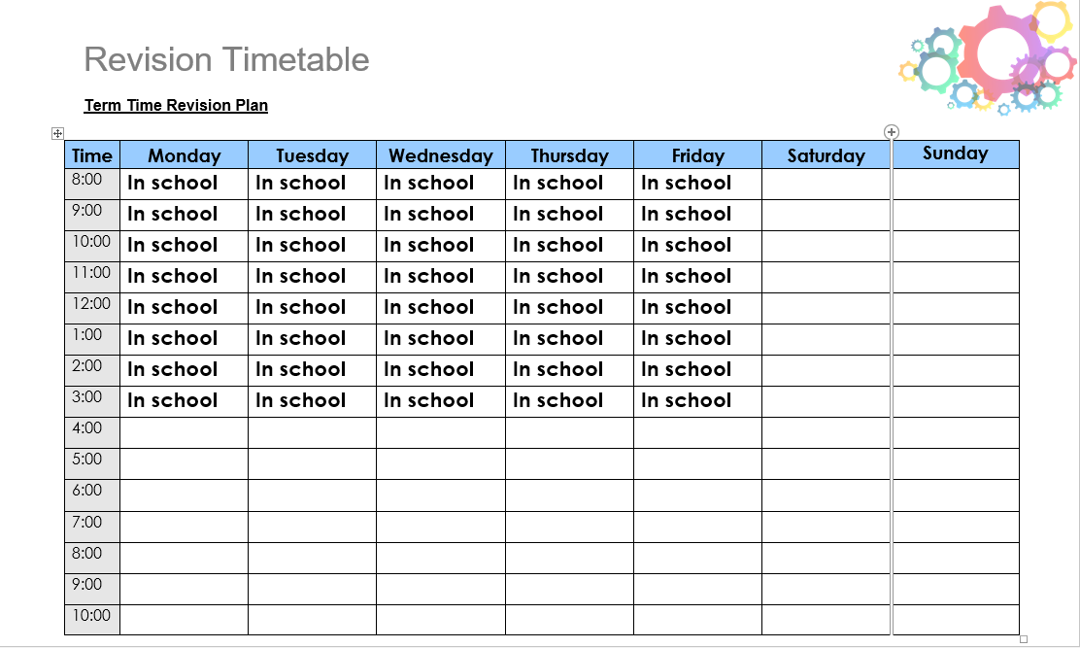

Slide 10
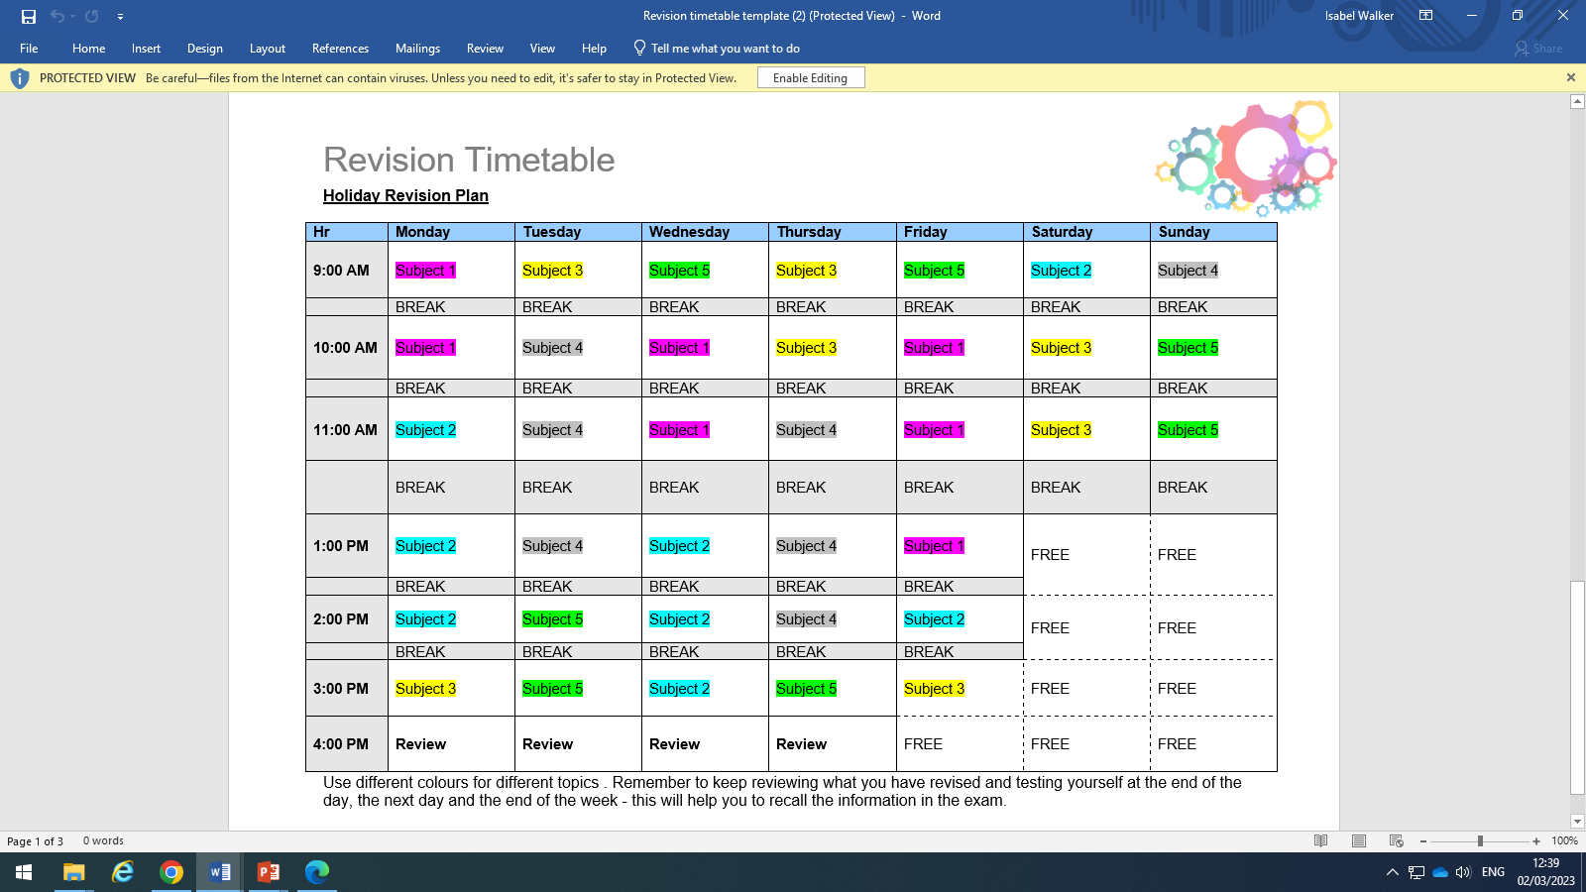

Slide 11
Revision Checklist-
Use the column on the right to tick/tally each time you spend 30 minutes revising. This way you can start to see progress in your revision. When you have done 2 sessions (1 hour) for a subject give yourself a treat 😊!
Remember to take a break of approx. 10 minutes after each session.
Subject
English Language
English Literature
Maths
Biology
Chemistry
Physics

Slide 12
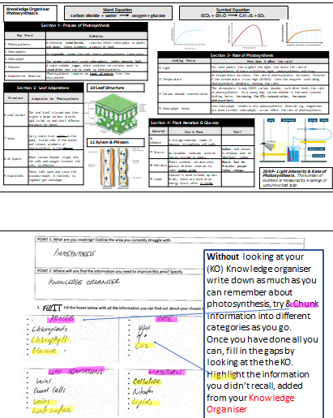
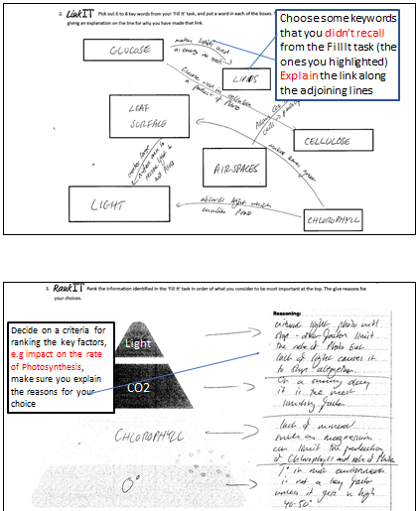
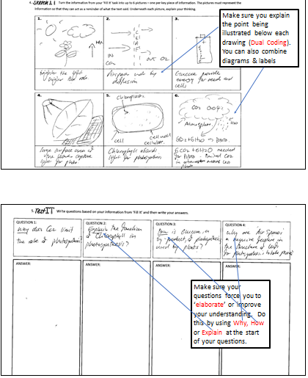
The Revision Process
The revision process will help you to identify gaps in your knowledge
*****You will be sent by email separately the templates of the revision process to use! *****

Slide 13
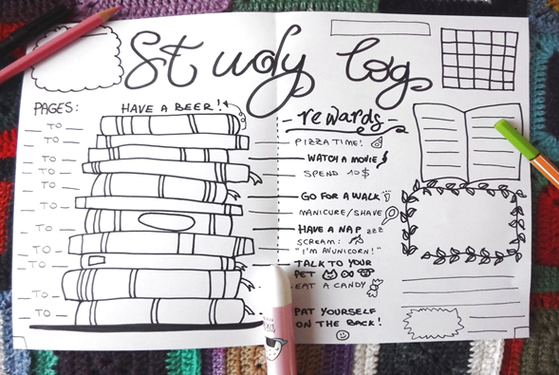
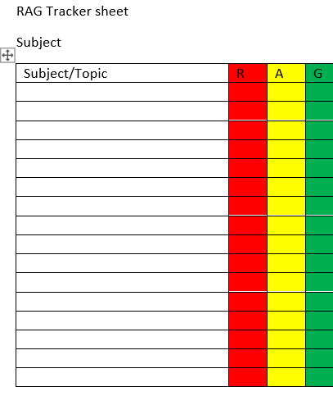
Make use of any RAG sheets you have already been given- use a blank one to build your own lists of areas to revise for any other subjects
Red= No knowledge/unconfident
Amber= Some knowledge
Green= Confident with knowledge
Aim to get your Red to Amber and Amber to Green.
Overtime keep revisiting your Reds and Ambers with the overall aim to increase knowledge and confidence in each subject/topic.

Slide 14
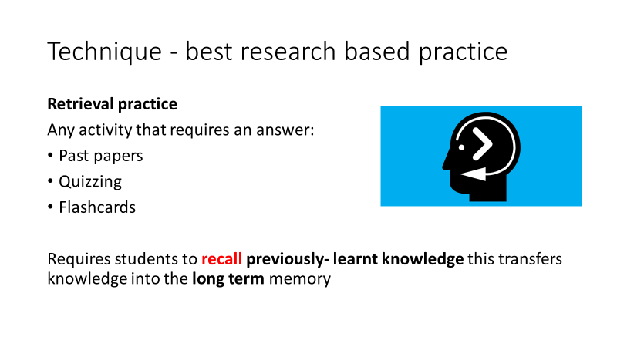
Planning Your Revision
Retrieval Practice

Slide 15
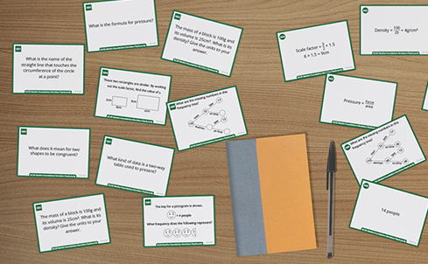

Slide 16
Using flashcards to revise
Flashcard and Retrieval Do | Flashcard and Retrieval Don’t
Put a single piece of information on each flashcard Sort Flashcards according to your confidence Create decks for each topic. You can use different coloured flashcards, per subject/topic/unit Mix up topics so you aren’t always testing yourself on the same topic. Practice the information you struggle with and need to improve/develop. Use “The Revision Process” to test yourself and move beyond simple facts and more towards detail and explanation. | Spend more time making flashcards than using them Put lots of information onto the flashcard. Make it messy Revise the flashcards in the same order Only read the flashcard, test yourself! Assume everything written is correct Avoid testing yourself on tough topics or ones you dislike, you want it to be difficult.

Slide 17
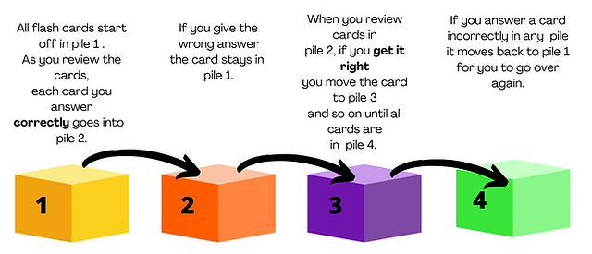
The Leitner System
Watch the video to see how to use flashcards using the Leitner System
https://www.youtube.com/watch?v=C20EvKtdJwQ

Slide 18
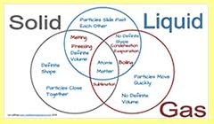
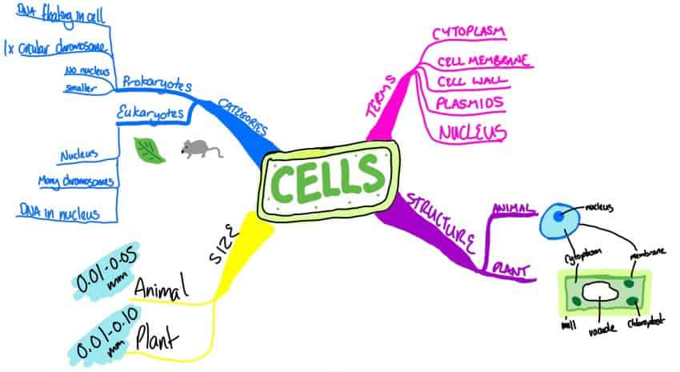
Alternatives to flashcards
Mind maps and Venn diagrams

Slide 19
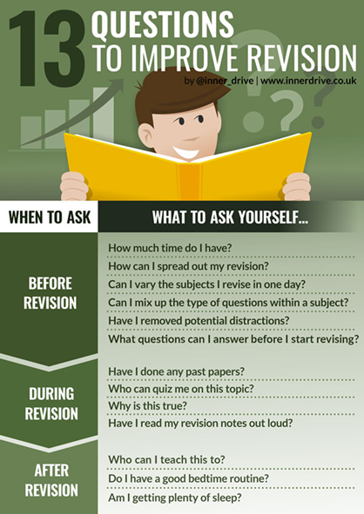
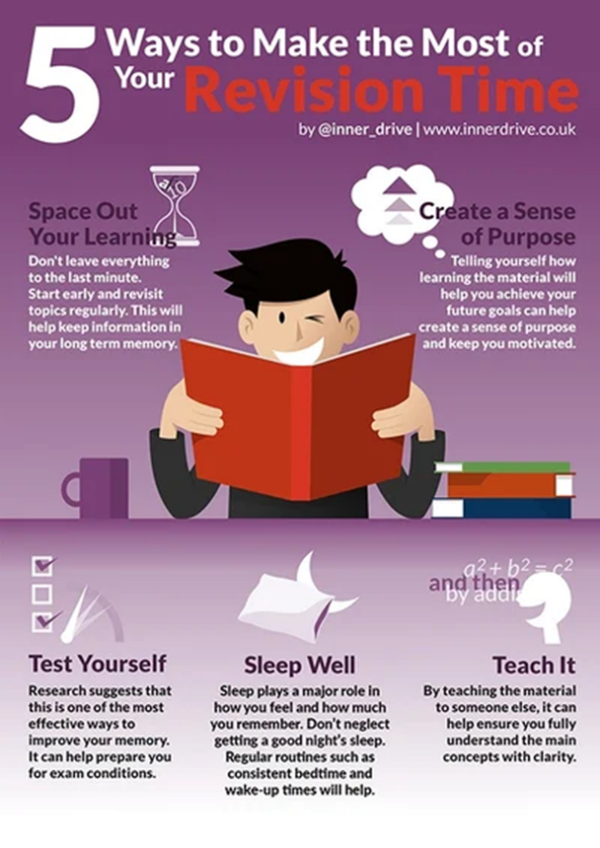
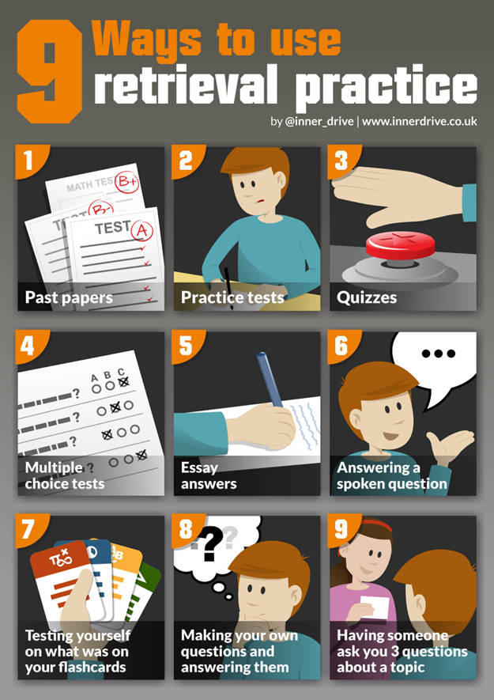

Slide 20
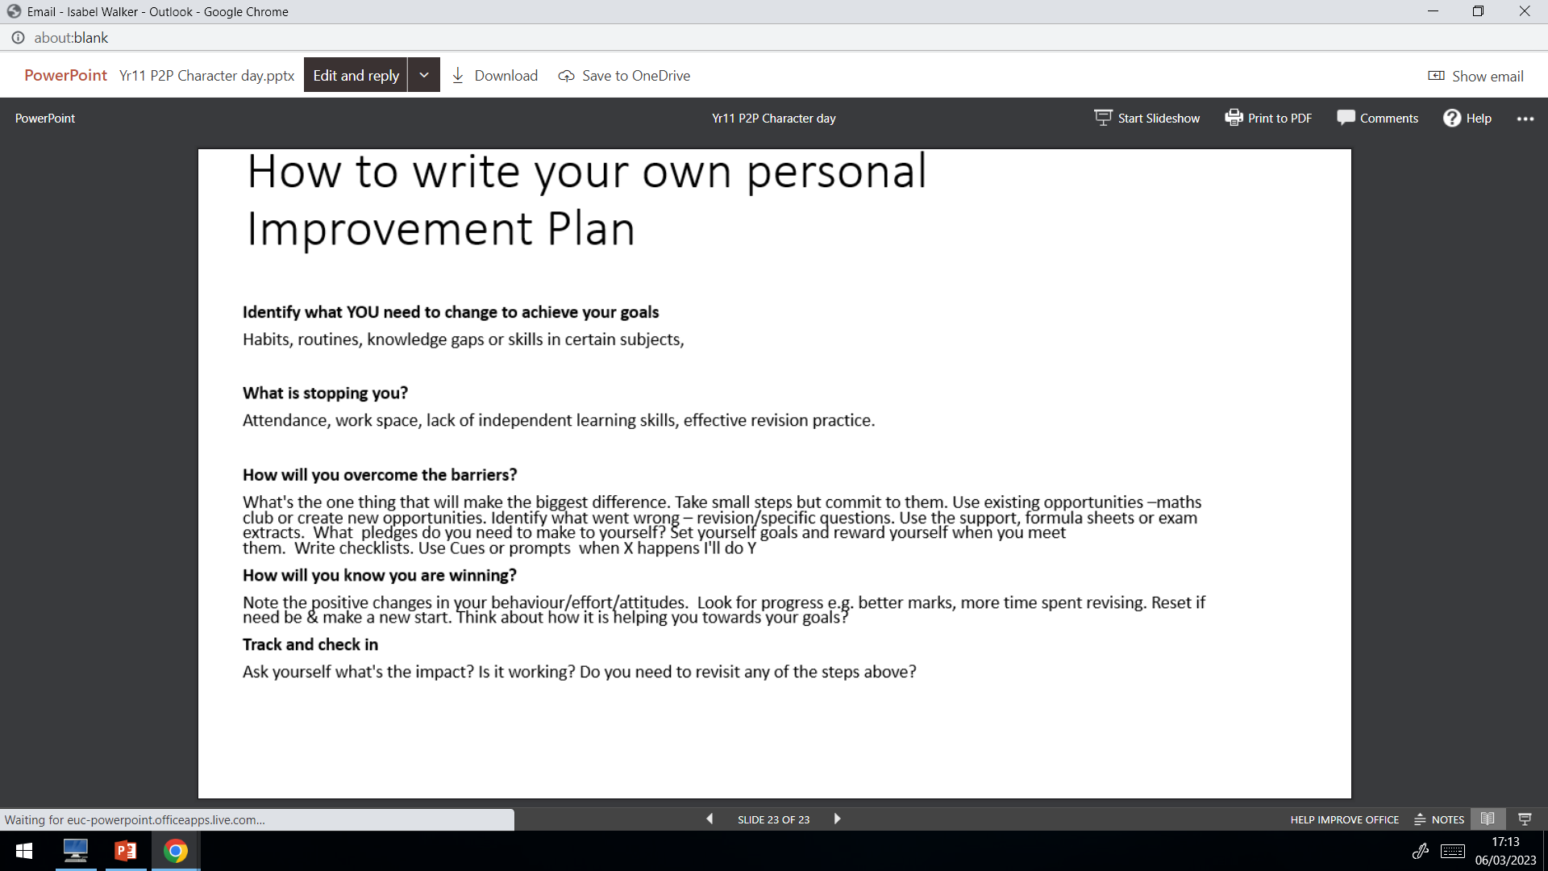
Creating your own personal Improvement Plan

Slide 21
Personal Improvement Plan
What YOU need to change to achieve your goals (Habits, routines, knowledge gaps or skills in certain subjects)
What is stopping you? (Attendance, work space, lack of independent learning skills, effective revision practice
How will you overcome the barriers? What is the one thing that will make the difference/ Identify what went wrong What pledges do you need to make to yourself?
How will you know you are winning? Look for progress Reset if needed and make a new start
Track and check in What has been the impact? Is it working? Do you need to revisit any of the above steps again?

Slide 22
Guidance on what to revise/ prepare for
A separate document will be emailed to you and home with revision lists and resources available to help you to revise for your GCSE exams.

Slide 23
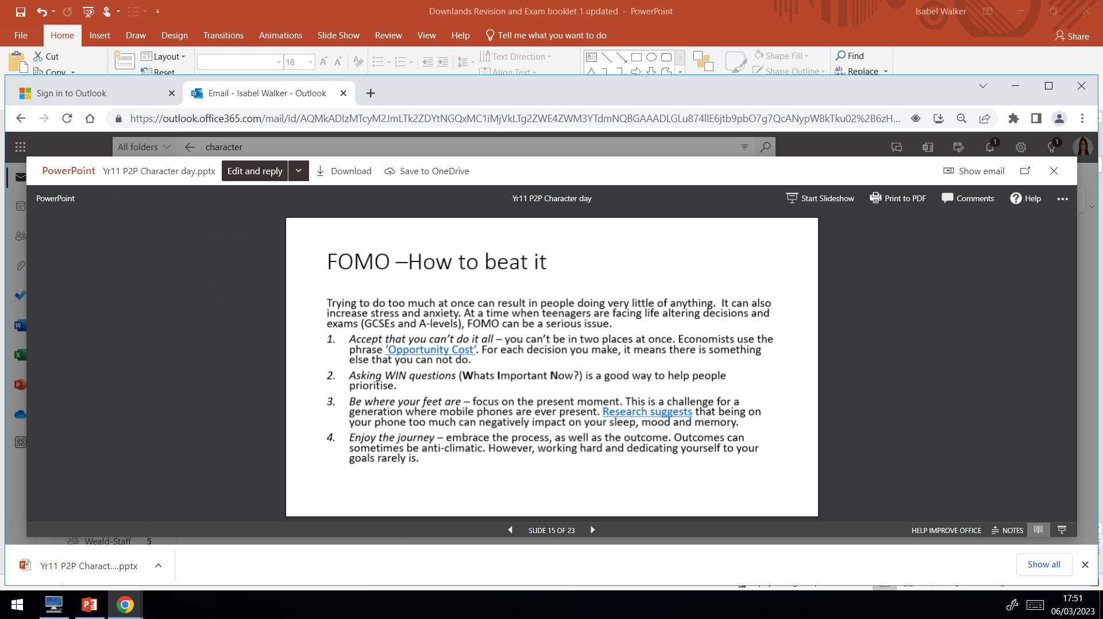
FOMO- How To Beat It

Slide 24
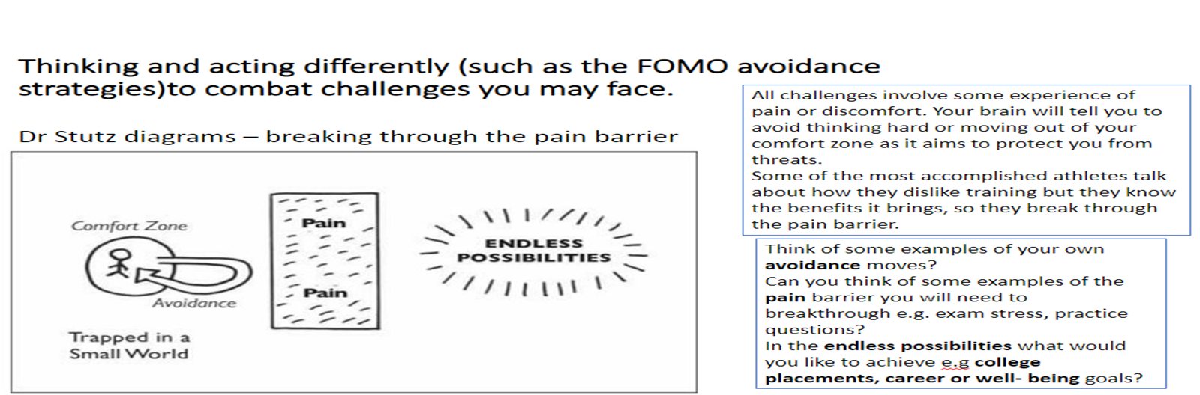

Slide 25
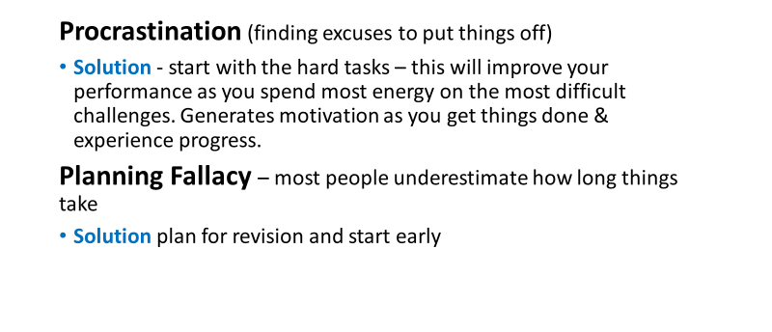
Traps to Avoid

Slide 26
Coping with a Busy Exam Schedule
Whenever you prepare for exams it is essential to take good care of yourself as this helps in PREPARING TO PERFORM.
The blog below gives some excellent on the various ways that you can prepare best, especially regarding taking good care of yourself.
https://blog.innerdrive.co.uk/cope-with-busy-exam-schedule

Slide 27
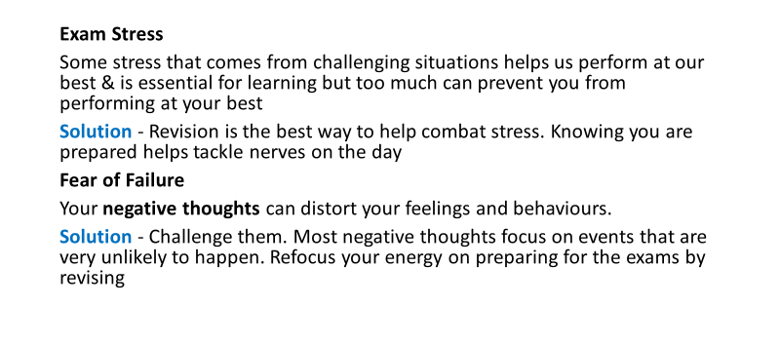
Managing Stress

Slide 28
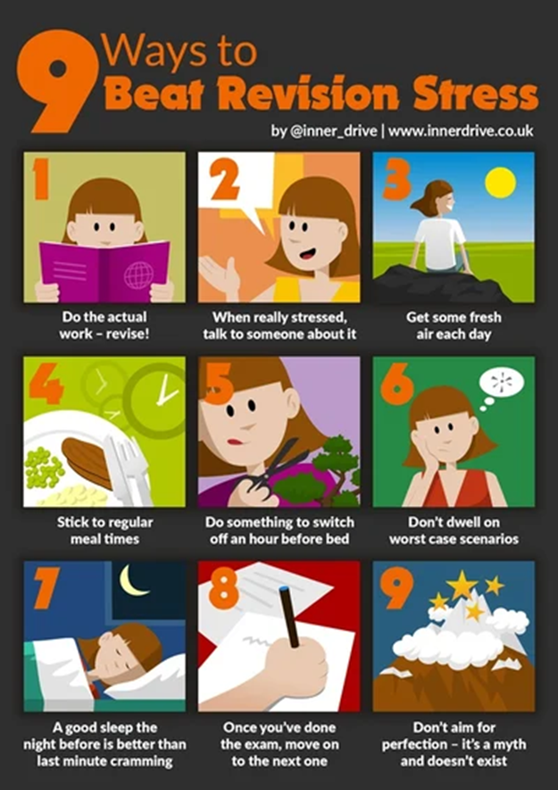
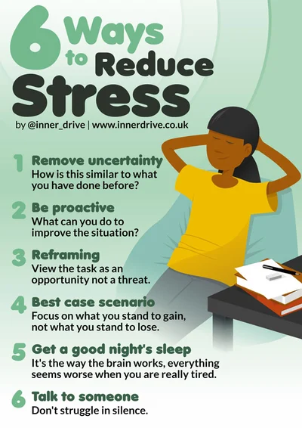

Slide 29
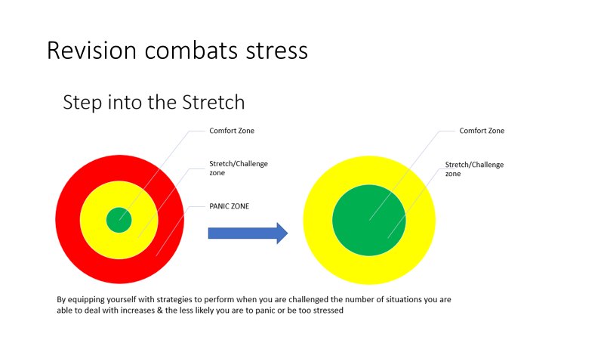
Revision Combats Stress

Slide 30
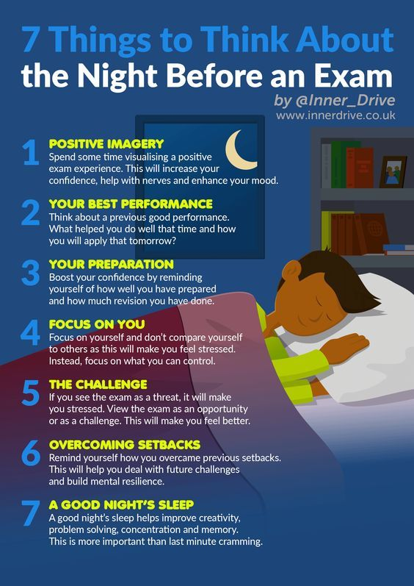
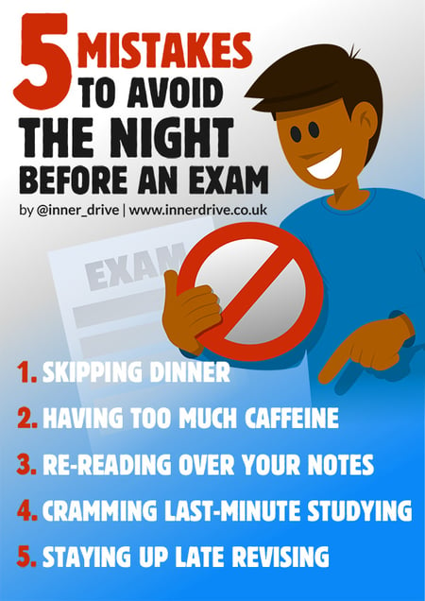

Slide 31

Mindful Activities
If you’re feeling overwhelmed try some of these activities to;
Rest your mind, Reset and Refocus
Remember everyone is different, you can only do your best
Bake a cake/biscuits
Dance/Sing to your favourite music
Go for a walk
Be quiet and present
Breathing Techniques
Colouring

