Slide 1
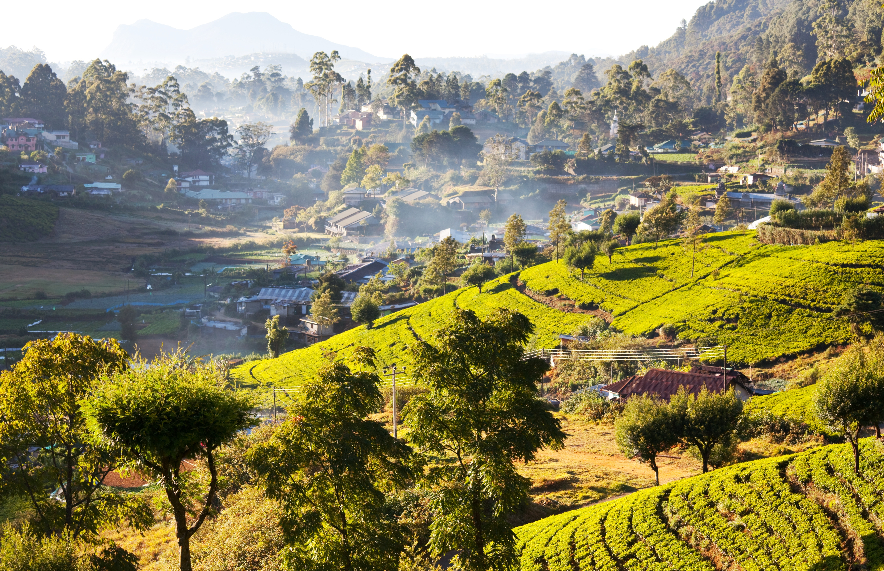
Sri Lanka
Sports Tour
22nd – 30th May 2026

Slide 2
01
Safety & Security

Slide 3

The Rayburn
Tours Difference
We are an independent,
family-run company and
we have been creating
unforgettable international
experiences for groups
since 1965
The Rayburn Tours Team
A family-run company
Unforgettable international experiences for young people
Over 50 years’ experience
Team of dedicated specialists
Delivering on promises of safety, support, service and experiences time and time again
Our Customers
Taking care of the travel arrangements for over 28,500 young people in 2023
Overall average customer service rating of 4.63 out of 5 in the same year
100+
Over 100 travel experts
Creating completely tailor-made experiences
For over 28,500*
passengers each year
*Statistics based on 2023.
Notes:
The Rayburn Tours Team
We are a family-run company who have been creating unforgettable international experiences for young people for over 50 years.
With a wealth of expertise, our team of specialists are dedicated to ensuring we deliver our promises of safety, support, service and experience time and time again.
Our Customers
Taking care of the travel arrangements for 23,000 young people each year and with an average customer service rating of 4.7 out of 5, your child is at the centre of everything we do.
Our Customers
Taking care of the travel arrangements for 23,000 young people each year
Average customer service rating of 4.7 out of 5

Slide 4


Safety On Tour
Safety is our Priority
Every element of every tour is carefully assessed and monitored
Founding member of the School Travel Forum (STF)
Partnerships with external health and safety organisations and advisors
Our Robust Safety Management System includes:
Accommodation and Coach Operator Audits
Excursion and activity assessments
Risk Management handbooks
24-hour on-tour emergency contact and Crisis Management Plan
DBS checked staff, couriers and coach drivers
Your Child’s Learning & Development
With 100% of educational experiences tailored to complement the National Curriculum, GCSE and A level specifications (or equivalent), you can be confident that your child’s learning needs will be supported.​
The quality of these educational experiences is reinforced by the Learning Outside the Classroom accreditation​

Slide 5
Financial Security
ABTOT Bonding​
In the unlikely event of tour operator failure, monies paid for your non-flight tour is financially protected and can be recouped.
If already on tour, assistance will be available to ensure the tour can be completed and you are returned home.​
ATOL Licence​
When booking a flight tour, our ATOL licence provides the reassurance that in the unlikely event of tour operator failure before departure, your money is financially protected and can be recouped.
If already on tour, assistance will be available to ensure the tour can be completed and you are returned home.​
​
ABTOT Membership
​The Association of Bonded Travel Organisers Trust Limited (ABTOT) provides financial protection under The Package Travel and Linked Travel Arrangements Regulations 2018 for Rayburn Tours 5508 and in the event of their insolvency, protection is provided for: Non-flight packages ABTOT cover provides for a refund in the event you have not yet travelled or repatriation if transportation was included in your package.
Please note that bookings made outside the UK are only protected by ABTOT when purchased directly with Rayburn Tours.
In the unlikely event that you require assistance whilst abroad due to our financial failure, please call our 24/7 helpline on 01702 811397 and advise you are a customer of an ABTOT protected travel company. You can access The Package Travel and Linked Travel Arrangements Regulations 2018 here: https://www.legislation.gov.uk/uksi/2018/634/contents/made You can find out more about ABTOT here: https://www.abtot.com/

Slide 6

Aviva
Insurance
When travelling on tour, every group member must have insurance​
We will provide your group with full travel insurance through Aviva insurance.​
Further details regarding insurance, including full details of Aviva insurance cover are available at; https://www.rayburntours.com​​

Slide 7
02
Destination Information

Slide 8
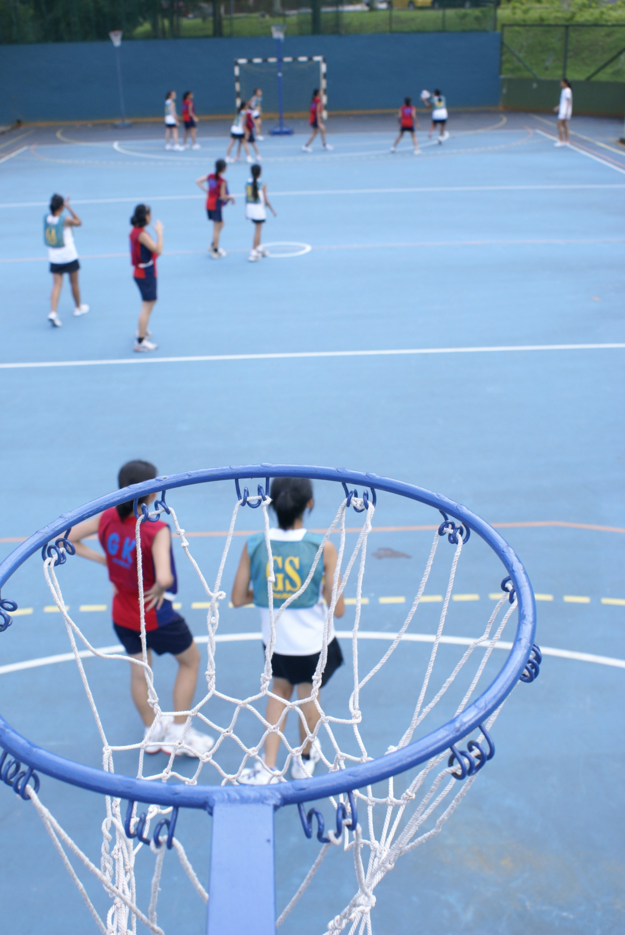
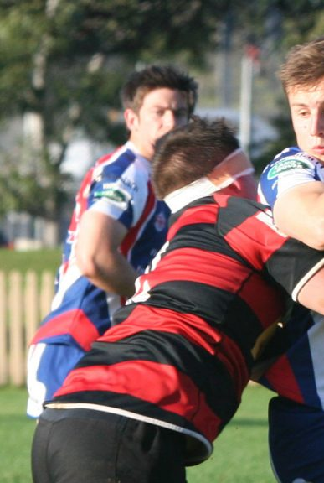
Key Tour
Information
Return indirect flights from London to Colombo
2 nights’ accommodation in the Pegasus Reef Hotel
2 nights’ accommodation in Citrus Hotel Hikkaduwa
2 nights’ accommodation in a 3* Hotel in Kandy
1 night accommodation in Sigiriyana Resort
Meals on a half board basis
Resort coaching for the duration of the tour
A programme of activities and excursions​
Comprehensive travel insurance​

Slide 9
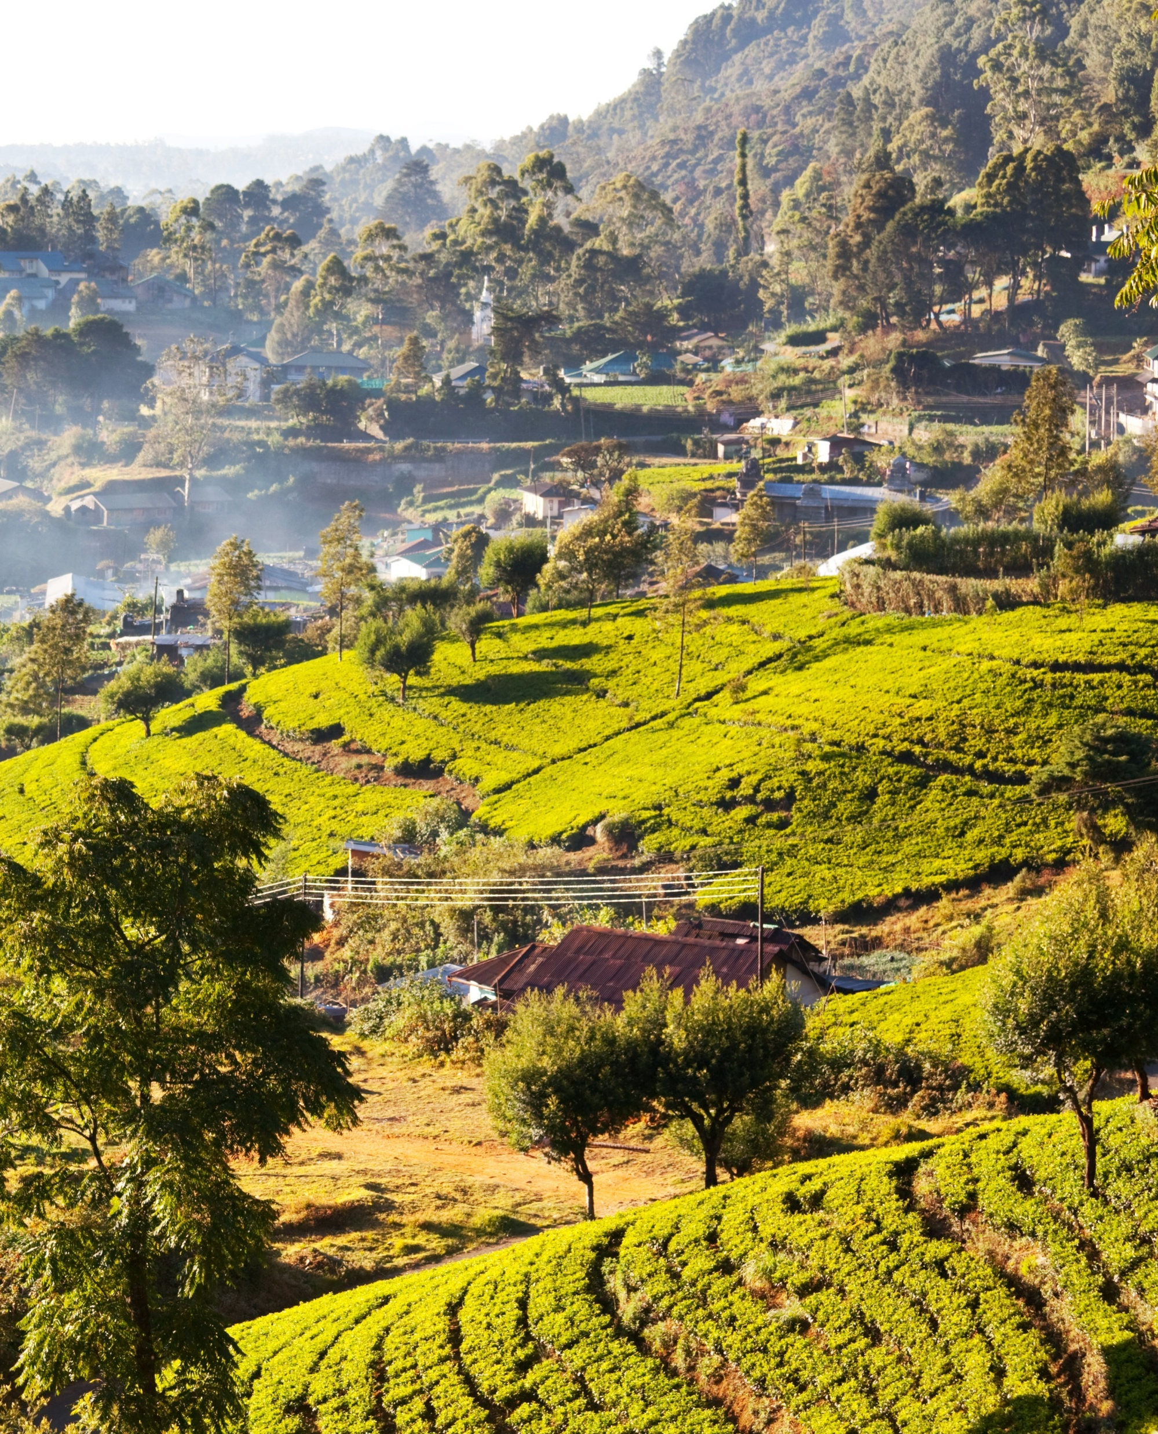
Know before you go!
Sri Lanka has a tropical climate with two main monsoon seasons: the southwest monsoon (May to September) and the northeast monsoon (October to January). The weather can vary significantly depending on the region and the time of year. Coastal areas tend to be warmer and more humid, while the central highlands are cooler.
Pack lightweight, breathable clothing suitable for hot and humid weather, especially if you're visiting coastal areas. Bring sunscreen, sunglasses, and a hat for sun protection. In the central highlands, where temperatures are cooler, include warmer layers such as sweaters and jackets.
The currency used in Sri Lanka is the Sri Lankan Rupee (LKR).
Debit cards are widely accepted in Sri Lanka, but it's always handy to have some cash for smaller purchases, especially in remote areas or at local markets. ATMs are available in major towns and cities.
Sri Lanka uses Type D, Type M, and Type G electrical outlets, with a standard voltage of 230V and a frequency of 50Hz. If your devices use a different plug type, you'll need a power adapter to charge them.
Continued →

Slide 10
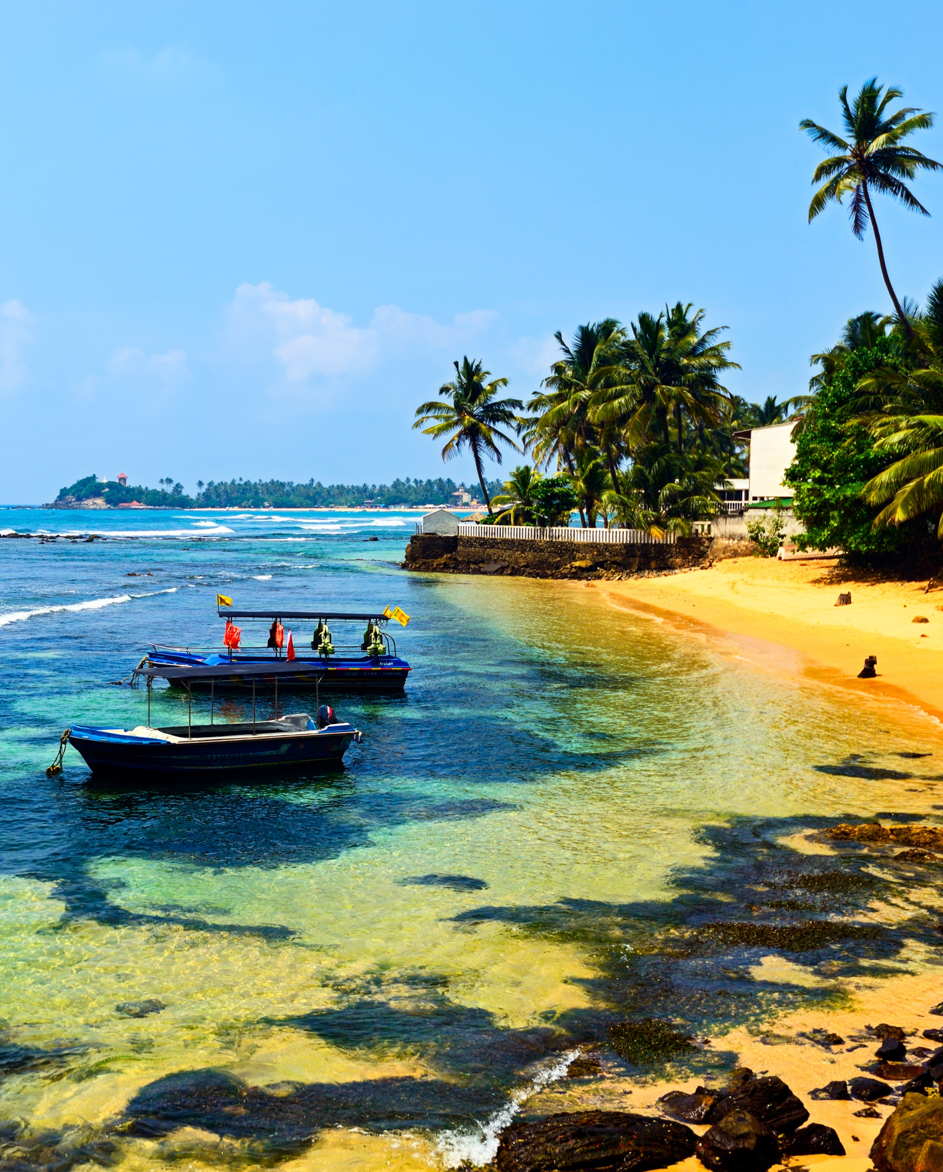
Language: Sinhala and Tamil are the official languages of Sri Lanka, but English is widely spoken and understood, especially in urban areas and tourist destinations. Learning a few basic phrases in Sinhala or Tamil can enhance your travel experience and show respect for the local culture.
Food: Sri Lankan cuisine is known for its rich flavors, aromatic spices, and use of fresh seafood and tropical fruits. Don't miss the opportunity to try classic Sri Lankan dishes such as rice and curry (a variety of curries served with rice), hoppers (rice flour pancakes), kottu roti (chopped roti mixed with vegetables and meat), and fresh coconut sambol.
Culture: Sri Lanka has a rich cultural heritage, with influences from Buddhism, Hinduism, Islam, and Christianity. Sri Lankans are generally warm, hospitable, and proud of their traditions. When greeting someone, a handshake or a friendly smile is common, along with a polite "ayubowan" (May you live long) or "vanakkam" (hello in Tamil).

Slide 11
03
Tour Information

Slide 12

Accommodation
2 nights’ accommodation in the Pegasus Reef Hotel
2 nights’ accommodation in Citrus Hotel Hikkaduwa
2 nights’ accommodation in a 3* Hotel in Kandy
1 night accommodation in Sigiriyana Resort
Adults to be accommodated 4 x twin rooms with private facilities
Students to be accommodated in twin rooms with en-suite facilities
Half board basis provided by the above-named accommodation

Slide 13
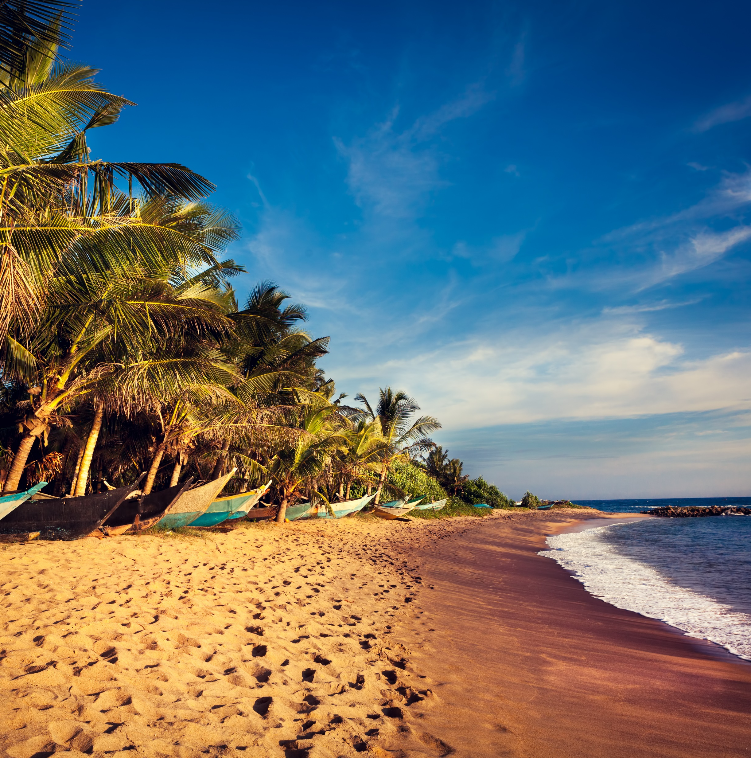
Excursions included
Gangaramaya Temple
Dambulla Cave Temple
Minneriya National Park evening safari
Kandy city tour
Temple of the Tooth visit
Visit to a turtle hatchling sanctuary
Visit a tea factory
Visit a spice garden (optional)
Community work afternoon teaching English and arts and crafts at a children’s home in Kandy
Cultural dance show
Beach afternoon
Sport arrangements
3 x netball fixtures (per team) against local opposition – based on 4 teams
3 x rugby fixtures (per team) against local opposition – based on 2 teams
Lunches after matches
Referees and officials
3L of water per player per match

Slide 14
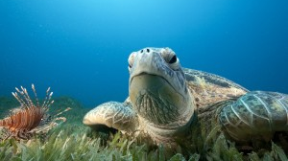
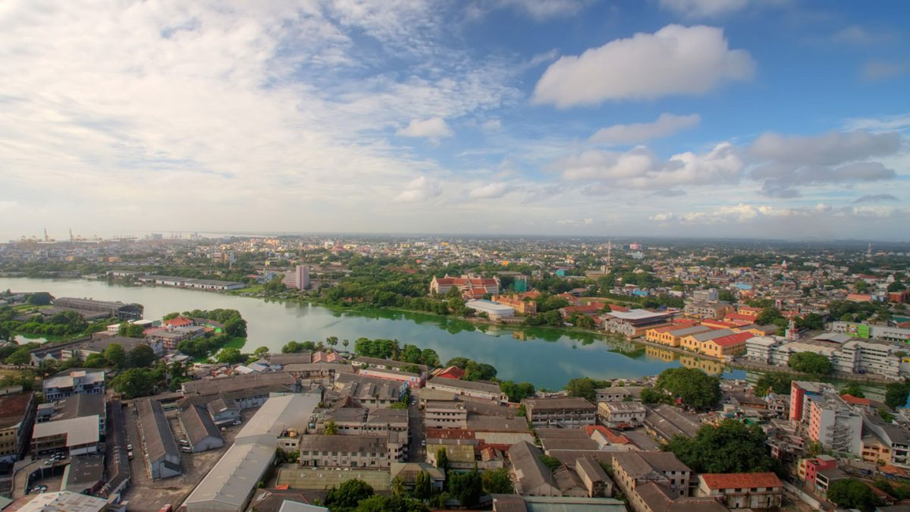
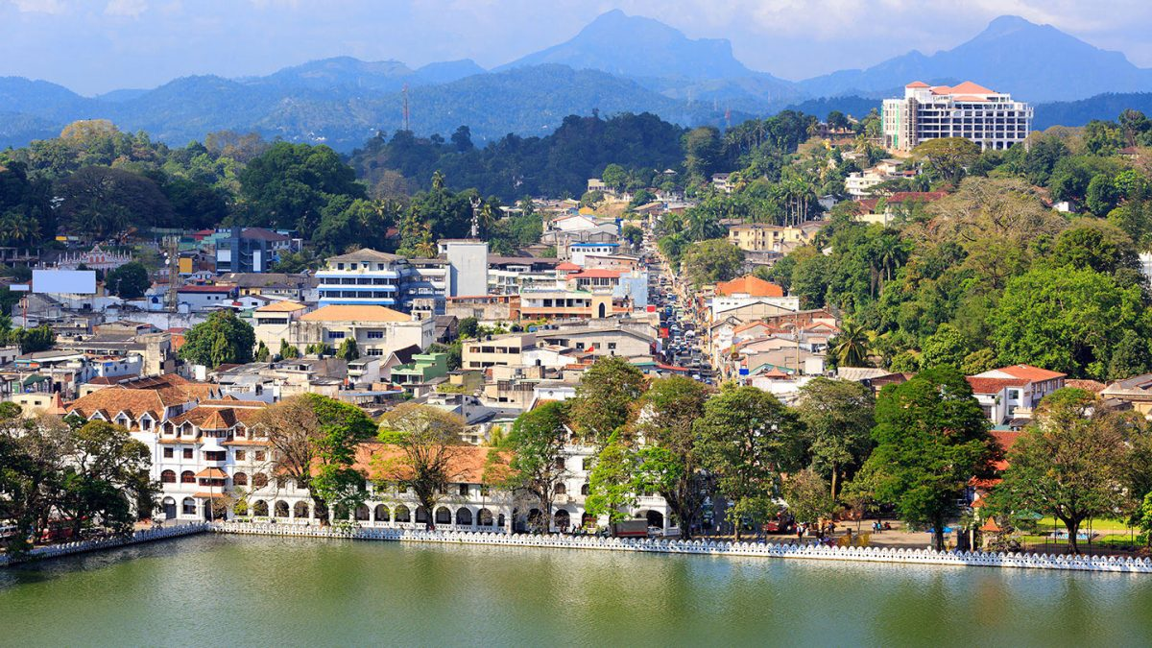
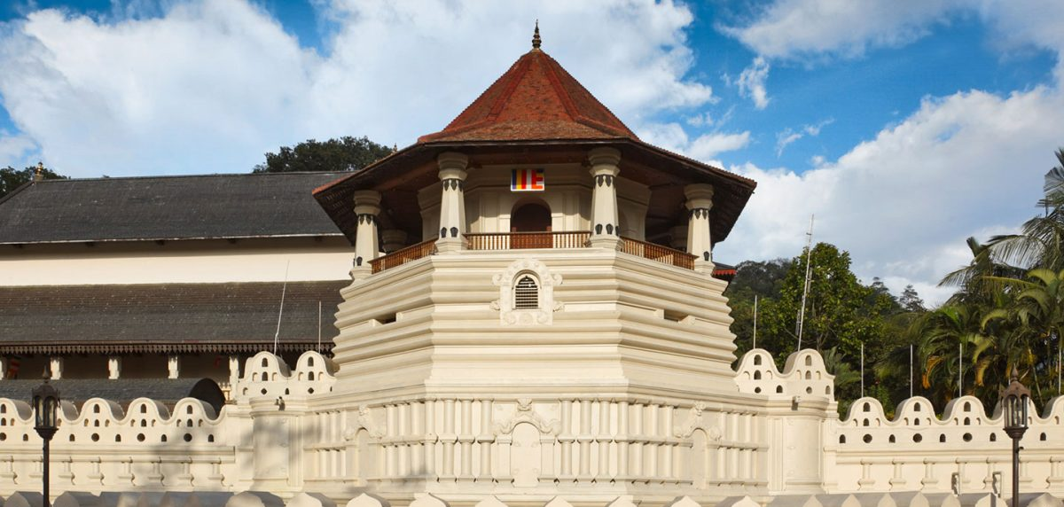
Turtle Sanctuary
Colombo City Tour
Kandy City Tour
Temple of The Tooth

Slide 15
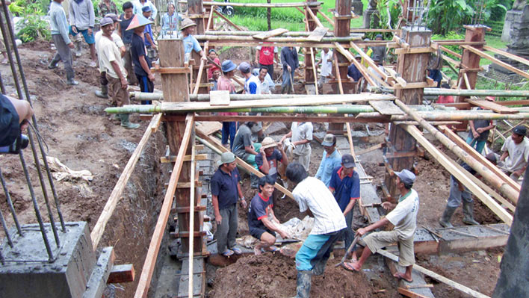
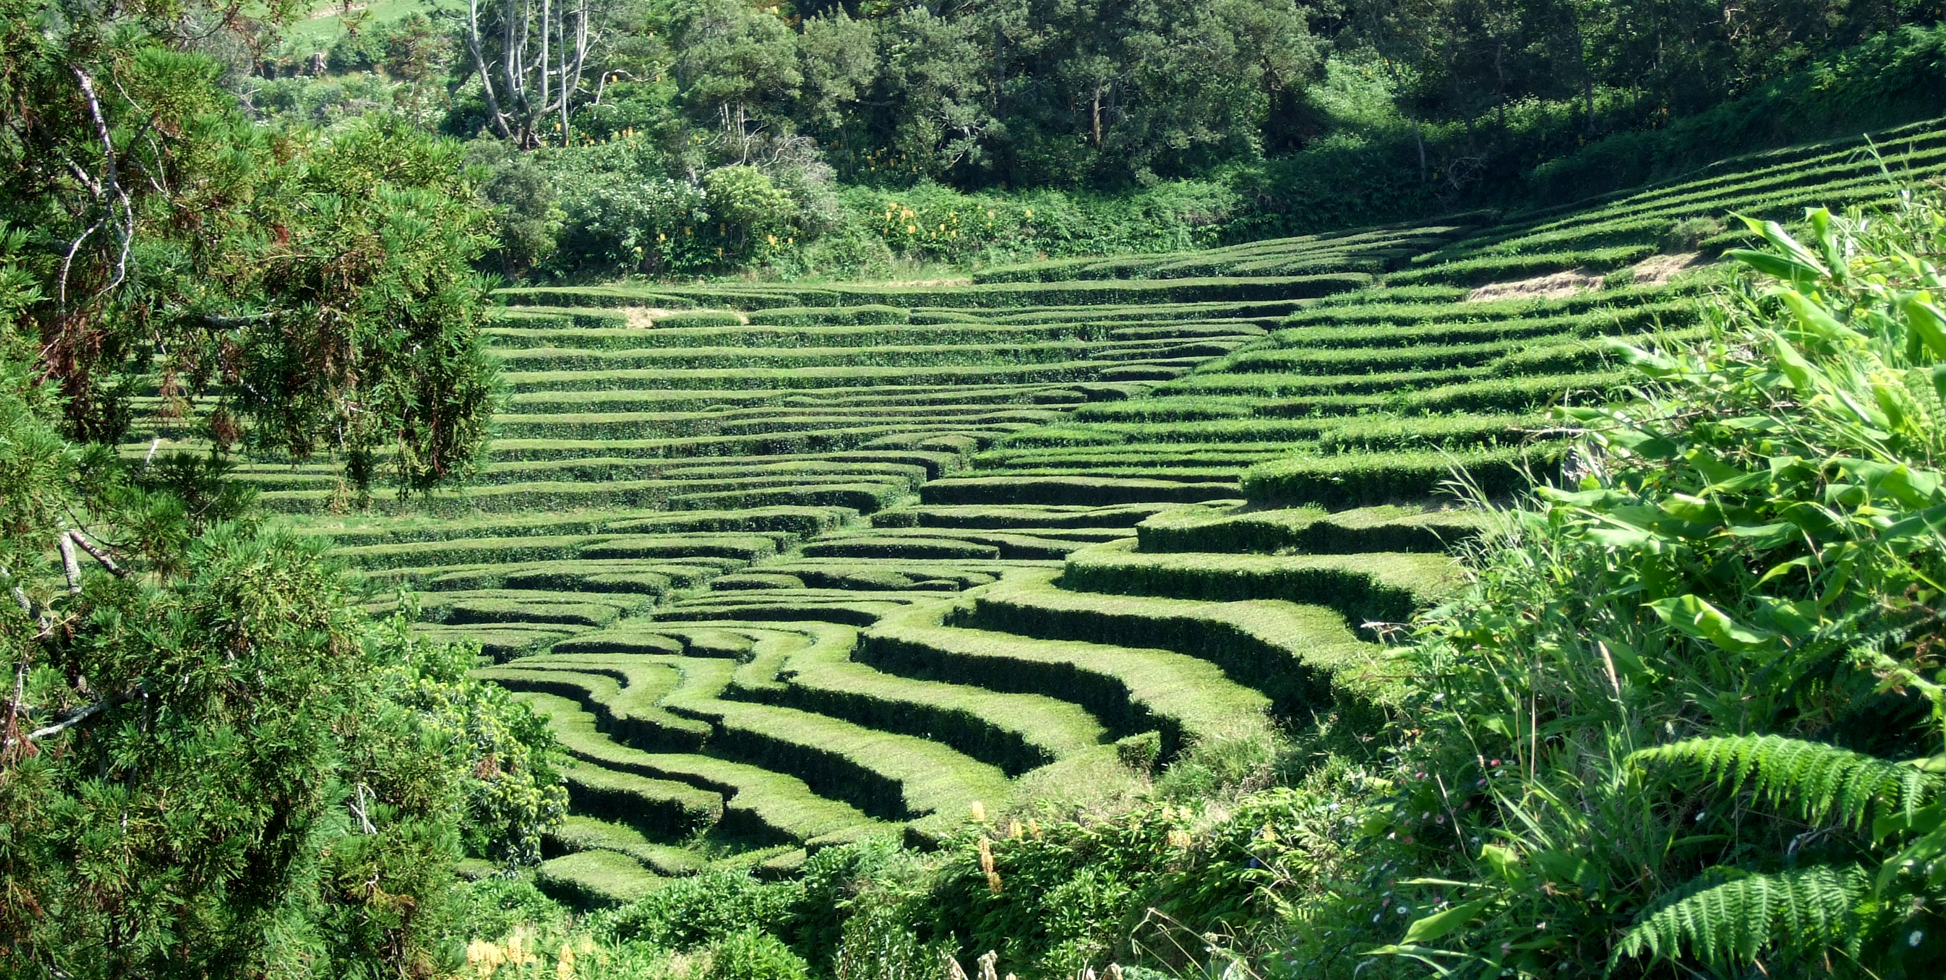
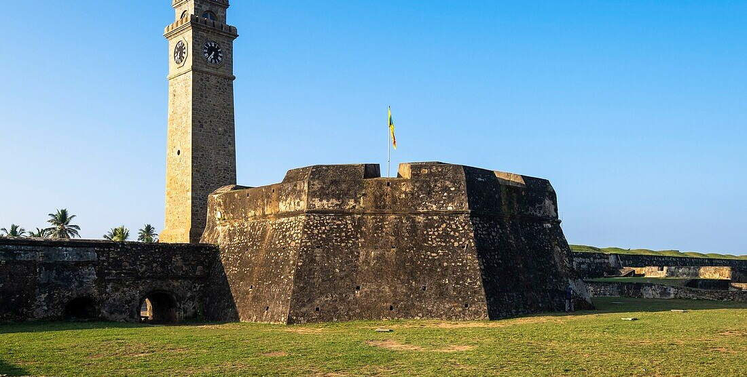
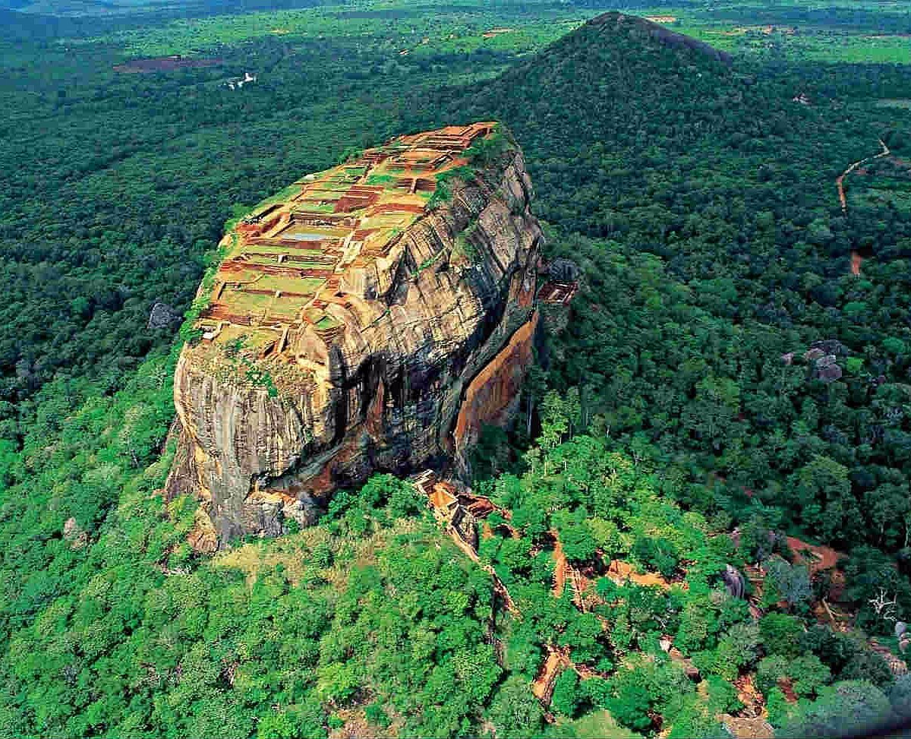
Foundation of Goodness
Tea Plantation
Galle Dutch Fort

Slide 16
04
Itinerary

Slide 17
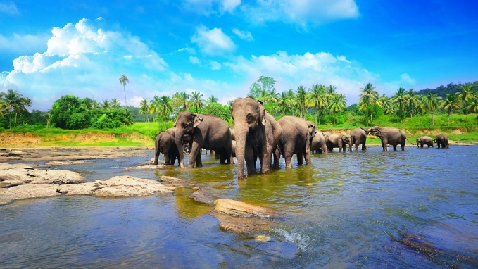
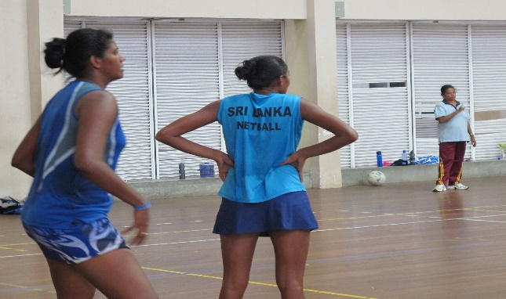
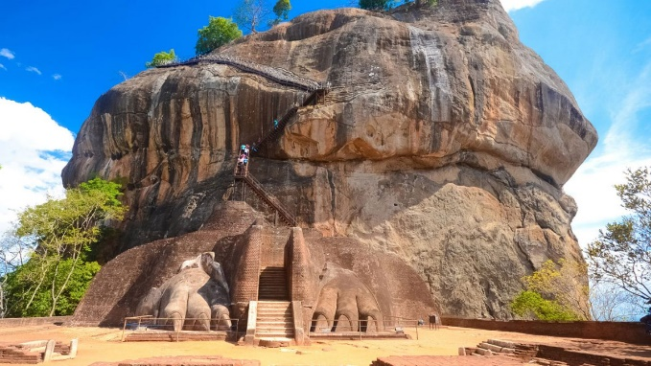
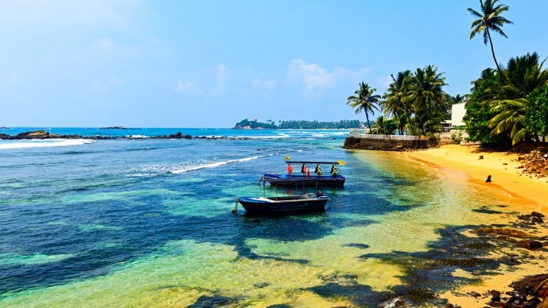
Sample Itinerary
Here’s what your trip could look like
(*please see your tour inclusions for information about which particular excursions are included in your tour price)
Day 3
Morning
Breakfast and training session
Afternoon
Fixture #1
Evening
Evening meal at Hotel
Day 5
Morning
Breakfast at hotel and leave for Kandy
Afternoon
Visit a spice Garden en route before afternoon Fixtures #2
Evening
Volunteering teaching English and arts and crafts at a children's home in Kandy before evening meal at hotel
Day 7
Morning
Breakfast at hotel before visiting turtle hatchery en route to Hikkaduwa
Afternoon
Turtle Hatchery
Evening
Dinner at accommodation
Day 9
Morning
Check out and depart for the UK
Afternoon
Travel
Evening
Arrive home
Day 1
Evening
Depart UK by flight
Day 2
Afternoon
Arrive in Sri Lanka and head to Pegasus Reef hotel before heading to the beach
Evening
Evening meal at hotel
Day 4
Morning
Breakfast then depart for Sigirya
Afternoon
Visit a Dambulla Cave Temple
Evening
Evening Game drive in Minneriya National Parlk
Day 6
Morning
Breakfast Fixture #3
Afternoon
Temple of the Tooth relic
Evening
Cultural dance show before Dinner at accommodation
Day 8
Morning
Breakfast at hotel and visit the Foundation of Goodness
Evening
Cool off in the pool before evening meal and host your own awards evening!

Slide 18

Any questions?
Please email
dshah@downlands.org

