Slide 1

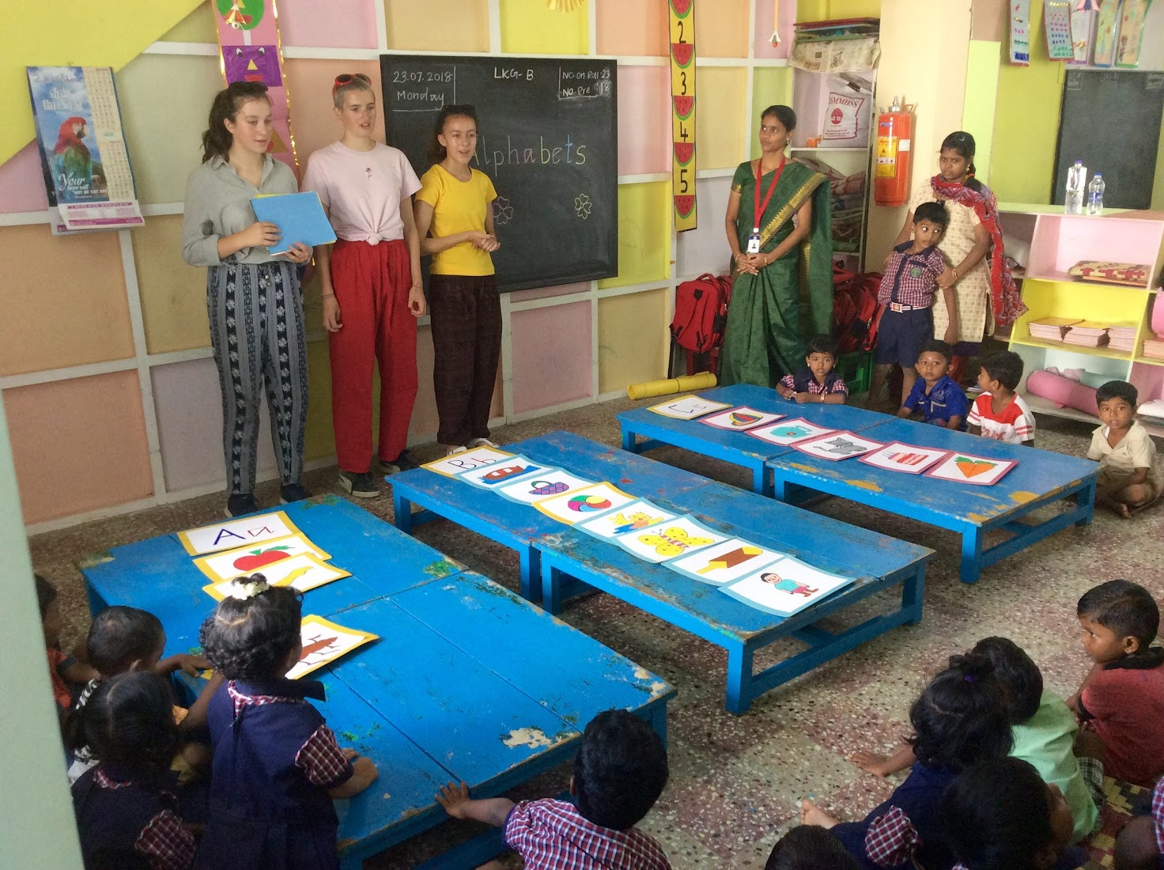
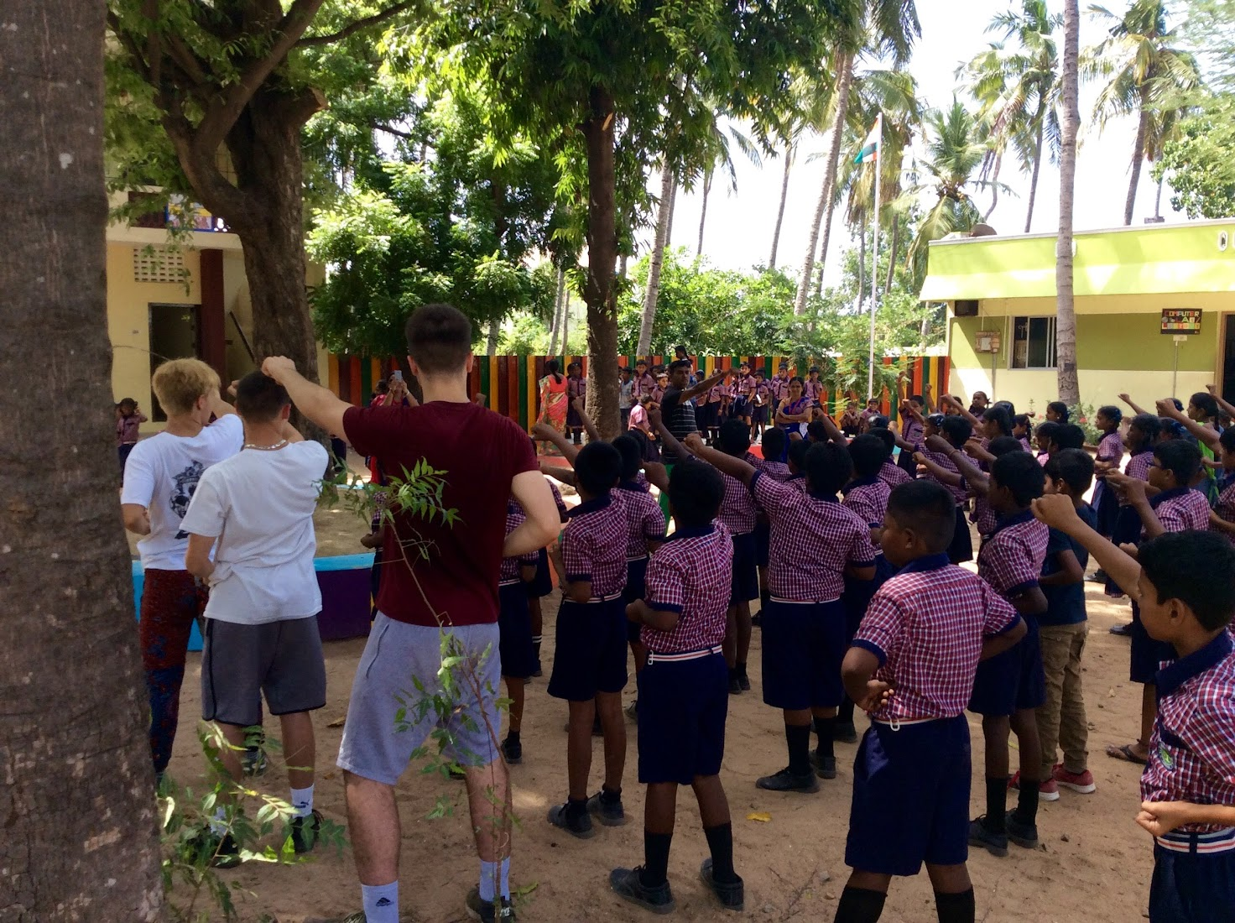
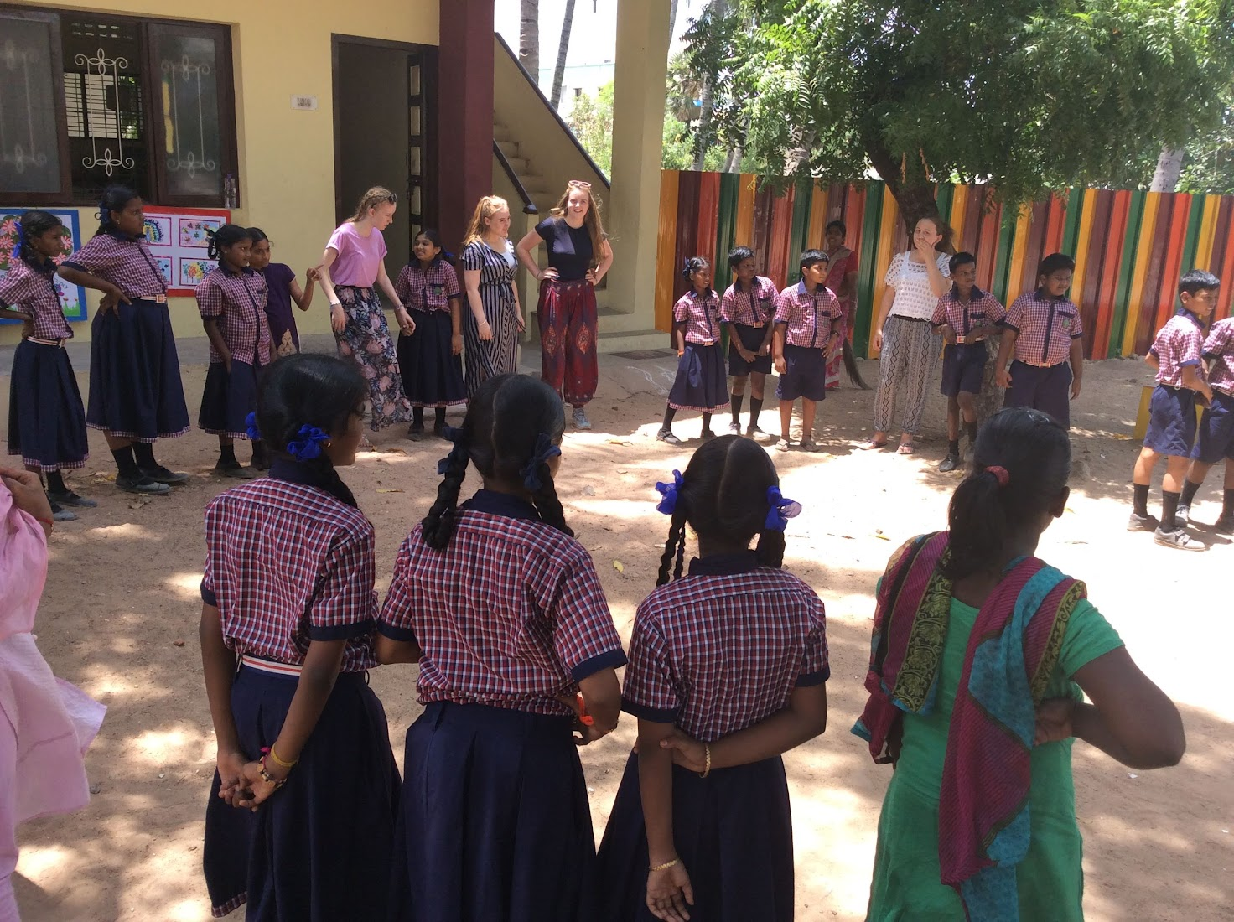

Slide 2
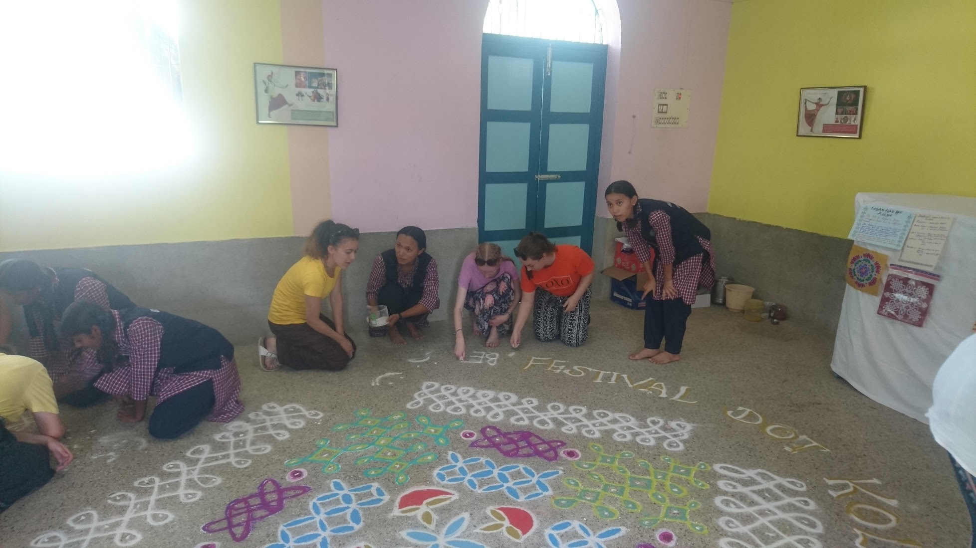
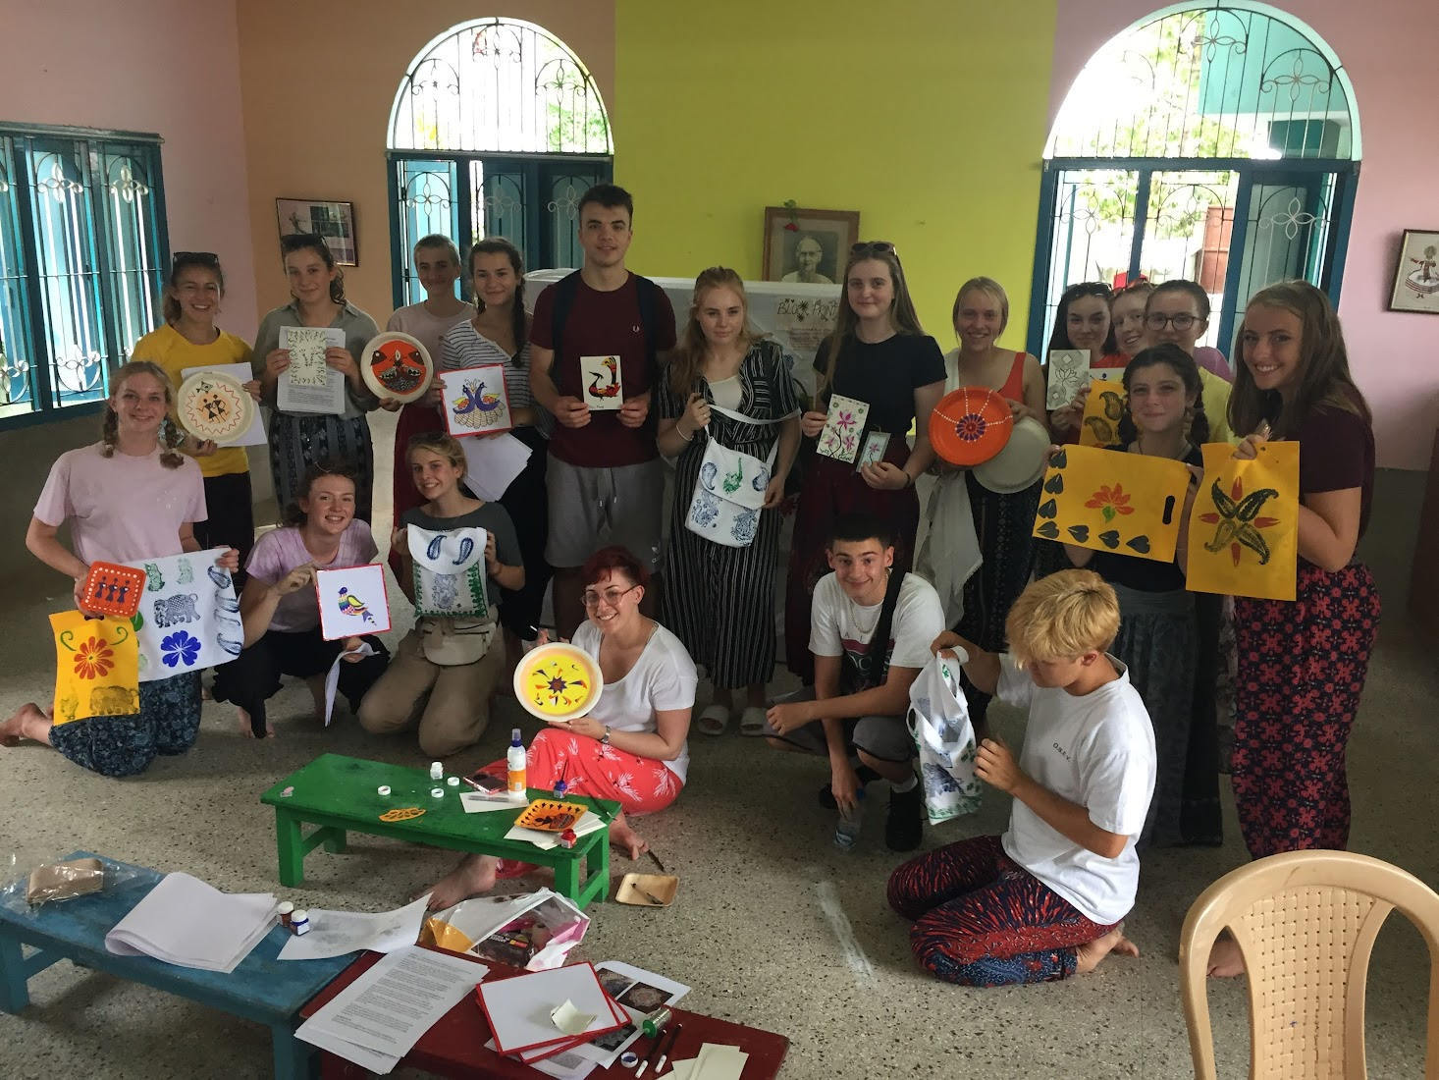
Itinerary
Kit List
Visa information
Consent forms
Medication
Passports
Spending money
Rules and expectations
Indian culture

Slide 3
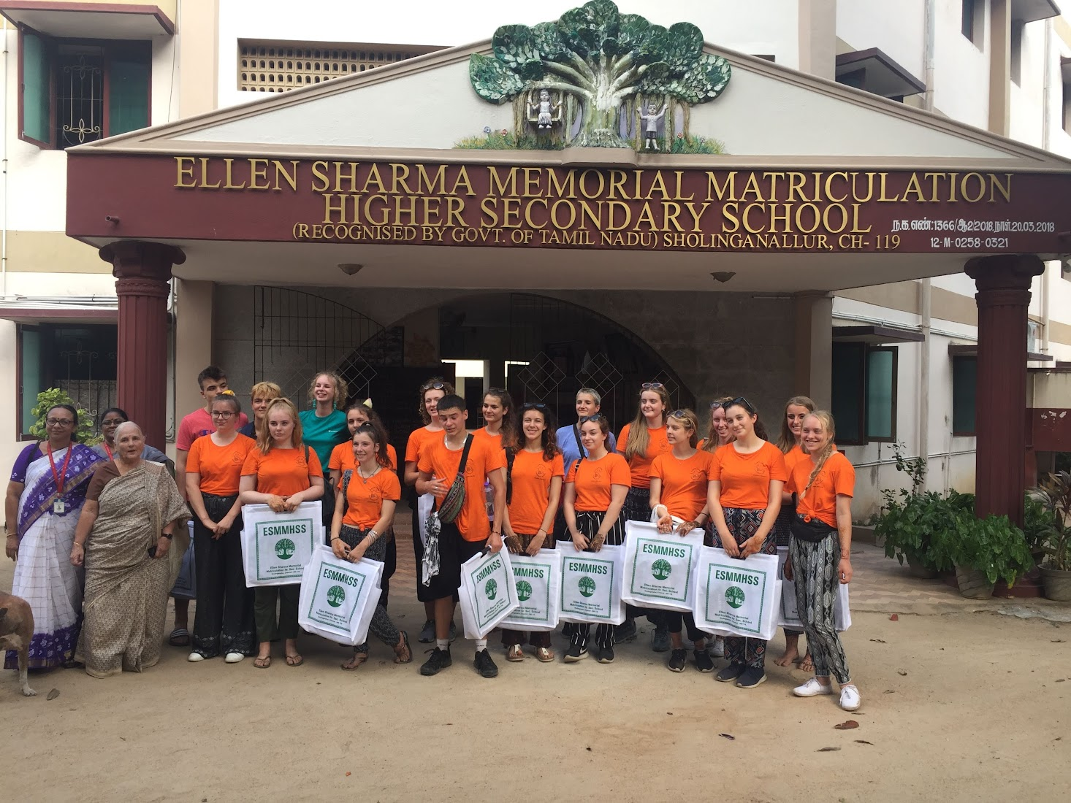
Our partnership with Ellen Sharma School
We have been partnered since 2007
This is our third student visit in this time.
We have had 5 reciprocal teacher visits, funded by The British Council
Since Covid, our relationship has become less prominent. The purpose of this trip is to reinvigorate our partnership.

Slide 4
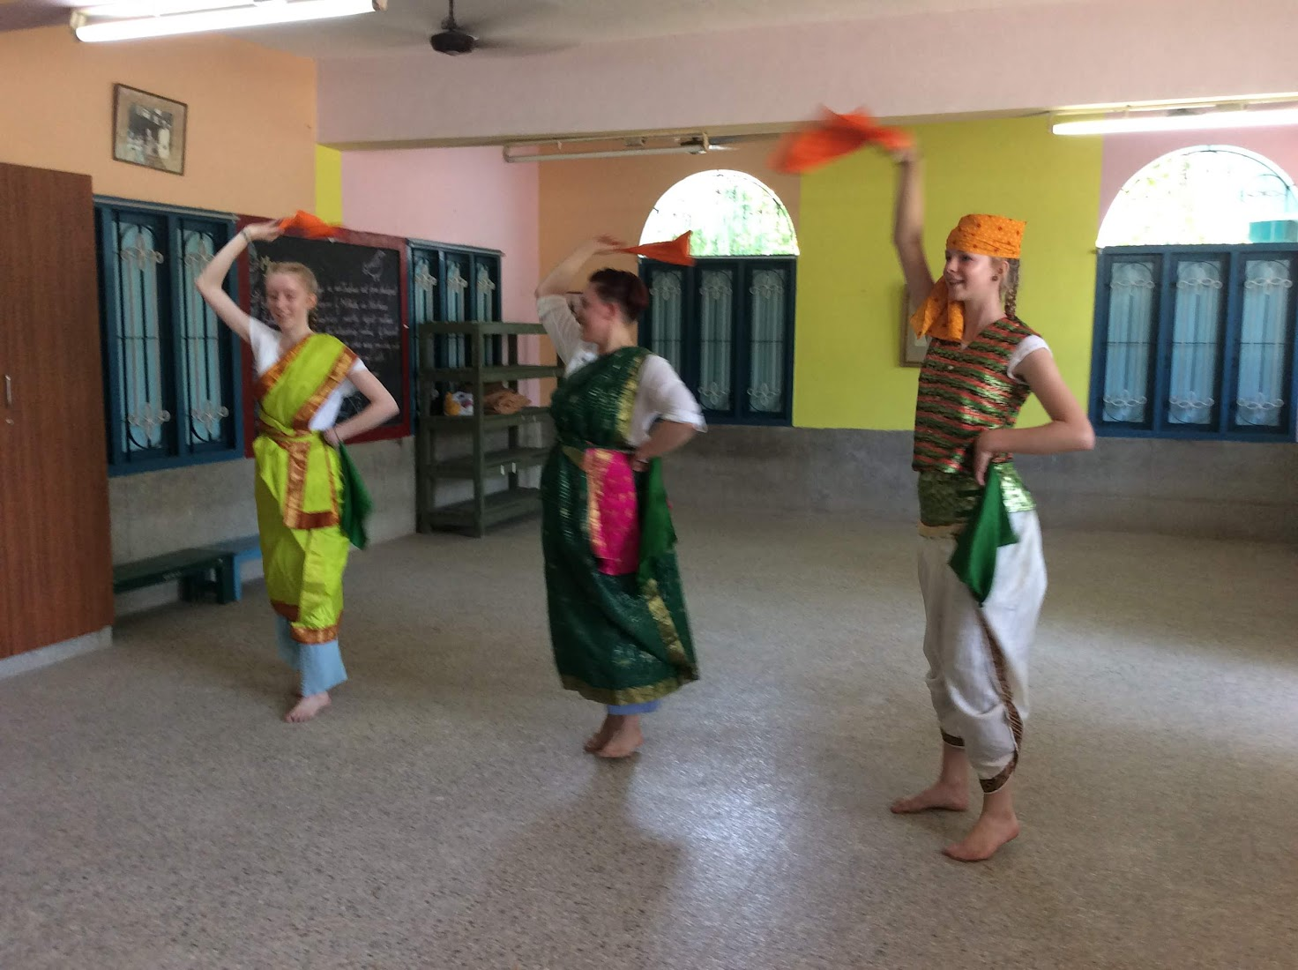
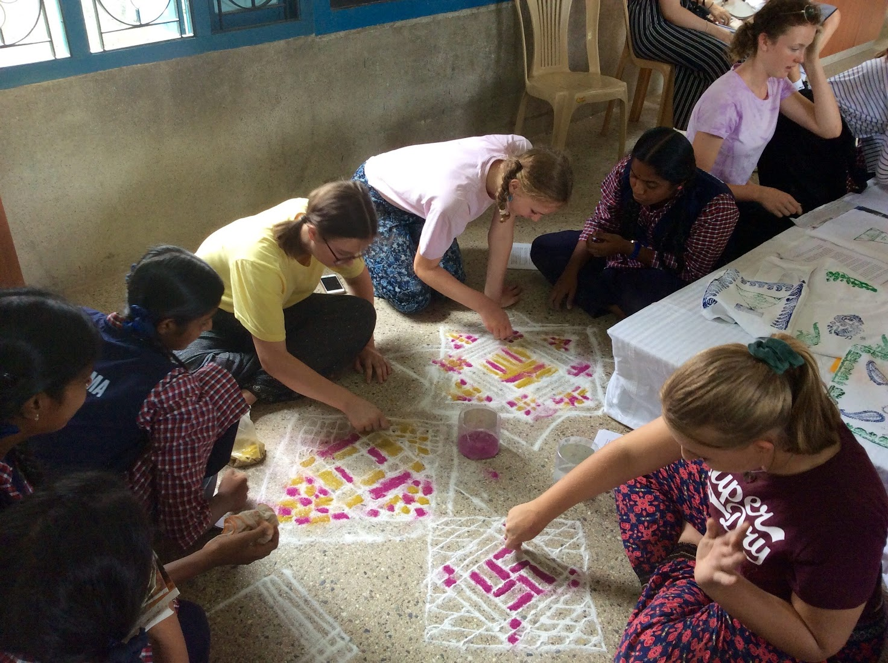
About Ellen Sharma
Kindergarten through to Year 11 on one site
The site is large, green and coming into the 21st century quickly!
The school has a lot of core eco principals.
Serves a wide range of students from very different backgrounds.

Slide 5
Saturday 12th July
10:15am Meet at Downlands
10:45am Coach departs for Gatwick
11:30am Check in to flight at Gatwick (EK16) to Dubai
14:30 Flight departs

Slide 6
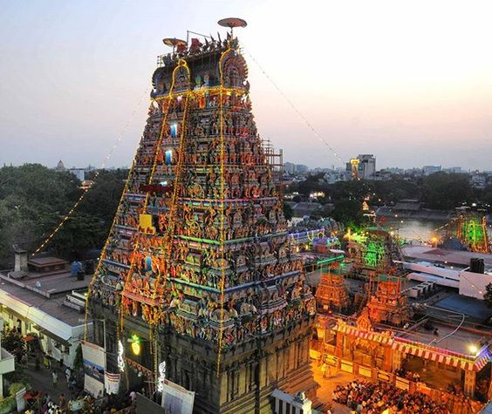
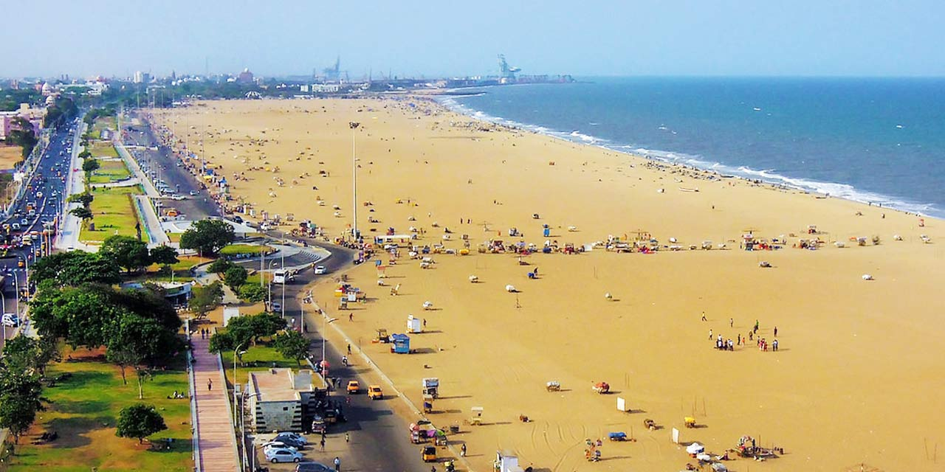
Sunday 13th July
00:40 Arrive in Dubai
02:45 Depart Dubai airport (EK 544)
08:30 Arrive at Chennai Airport
09:30 Transfer to Hotel Halez, Chennai
Afternoon to relax and recharge, evening meal in hotel!

Slide 7
Monday 14th July & Tuesday 15th July
07:30 Breakfast in hotel
08:30 Depart for Ellen Sharma School on foot
Day at Ellen Sharma completing workshops and spending time with students. Lunch will be provided by the school.
18:00 Evening meal at Hotel Halez

Slide 8
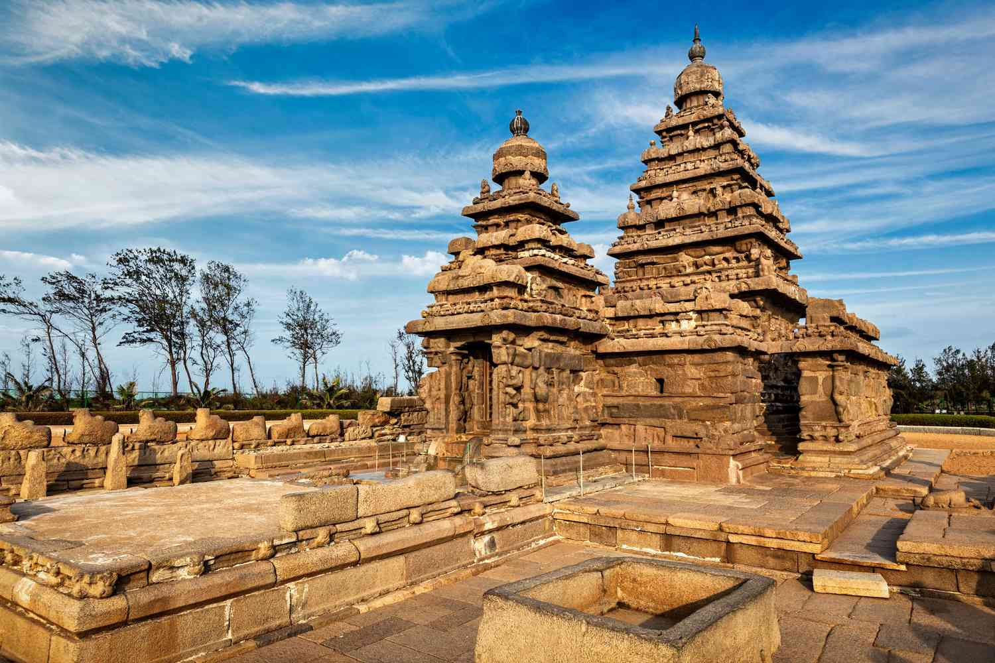
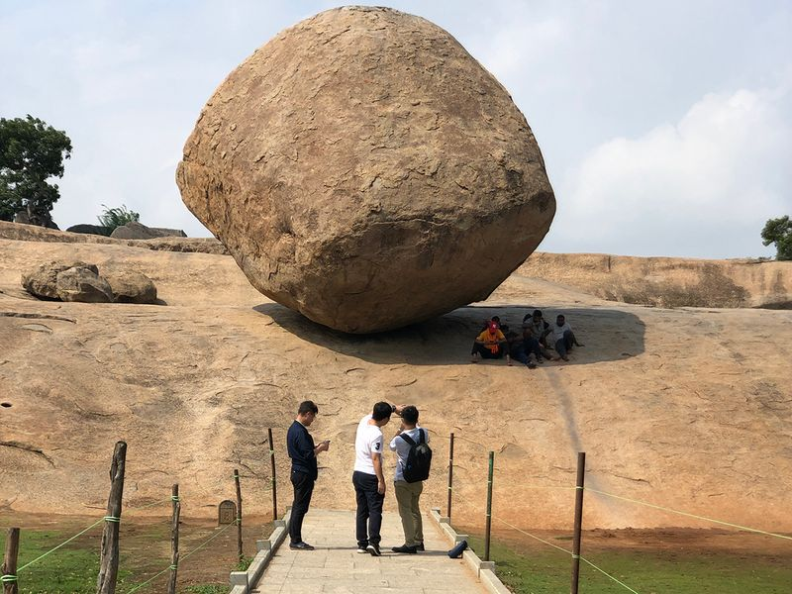
Wednesday 16th July
07:30 Breakfast in hotel
08:30 Depart for Mahabalipuram, Dakshina Chitra & Crocodile Bank. Lunch will be at a local restaurant
17:00 Return to Hotel Halez
18:00 Dinner in Hotel Halez

Slide 9
Thursday 17th & Friday 18st July
07:30 Breakfast in hotel
08:30 Depart for Ellen Sharma School on foot
Day at Ellen Sharma completing workshops and our teaching sessions. Lunch will be provided by the school.
18:00 Evening meal at Hotel Halez

Slide 10
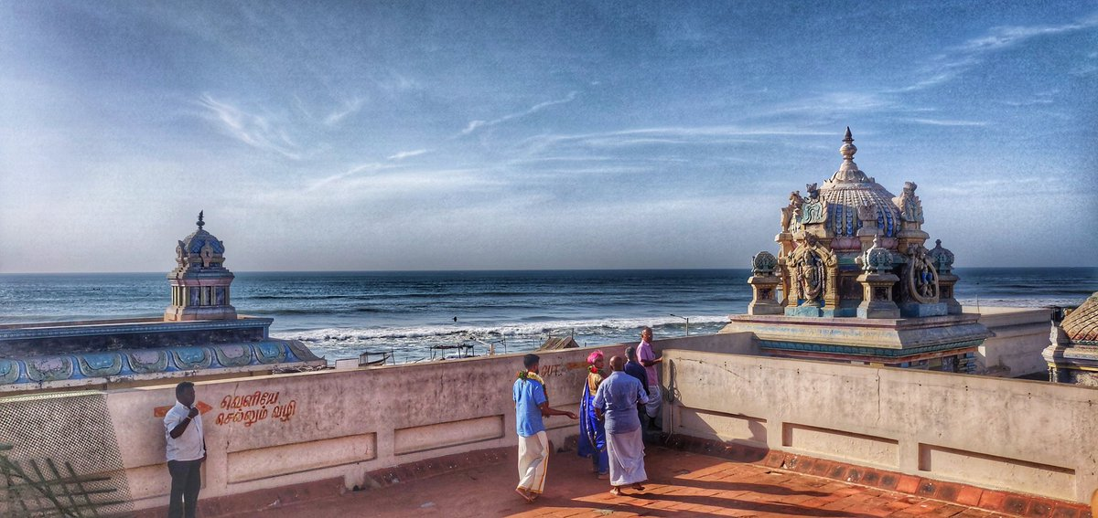
Saturday 19th July
07:30 Breakfast in hotel
08:30 Depart for tour of Elliot Beach, Ashtalakshmi Temple & Mylapore Markets
15:00 Back to Hotel Halez for showers and final packing
17:30 Depart from Hotel Halez
18:30 Check in for flight EK 547 to Dubai
20:00 Depart on flight EK 547

Slide 11
Sunday 20th July
00:45 Arrive in Dubai airport
02:45 Depart on flight EK 11 to London Gatwick
07:20 Arrive in London Gatwick
08:00 Coach transfer leaves Gatwick
08:45 Arrive back to Downlands for parents to collect

Slide 12
Kit List
Baggage allowance
1 x 30kg hold luggage
1 x 10kg hand luggage and 1 x small personal item (hand bag/camera bag/small rucksack)
Clothing
Comfy shoes for walking around tourist sites/playing sports!
Flip flops/sliders/sandals which can be taken off easily
Long trousers/skirt/shorts/dresses (with shoulders covered). These must not be above your knee caps.
T-shirts with sleeves (no strap tops at any times and not tight fitting)
Scarf/shawl
Sun hat
Sun glasses
Pyjamas (hotel air con can be quite cold!)
Swim suit (please be respectful)
Changes of socks and underwear
India trip t-shirt
Downlands polo shirt

Slide 13
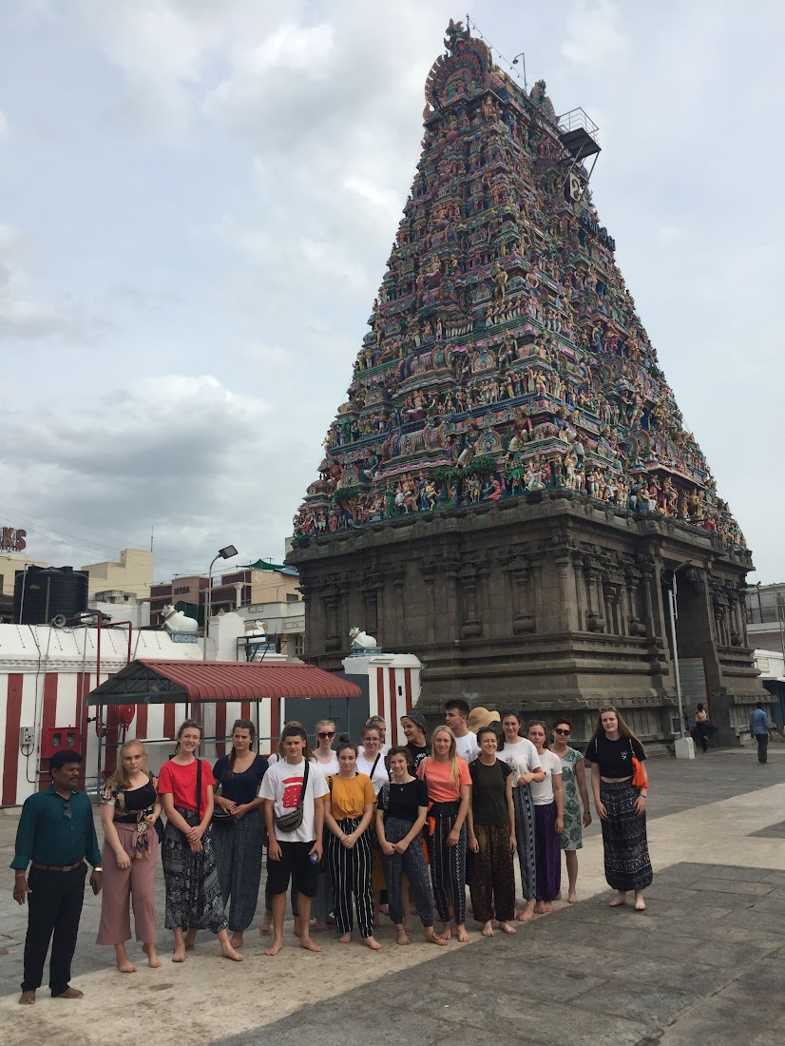
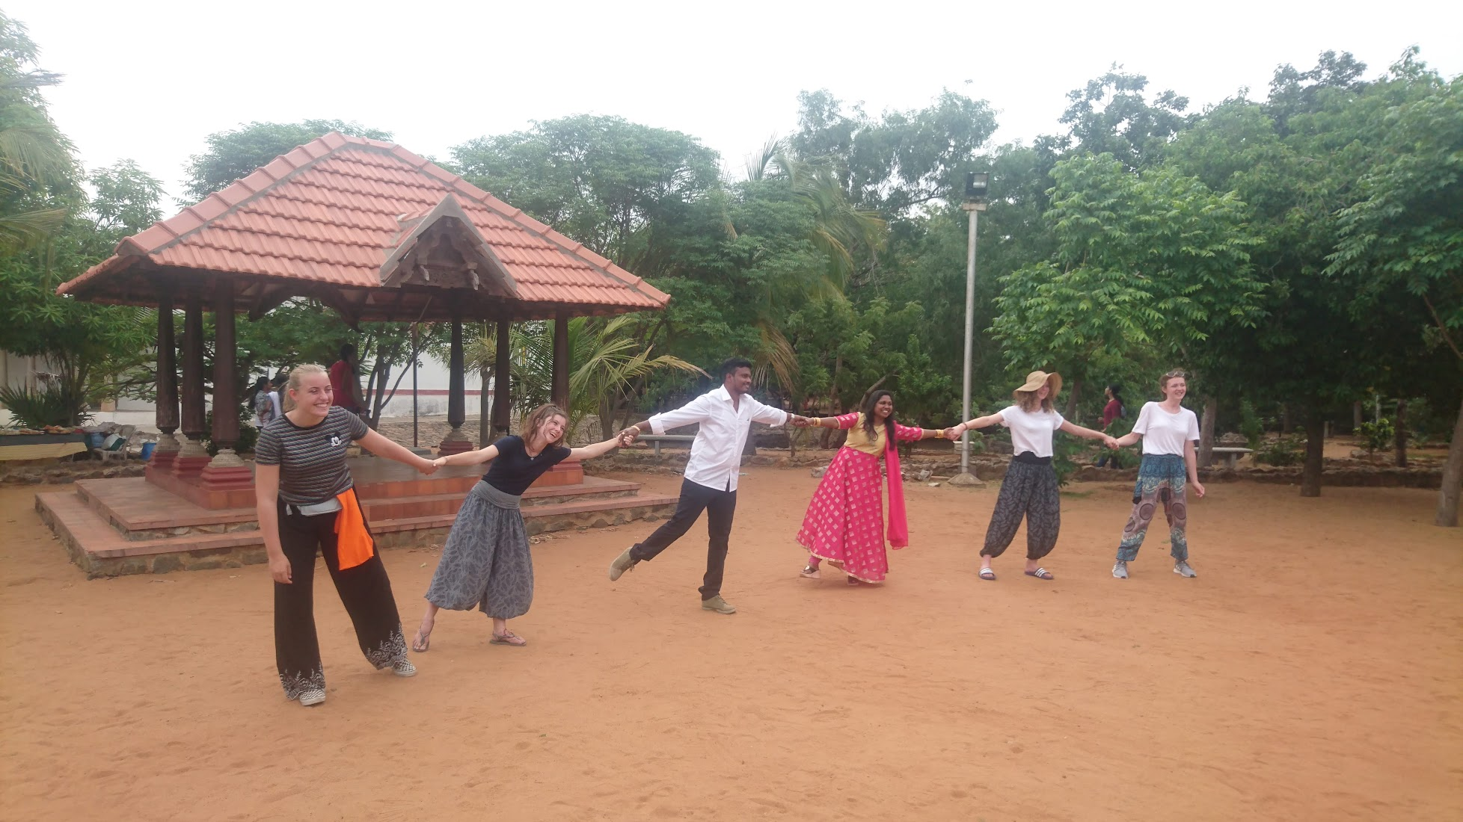
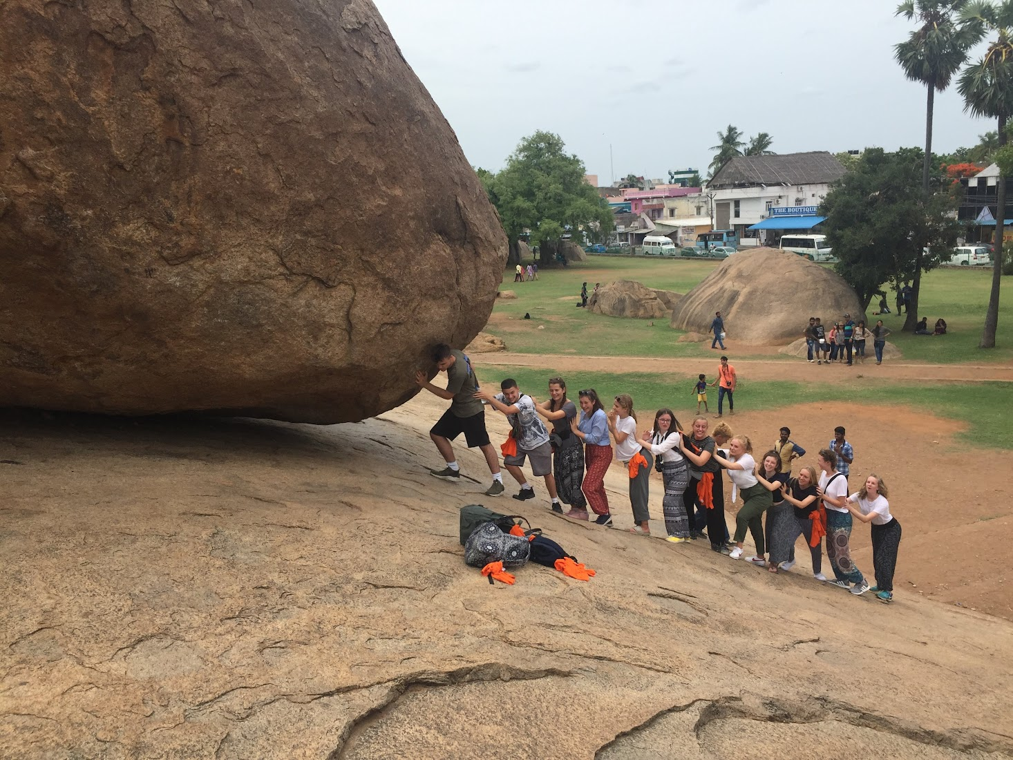

Slide 14

Kit List
Other
Any medication (labelled)
Day pack/small rucksack
Suncream (SPF 30 minimum, 50 is preferable)
After sun cream/gel
Toiletries
Anti-bac gel
Spending money (in cash, GBP)
Eye mask
Plug adapter (three pin – see photo)
Camera
Chargers
Portable battery packs
Watch/alarm clock
Money belt
Paracetamol, hayfever relief, Imodium and plasters
Travel sickness tablets
Evidence of vaccinations

Slide 15
Visa Applications
You will need:
Scanned Bio Page of the passport showing the Photograph and Details
Photo with below:
  Format - JPEG
  Size
    Minimum 10 KB
    Maximum 1 MB
  The height and width of the Photo must be equal.
  Photo should present full face, front view, eyes open and without spectacles
  Center head within frame and present full head from top of hair to bottom of chin
  Background should be plain light colored or white background.
  No shadows on the face or on the background.
  Without borders.

Slide 16
Visa Applications
You wont be able to apply until Friday 13th June (30 days before arrival). Please do this ASAP from this date
You will make your application at: https://indianvisaonline.gov.in/evisa/tvoa.html
You will be applying for a 30 day e-Tourist visa
Further details are needed are in the information booklet
When you have been granted your e-Visa and sent the documentation, please send to Anna Ludnow aludnow@downlands.org by Monday 30th June.

Slide 17
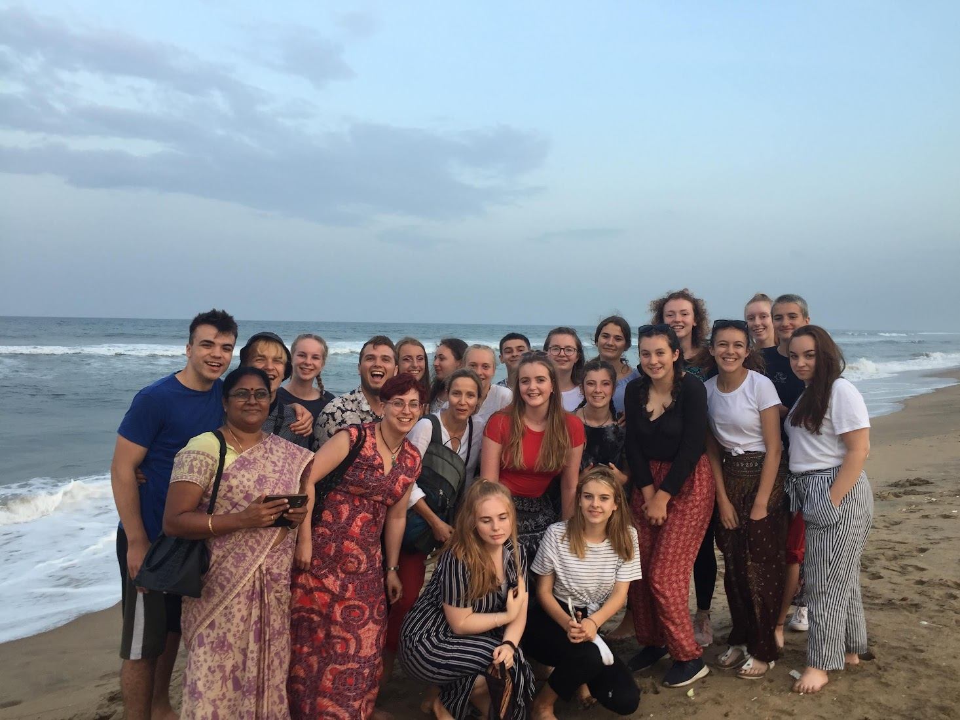
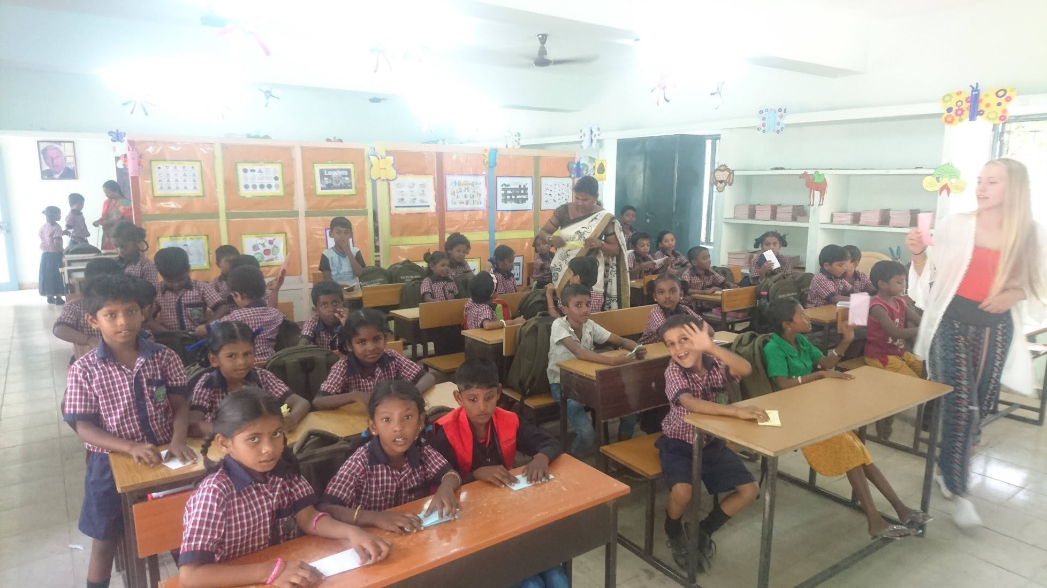
Consent forms
Swimming consent form – leave at end of meeting
Permission to travel form – by Friday 30th June to Mr Smith or Trips Office.

Slide 18
Medication
Students should not bring any medication with them. We will travel with a stock of paracetamol, ibuprofen, antihistamine, Kwells and Imodium Instants. You must given permission for us to administer these.
If your child must take another over-the-counter or prescription medication. This must be handed into staff before departure.
If you do not complete the survey in your booklet, we will not be able to administer any medication.

Slide 19
Sun Cream & Insect Repellant

Slide 20
Passports & GHIC
Passports can start being bought into school from tomorrow (Friday 13th June). They must be in school by Monday 30th June.
Please hand them in to the Trips Office or Mr Smith.

Slide 21
Spending money
All meals and excursions are included, however your child may need a small amount of spending money for shopping. Products are cheap, so no more than £150 (depending on how many gifts they need to buy!)
Indian rupees are a closed currency, so they will need to bring this spending money in cash (GBP). We will then arrange for a currency exchange to come to the hotel and exchange this cash.

Slide 22
Rules & Expectations
We are a team, we will work as team. I expect kindness from everyone always.
Show respect to Indian teachers, hotel staff and drivers at all times.
Listen to staff about dress-code and sun protection. This is not because we are cramping your style, it is for your own safety.
Listen to staff when we are moving, especially on foot. The roads can be chaotic so we need to absolutely trust you.
Only use the swimming pool area when supervised.
If something is making you uncomfortable, please tell us.

Slide 23
Indian Culture
Expect people to stare and take photos of you. But ask permission before you take a photo of someone.
Be mindful of blasphemy and swearing (Oh my God etc.)
Be water conscious. Only drink bottle water and be mindful in pool/showers.
Be prepared to eat with your right hand. You must always wash hands before eating.
Remove your shoes before entering most rooms. Follow what others are doing.
Do not wait to start eating and do not feel obliged to always finish a meal.

Slide 24
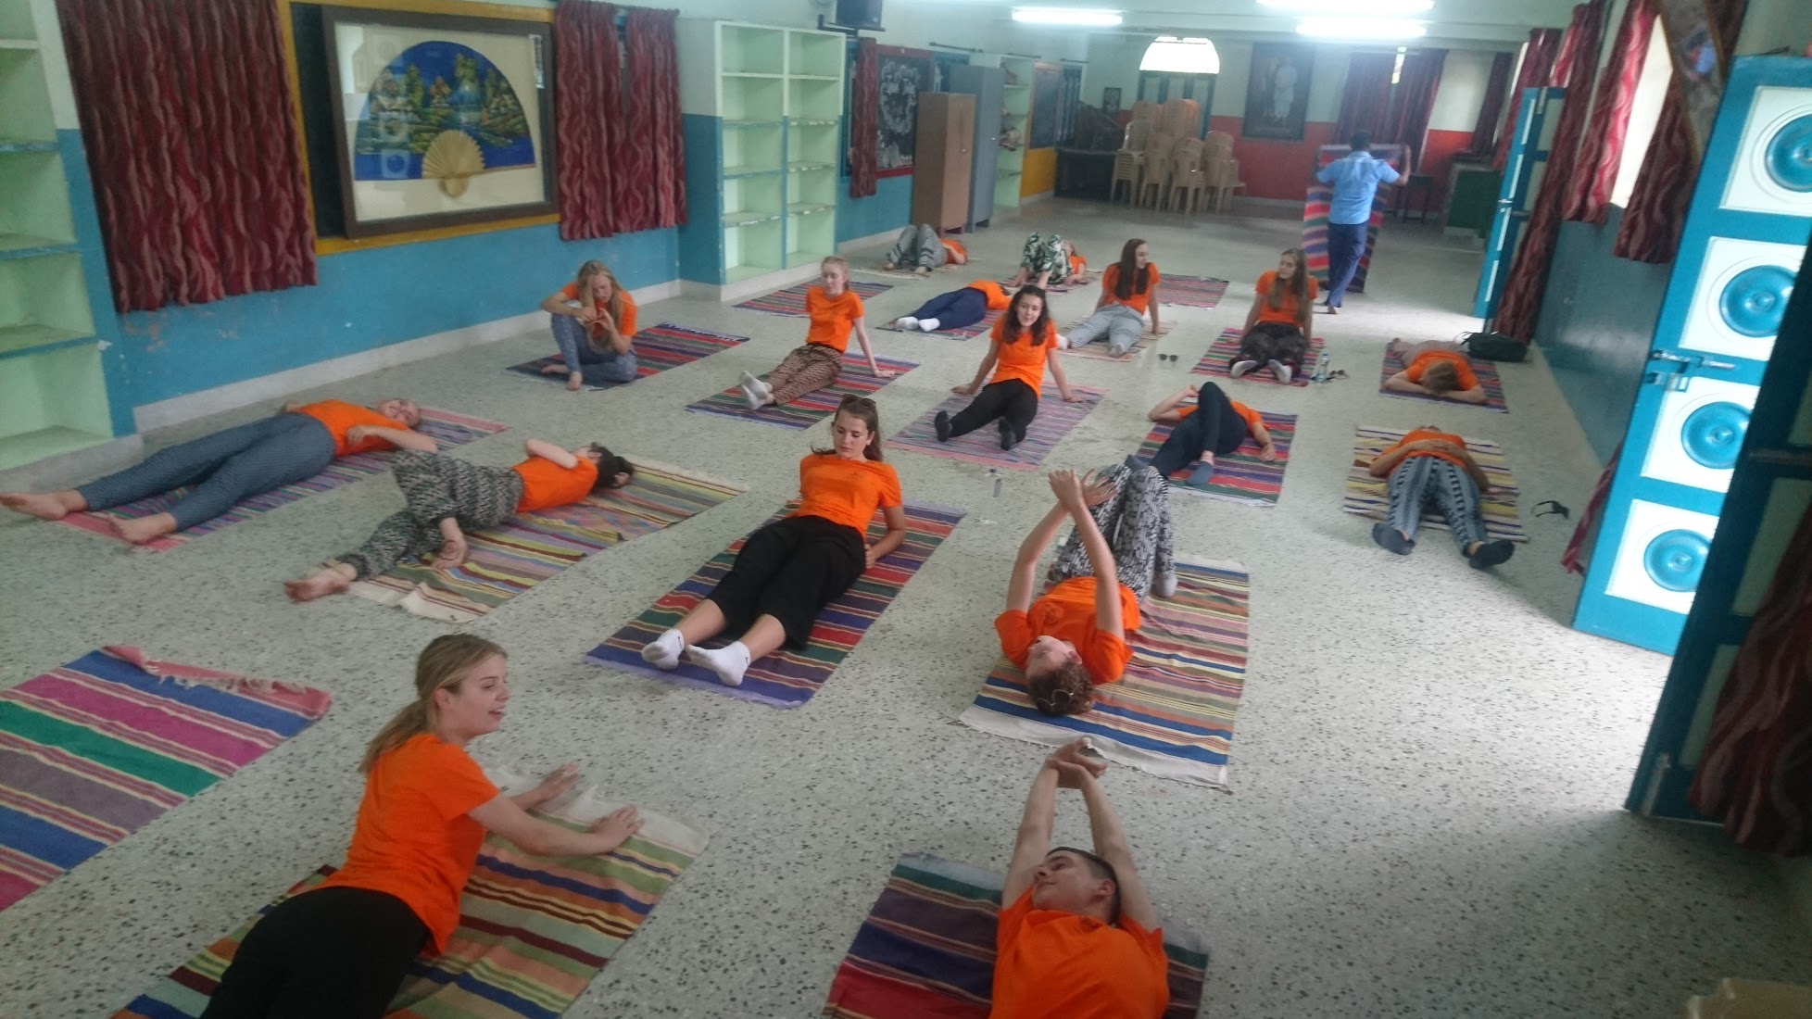
Any questions?

