Slide 1

Year 9 – Character Passport Trip
France 2026

Slide 2
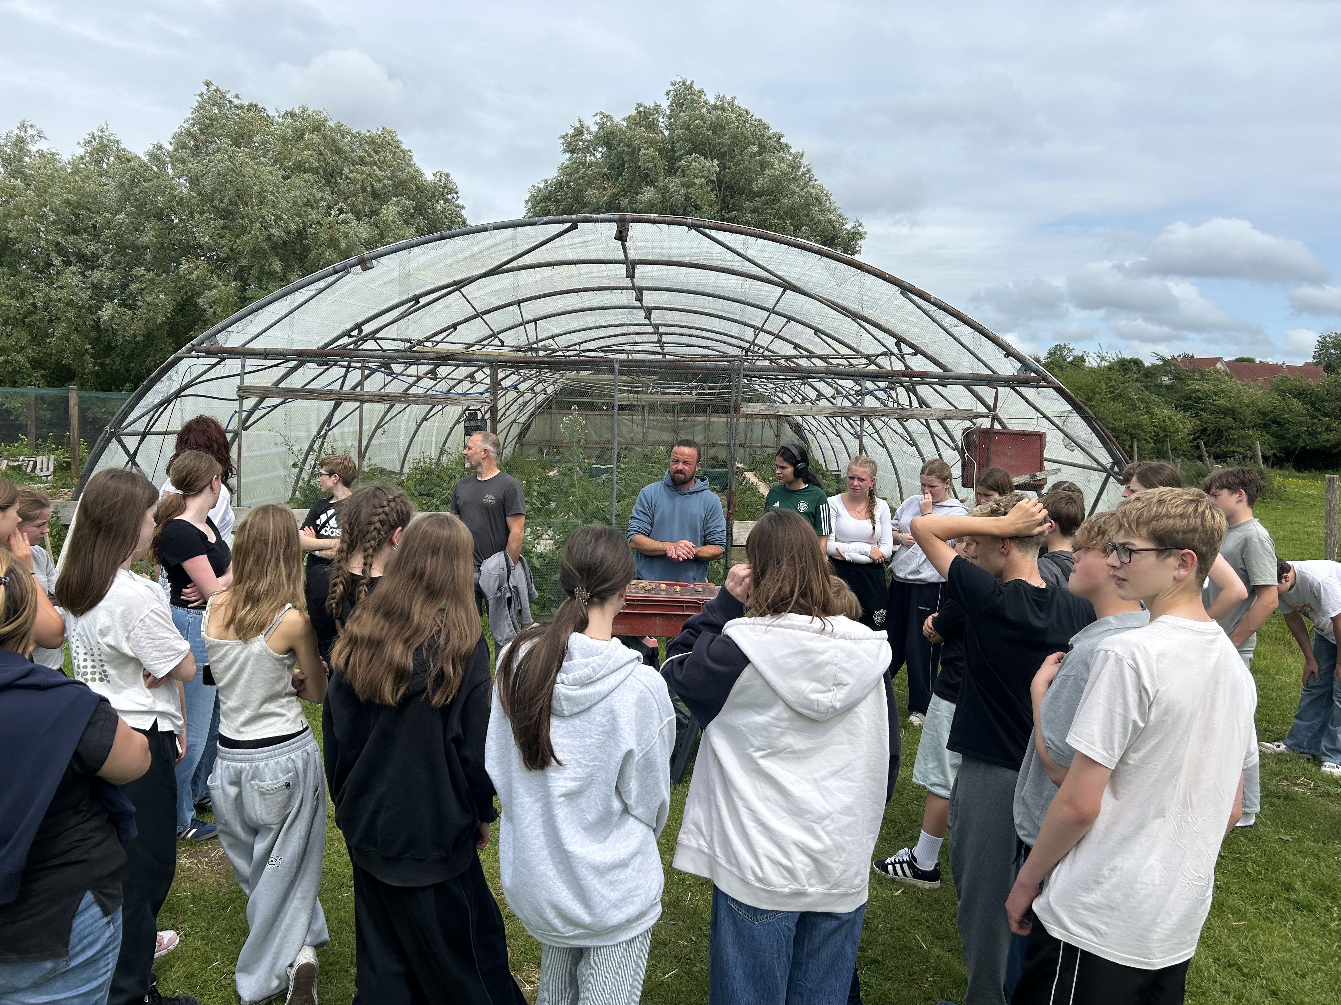
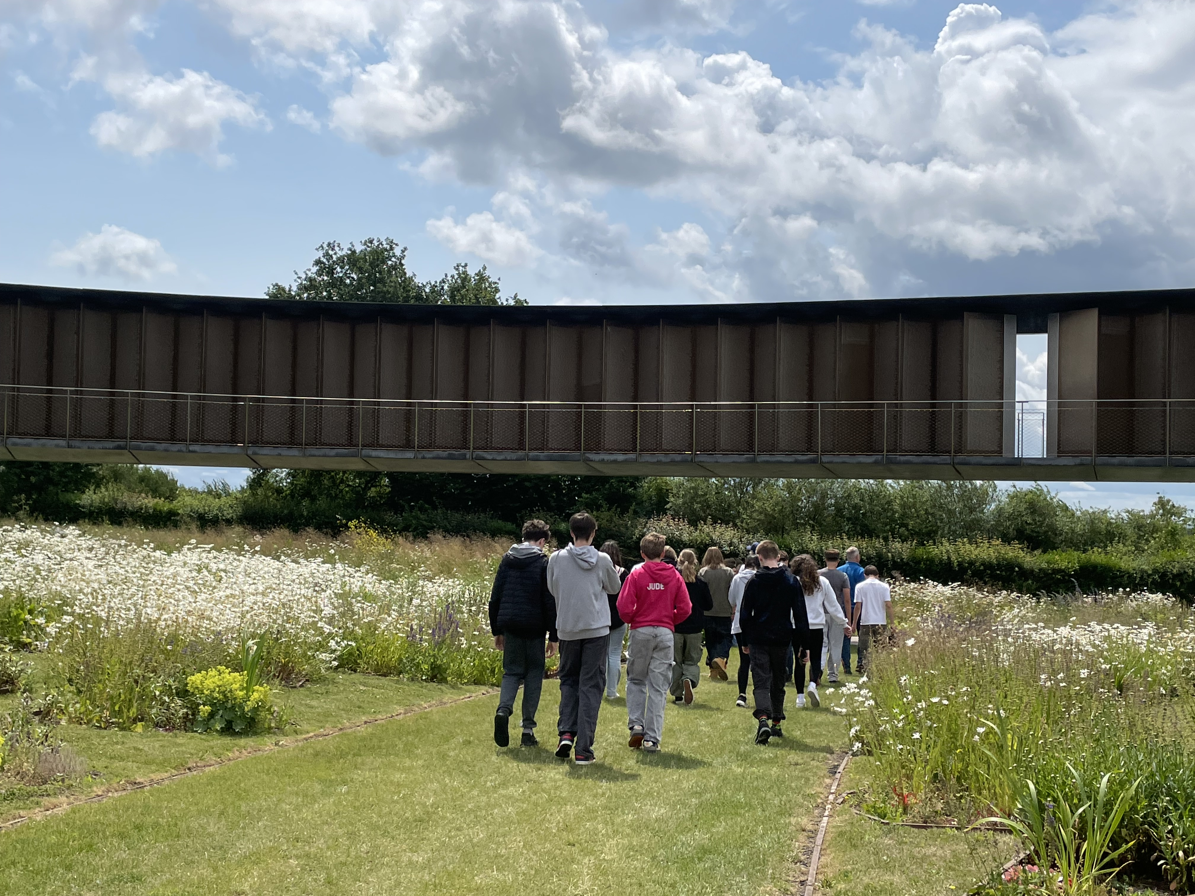
What?
Students will have a choice of either:
Opal Coast or Somme

Slide 3
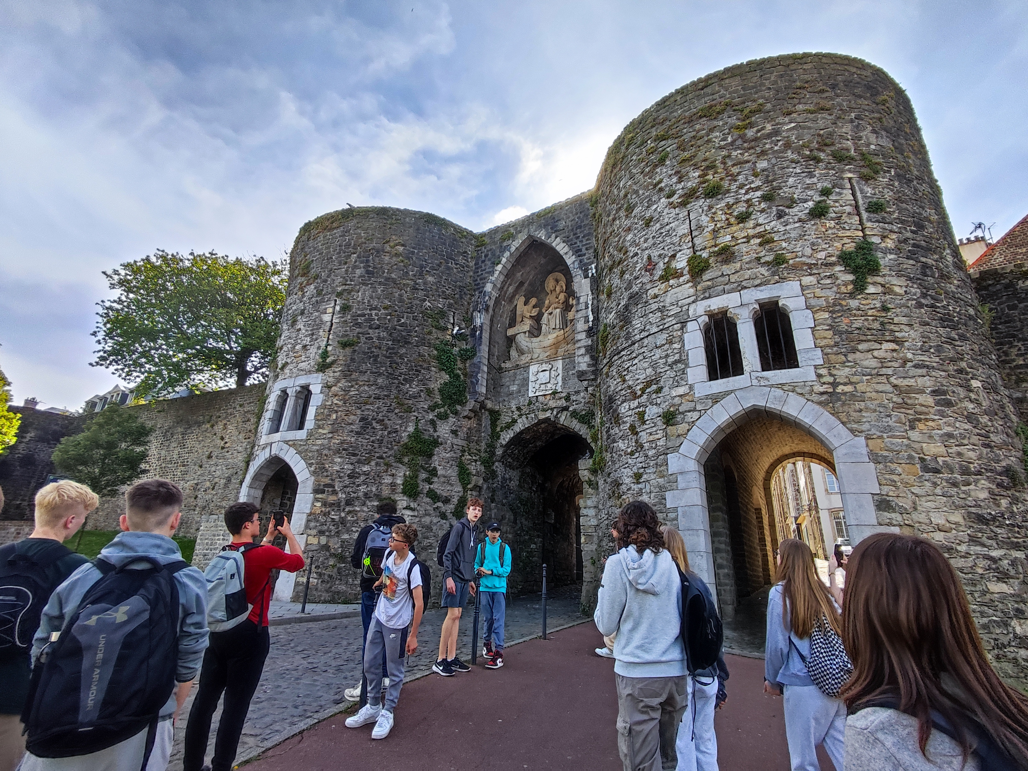
Opal Coast
A short hop across the channel The Opal Coast is an ideal region for first time visitors to France. Located between Calais and Boulogne-sur-Mer, in the north west of France, the Opal Coast is renowned for picture postcard settings that are rich in tradition and history.
Throughout the trip, students will be able to:
  Practice French at the Le Touquet Farmers Market;
  Discover how chocolates are made at a small manufacturer
  Visit a local snail farm, including tasting
  Visit the sea lions, penguins and other marine species at Nausicaa Sea Centre.
  Spend time in Boulogne Old Town and on the beach.

Slide 4
Opal Coast
This trip is perfect for:
Students who are studying French.
Students who are interested in different cuisines.
Students who are interested in marine life
Students who would like to explore a different culture.
I wasn’t sure what to expect from 48 hours in a part of France I’d never heard of. However this trip was so much fun and it was brilliant to spend time with my tutor group. A highlight was the huge aquarium tank with manta-rays and penguins. I also loved playing volley ball on the beach!
A current Year 10 student (2025)

Slide 5
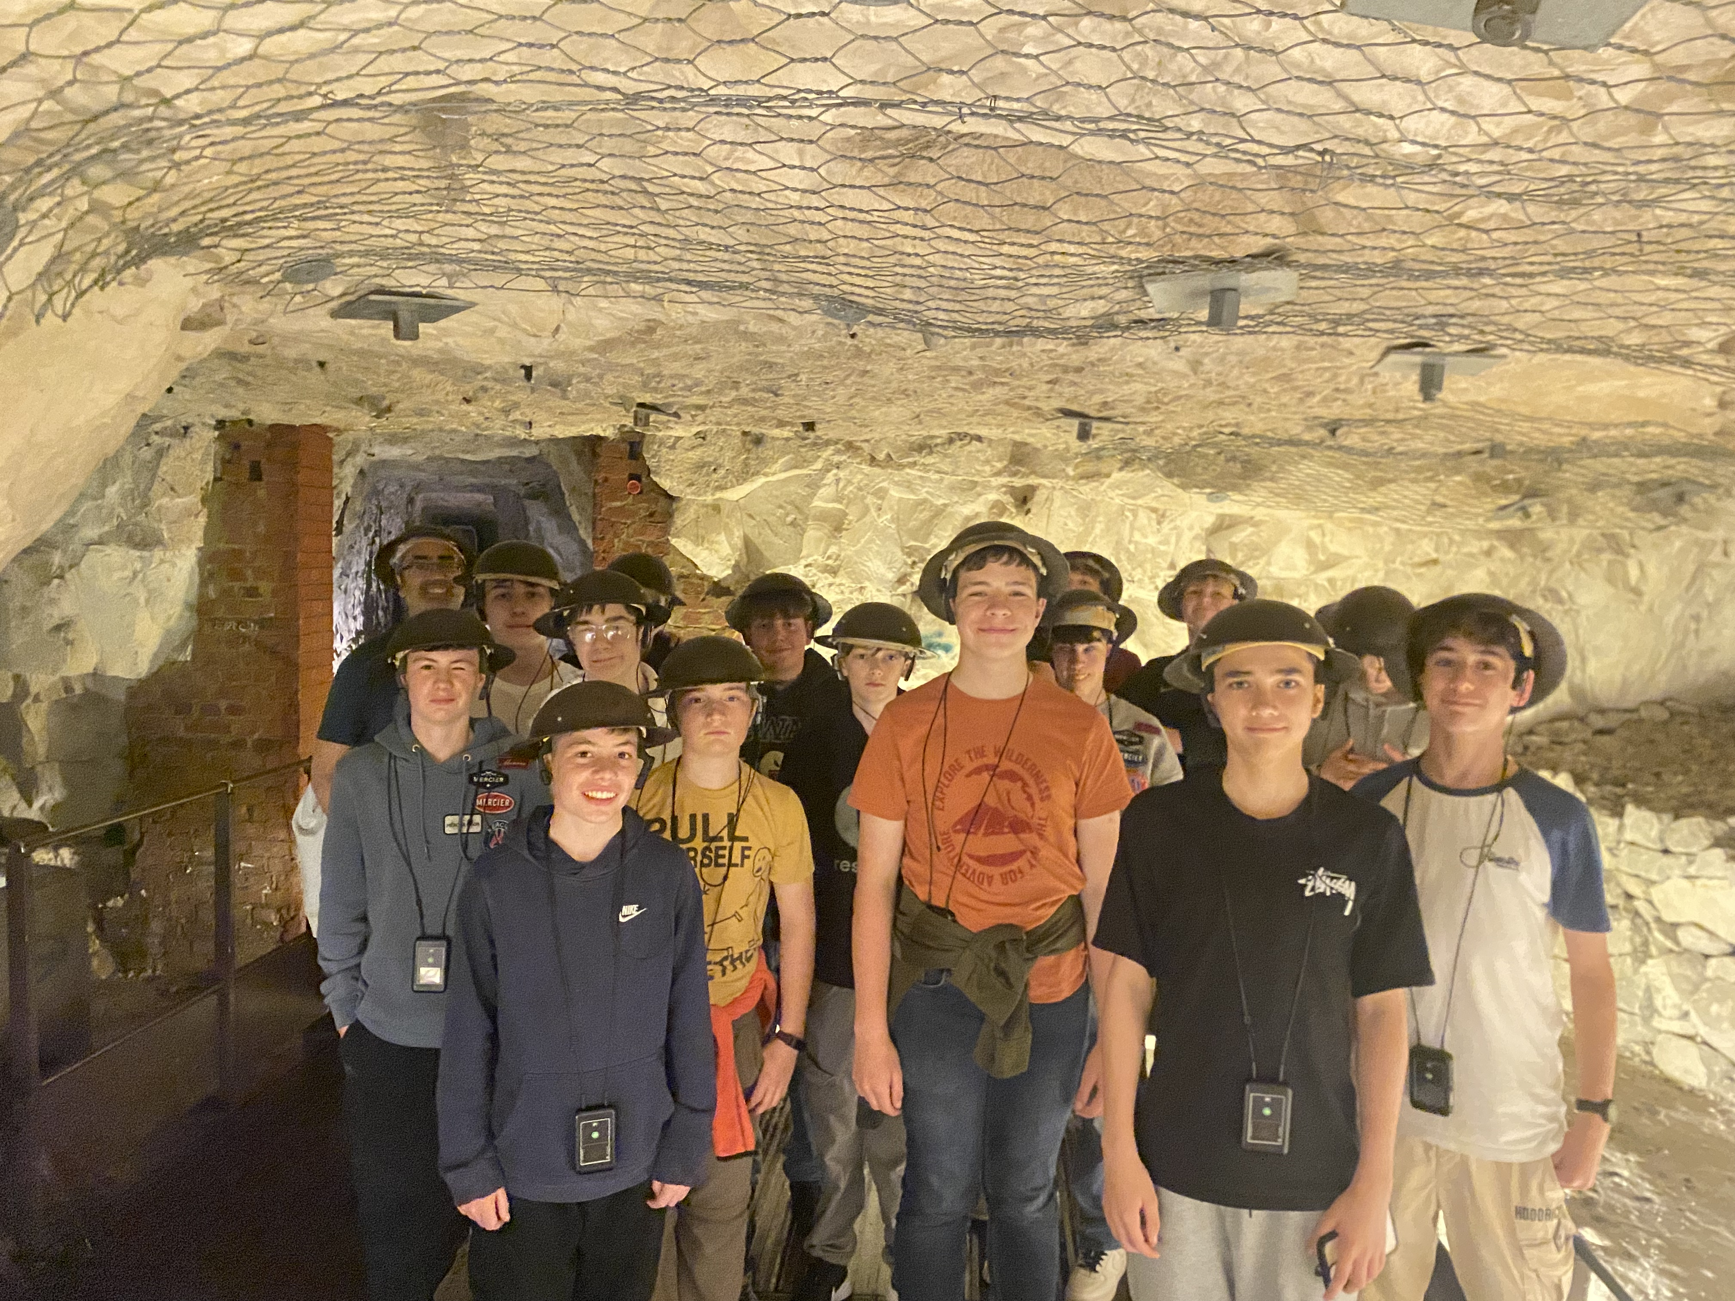
Somme
Students will have the opportunity to see many different exciting aspects of the First World War.
They will be able to explore and walk through actual trenches to get a sense of the conditions.
Students will put on their steel 'Tommy' helmets and go underground into the Arras Tunnels which were built and used by the soldiers. We will walk around the Lochnager Crater the biggest, manmade explosion in human history up to that point!
There will also be an opportunity to explore French culture through a visit to a farmers market.

Slide 6
The Somme
This trip is perfect for:
Students who are considering studying GCSE History.
Students who are interested in different cuisines.
Students who are interested in real life stories.
Students who would like to explore a different culture.
As someone who didn’t go on to study GCSE History, I still found this trip so interesting and fun! Our guide was brilliant and told us lots of real-life stories. A highlight was travelling through the French countryside and exploring the different trench systems.
A current Year 10 student (2025)

Slide 7
When?
Friday 12th to Saturday 13th June 2026.
We will depart between 3am and 4am on Friday and return around 8pm on Saturday
But don’t worry about the early start…. It’s a jam packed 48 hours and there is time for naps on the coach!

Slide 8
Who?
Opal Coast:
Students will be travelling with their tutor groups. There is likely to be 2-3 tutor groups per coach however we cannot confirm who until we have final numbers.
Two coaches will be staying at each hotel and students will be able to mix tutor groups for their rooms.
The Somme:
Students will be travelling on a mixed coach/es for this trip.
All students will be staying in the same hotel so can request to share with whomever they like.

Slide 9
How?
Sign up at this link by 9am Friday 12th September.
Once you have submitted your response, please log on to SCOPAY and pay the non-refundable deposit.
REMEMBER TO SIGN UP AND PAY THE DEPOSIT IN ORDER TO CONFIRM YOUR CHILD’S PLACE
The total cost of these trips are £285. (£75 for pupil premium students)
However, we do not want cost to be barrier.
Last year we had 90% of the year group on one of these trips and we would like to be able to do the same again. If cost is a problem, please contact Mr M Smith on msmith@downlands.org in confidence. Mr Smith will respond once term has begun.

