Slide 1

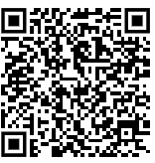


Would you like to be alerted about our latest apprenticeship vacancies?
Sign up to our mailing list at www.rewardstraining.co.uk/become-an-apprentice
Keep Me Informed

