Slide 1

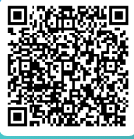
Parents Information Evening
Tuesday 10th March
Itinerary
Kit List
Luggage & Luggage Tags
Medication
Spending money
Rules
Insurance/Personal Possessions
Groups/rooms
Hoodie
Whilst you’re waiting, you could fill in the final information survey!

Slide 2
Staff
Mr M Smith: Group Leader
Miss Groves
Mr Calvert
Ms Corcoran
Ms Xenou
Miss Chiocca
Mr Walker

Slide 3
EMERGENCY CONTACT
07592 491377
I won’t be able to check the phone constantly, but will check it first thing in the morning and when we return to the hotel in the evening.

Slide 4

Follow for updates…
@Downlands_GEOG

Slide 5
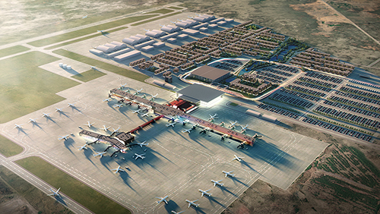
Departure Time
SATURDAY 28th MARCH
11:30 Meet at Gatwick North Terminal
12:10 Check in at London Gatwick
14:40 Flight departs LGW – Iceland Air FI471
17:55 Arrive at Keflavik International Airport
20:30 Check in to Hotel Hvolsvollur
21:30 Dinner at hotel

Slide 6
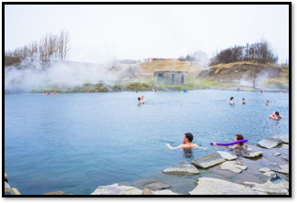
Sunday 29th March
07:45 Breakfast and depart hotel
10:00 Secret Lagoon
All swimmers are required to shower, without swimming costume, before entering the swimming pool. Please ensure all students are aware of this. This is for sanitation reasons and Secret Lagoon has separate communal showers for males and females.

Slide 7
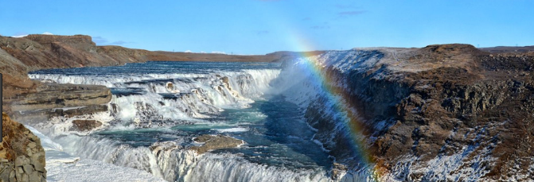
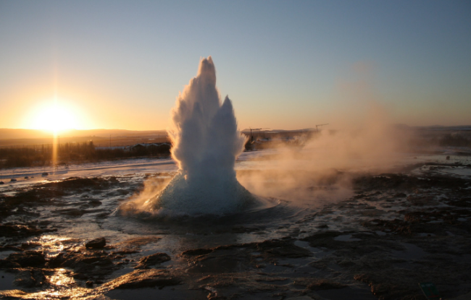
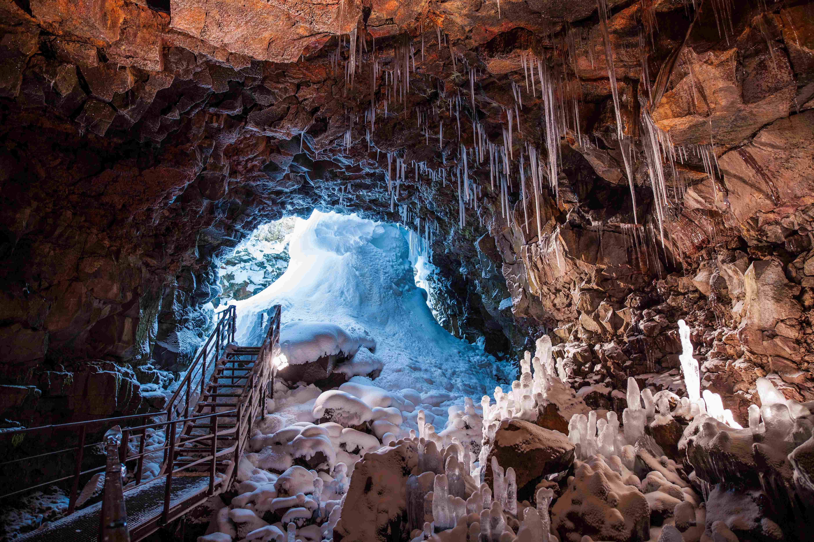
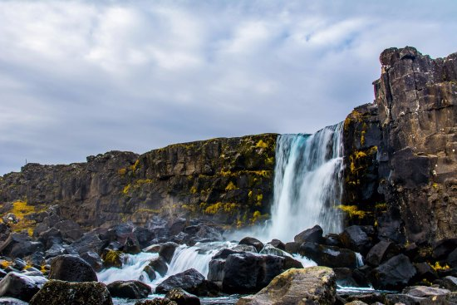
Sunday 29th March
Great Geysir
Gullfoss Waterfalls
Golden Circle Tour
Pingvellir National Park
Lava Cave

Slide 8
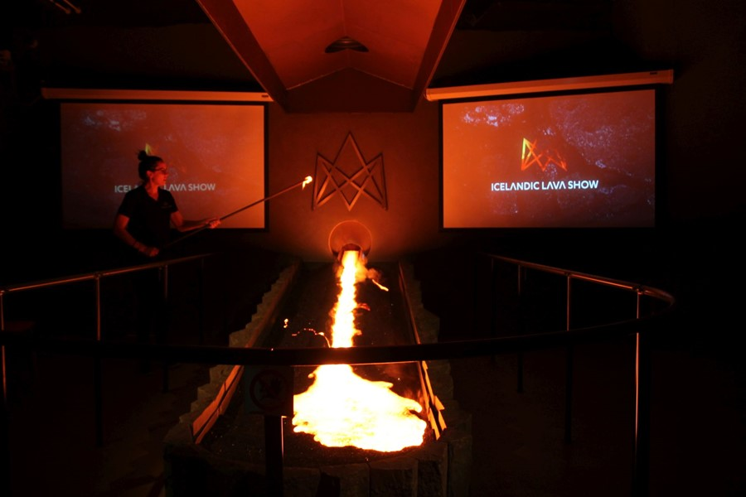
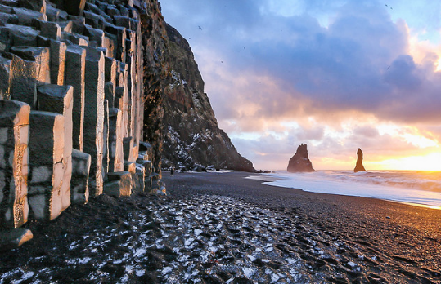
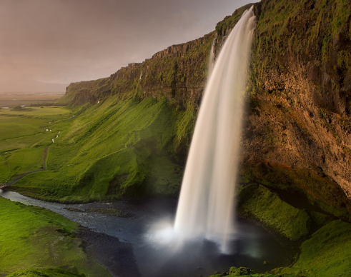
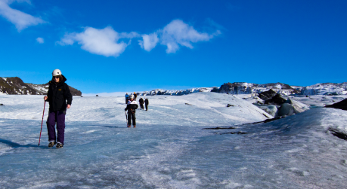
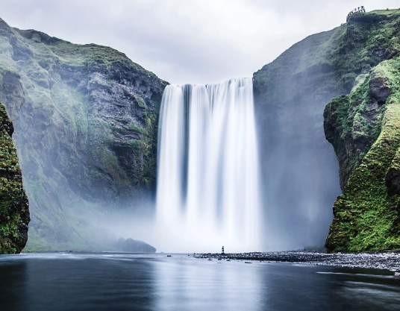
Monday 30th March
Exploring the South Coast
Lava Show
Seljalandsfoss waterfall
Solheimajokull Glacier
Skogar waterfall

Slide 9
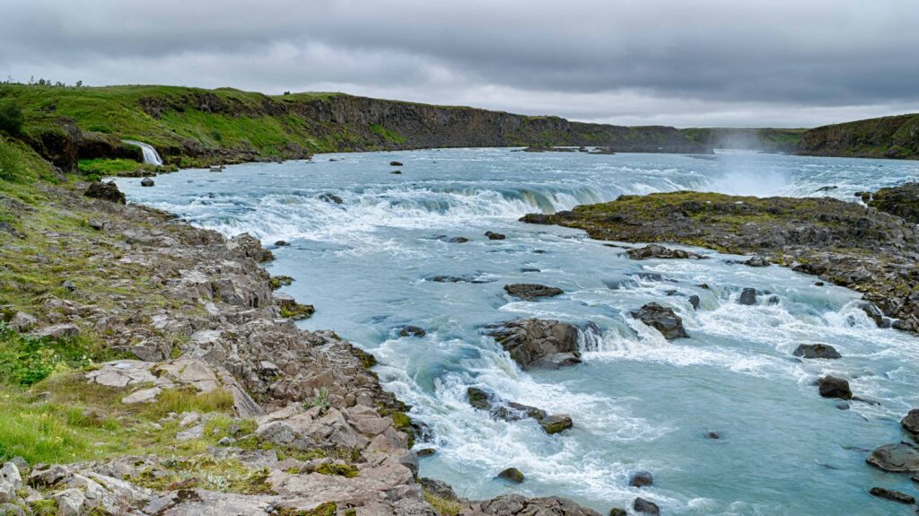
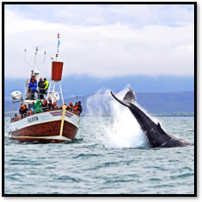
Tuesday 31st March
09:30 Check out of Hotel Hvollsvollur
10:30 Urridafoss Waterfall
13:00 Whale Watching
16:00 Free time in Reykjavik
18:15 Flyover Iceland
20:00 Dinner at Hamburger Factory
22:00 Check in to Hotel Vellir

Slide 10
Wednesday 1st April
06:00 Breakfast in hotel
07:15 Check out of Hotel Vellir
08:00 Check in at Keflavik Airport
10:30 Depart on Icelandair Flight FI472
14:40 Arrive at LGW North Terminal
15:30 Collect your child from Gatwick North Terminal

Slide 11
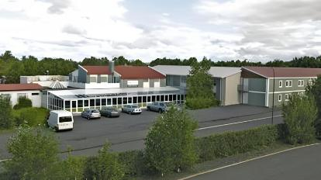
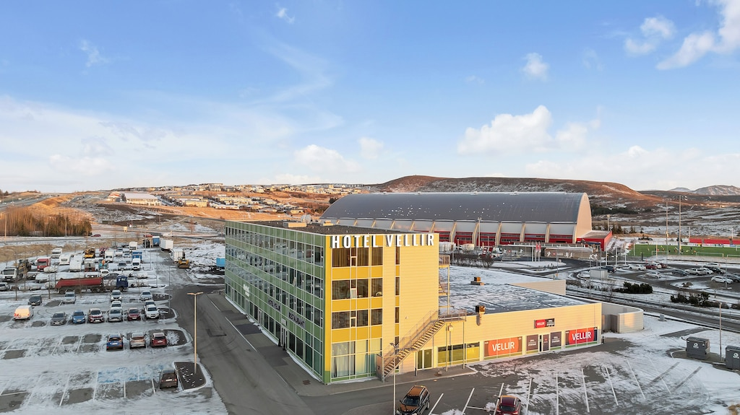
Hotel Information
Tuesday-Wednesday
Hotel Vellir
Saturday-Tuesday
Hotel Hvollsvollur
Both 3* accommodation
All accommodation has breakfast included, WiFi, telephones, safes & communal spaces.

Slide 12

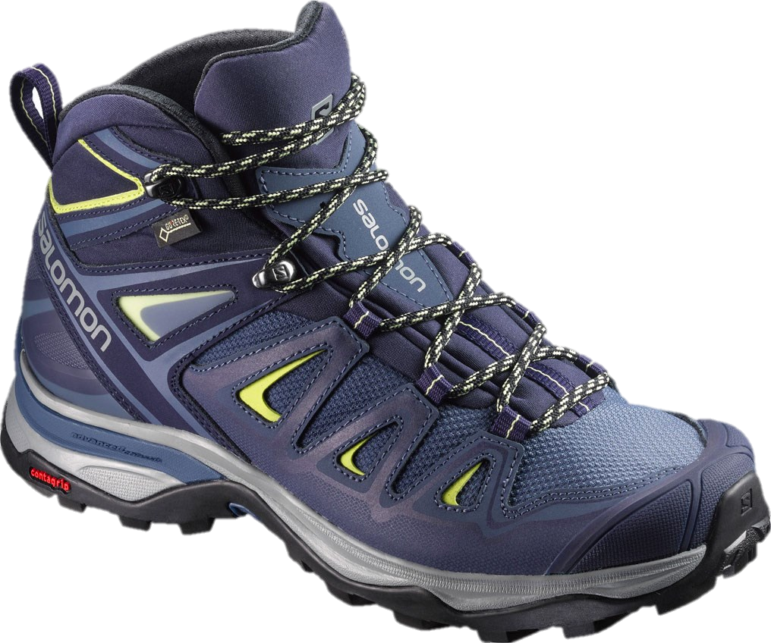
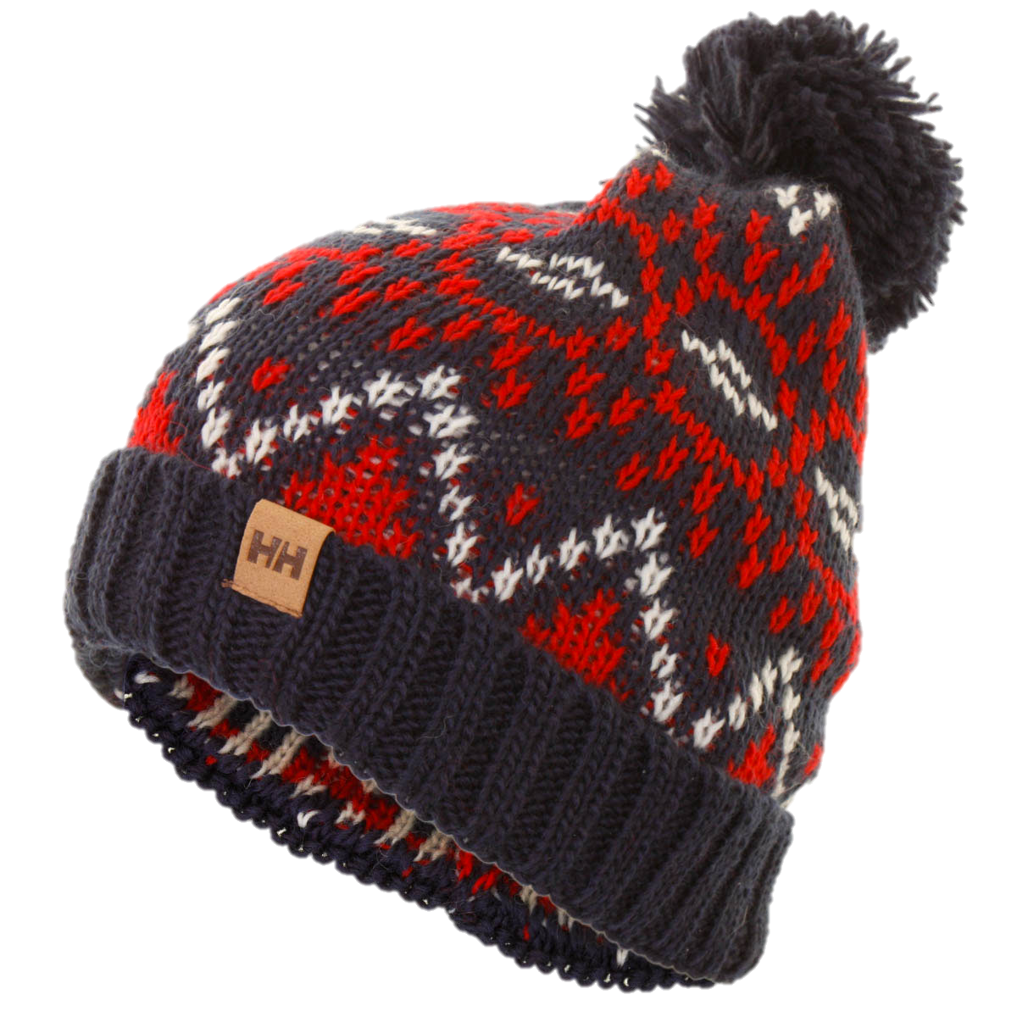
Kit List
Clothing
Sturdy walking boots/trainers with firm grip – footwear should be water resistant
Indoor shoes
Warm waterproof/wind resistant jacket (a good quality rain coat!)
Trousers (not jeans – except for the evening) – multiple sets
Long sleeved tops – to allow for layering
Water and wind proof over-trousers
Gloves (waterproof)
Scarf or snood
Wooly hat
Thick, warm socks (multiple)
Swim suit (please be respectful)
Changes of socks and underwear

Slide 13
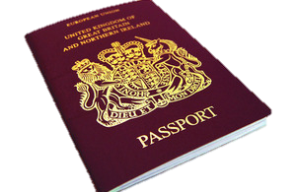
Kit List
Other
Passport & EHIC
A large towel
Day pack/small rucksack
Energy bars/snacks (food can be expensive)
Torch
Sunglasses
Re-usable water bottle
Plastic bags for wet items
Lunch box
Toiletries

Slide 14

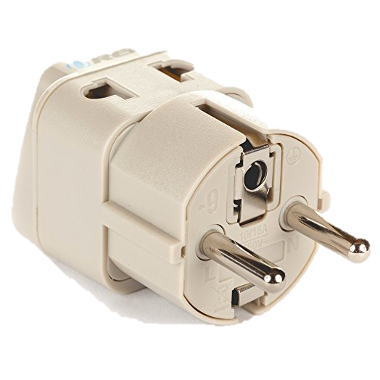

Kit List
Optional
Spending money
Sleeping mask
Books/magazines
Plug adapter
Camera
Chargers
Portable battery packs
Watch/alarm clock
Money belt

Slide 15
Passports
Pupils are to bring their passports in from Monday 9th March and bring them to the Finance Office.
We will then keep them in a safe until we travel.
Passports must be at Downlands by Friday 20th March
Please check both the issue date and expiry date

Slide 16
Luggage
Your main piece of luggage must be clearly labeled and weigh no more than 23 kgs
You are allowed two pieces of hand luggage:
  Small case (10kg): 55x40x20 cm
  Small personal bag (handbag/camera bag/small rucksack)
You are only allowed to take a small quantity of liquid in you hand luggage. These must be in individual containers with a maximum capacity of 100mm each and must fit into a clear plastic bag

Slide 17
Medication
Students should not carry any medication with them at any time. We will be travelling with a school stock of paracetamol, ibuprofen and Kwells Travel Sickness tablets. We will shortly be sending out a medication survey for you to complete giving consent for us to administer these. If you do not complete this survey, we will be unable to administer any medication to your child.
All other medication (including prescription medication), will need to be handed in to school reception by 3pm on the 27th March. It should be labelled, in it’s original container and with any prescription notes attached.

Slide 18
Money
Pupils will need a small amount of money for the trip.
They will be responsible for buying two of their lunches on the first and last day at the airports.
They may also want a small amount for extra snacks/souvenirs
Things are expensive in Iceland, it is estimated that the cost of living is 50% more than London!
I recommend no more than £100, but £50 would be more than enough!

Slide 19

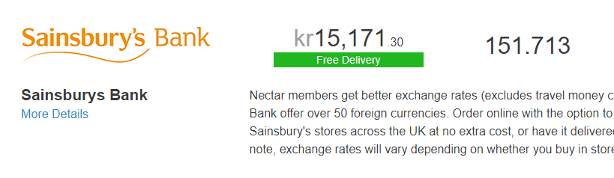

Money
Icelandic Krona
£1 = 150 Krona…
Easily accesible from most foreign exchange, but booking advised!

Slide 20
Money
We will offer a bank system if you would prefer Miss Groves to look after your money!
Bring your spending money (krona not sterling) to Ms Corcoran before the end of the day on Monday 23rd March in a clearly marked envelope.
You will be issued with a receipt and sign for money each morning.

Slide 21
Personal Possessions
Our insurance policy only covers lost or damaged items up to £150 so we’d avoid bringing expensive electrical items.

Slide 22
Rules
School rules will apply as well as the law of Iceland
No alcohol is to be consumed on the trip
No smoking/use of electronic cigarettes are allowed
Staff will be conducting bag searches using school policy
Students are expected to be punctual and polite – staff have worked hard to plan this trip and it is their own time too!
Students will be expected to treat the hotel staff/tour guides in the same way that they would treat a member of school staff.
Parents will be expected to fund the early return of a student whose conduct gives serious cause for concern on a visit, as agreed on the behavior contracts you have signed.

Slide 23
Phones
Closely mirrors the school smart device policy.
Students can use their phones freely during all time travelling.
During meal times, meetings, guiding etc. phones should not be used.
Obviously, fine to take as many photos as necessary!
Phones can and will be confiscated for extended periods of time if mis-used.

Slide 24
Rooms and groups
I will not know our room allocation until a few weeks before we travel
I am expecting the hotel to be pairs/threes.
Students are going to be put into mixed muster groups, with a member of staff as their go-to.
Please complete the room choices survey, behaviour policy and insurance agreement by Friday 6th March

Slide 25
Any Questions?

