Slide 1
This powerpoint is to help with how to use Sparx for revision and to guide you when picking which level to work at.
For topics marked Red or Amber, students should begin at the lowest level, and begin at the introduce questions. They should move up a level once they have answered one or two questions correctly. They do not need to try any level 4 questions for this topic.
For topics marked Green, students should begin with the highest level (“deepen”) questions. However, if they are getting “deepen” questions incorrect — even after watching the video — they should move down to the “strengthen” questions.
At any level, if a student answers a question incorrectly, they should watch the accompanying video before attempting further questions.

Slide 2
Before you start your revision, make sure you have all the necessary equipment (your Maths book, a notebook, your whiteboard, a pen, a pencil, a calculator, etc) and that your phone has been turned off so that you don’t get distracted.

Slide 3
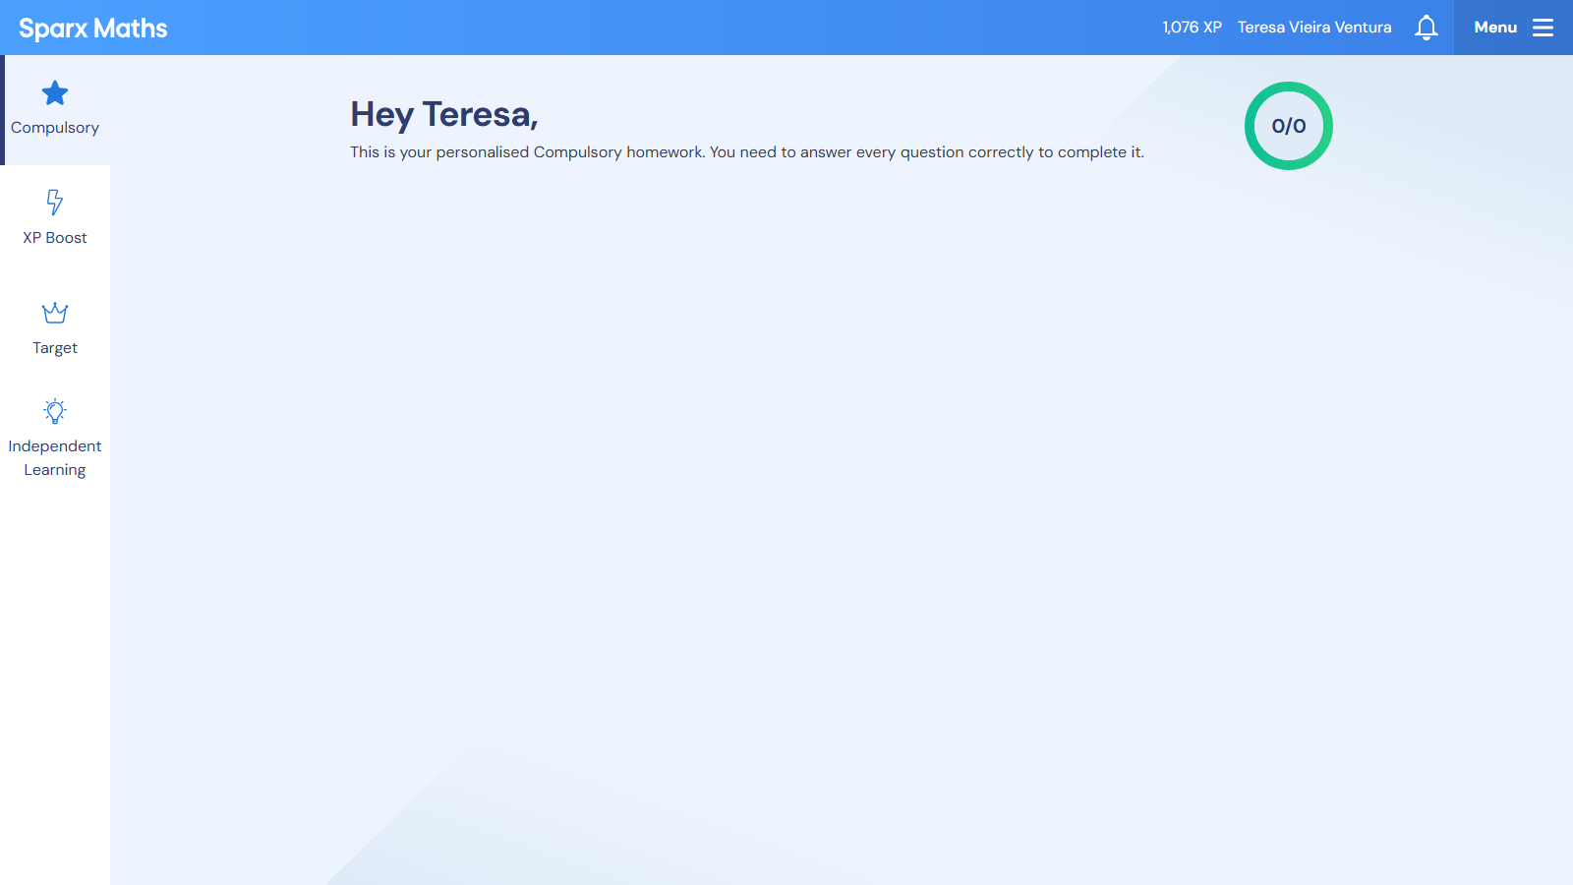

Slide 4
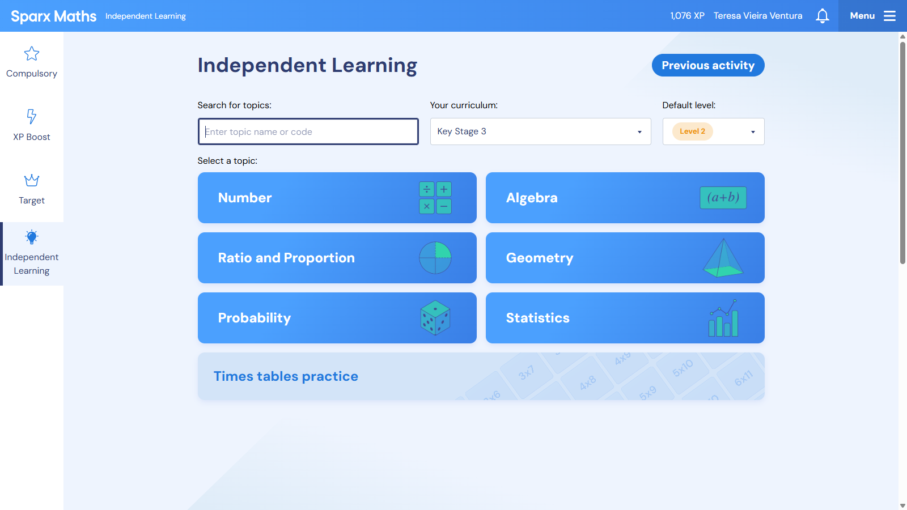
Type the code here

Slide 5
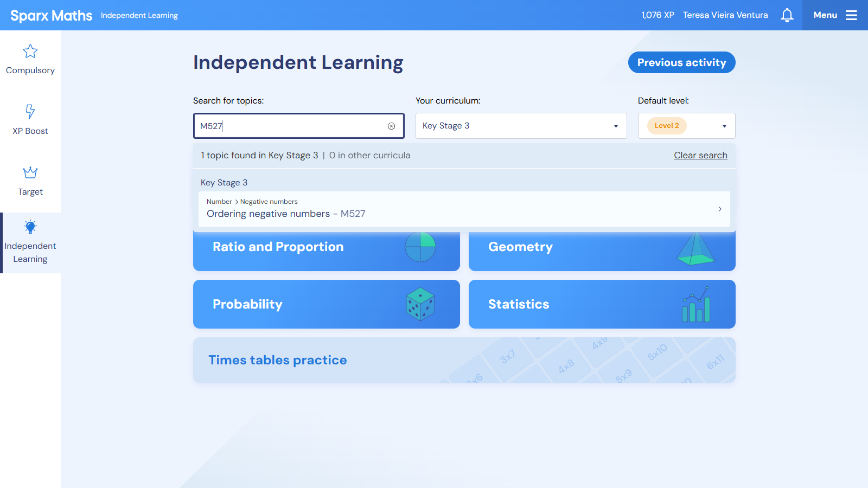

Slide 6
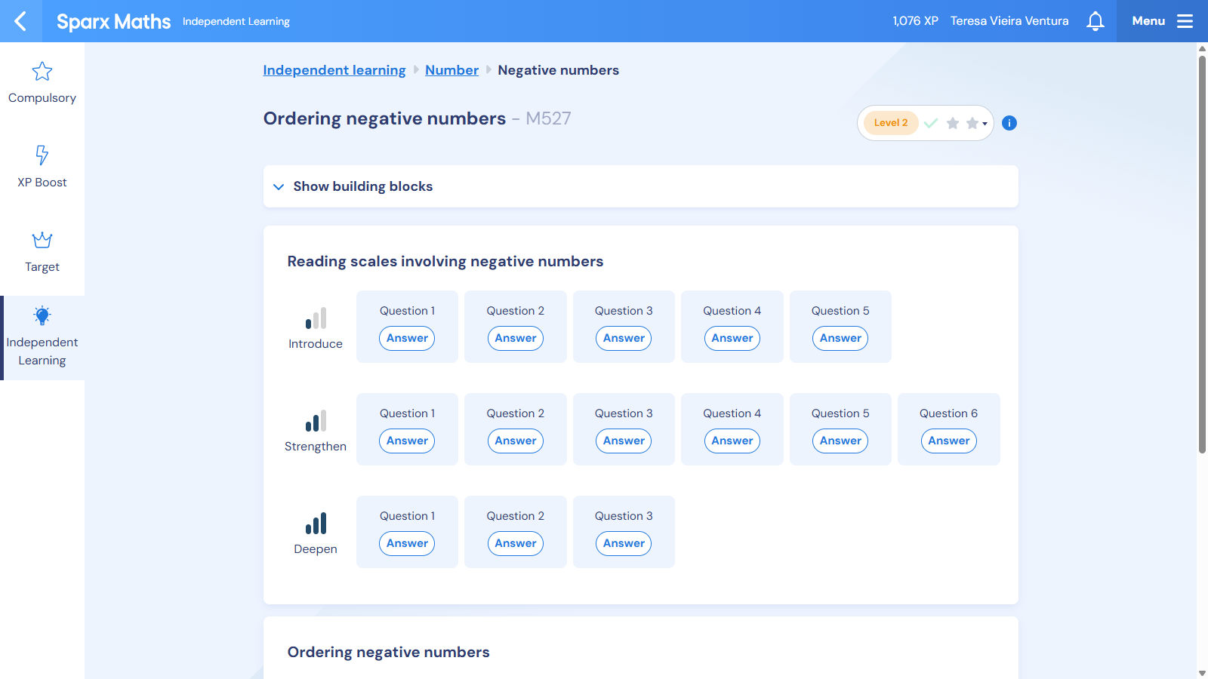
You can select a different level of challenge here
According to how confident you feel in each topic, decide the stage you want to start at.
You do not need to write the bookwork codes.

