Slide 1
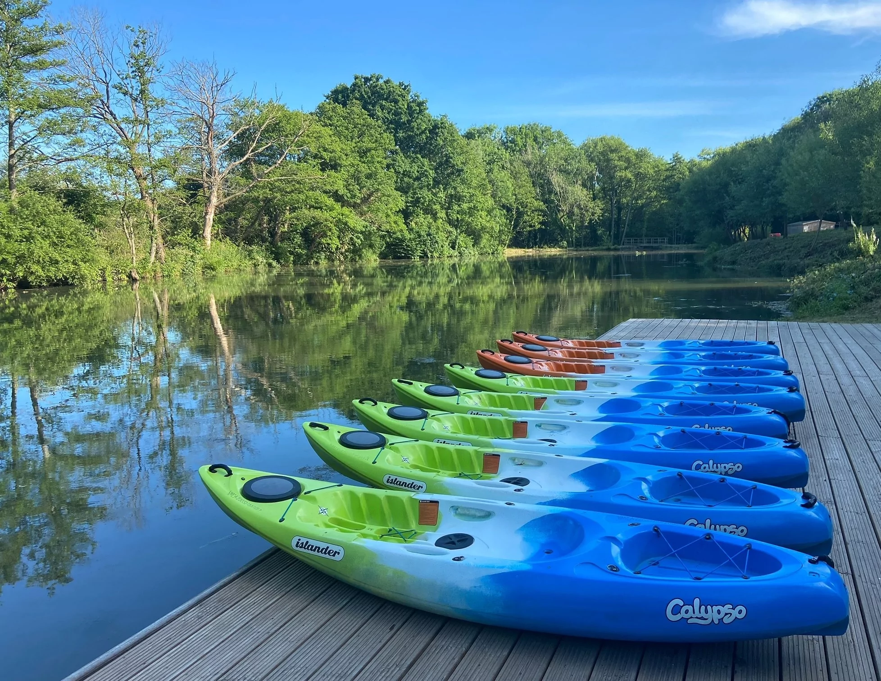
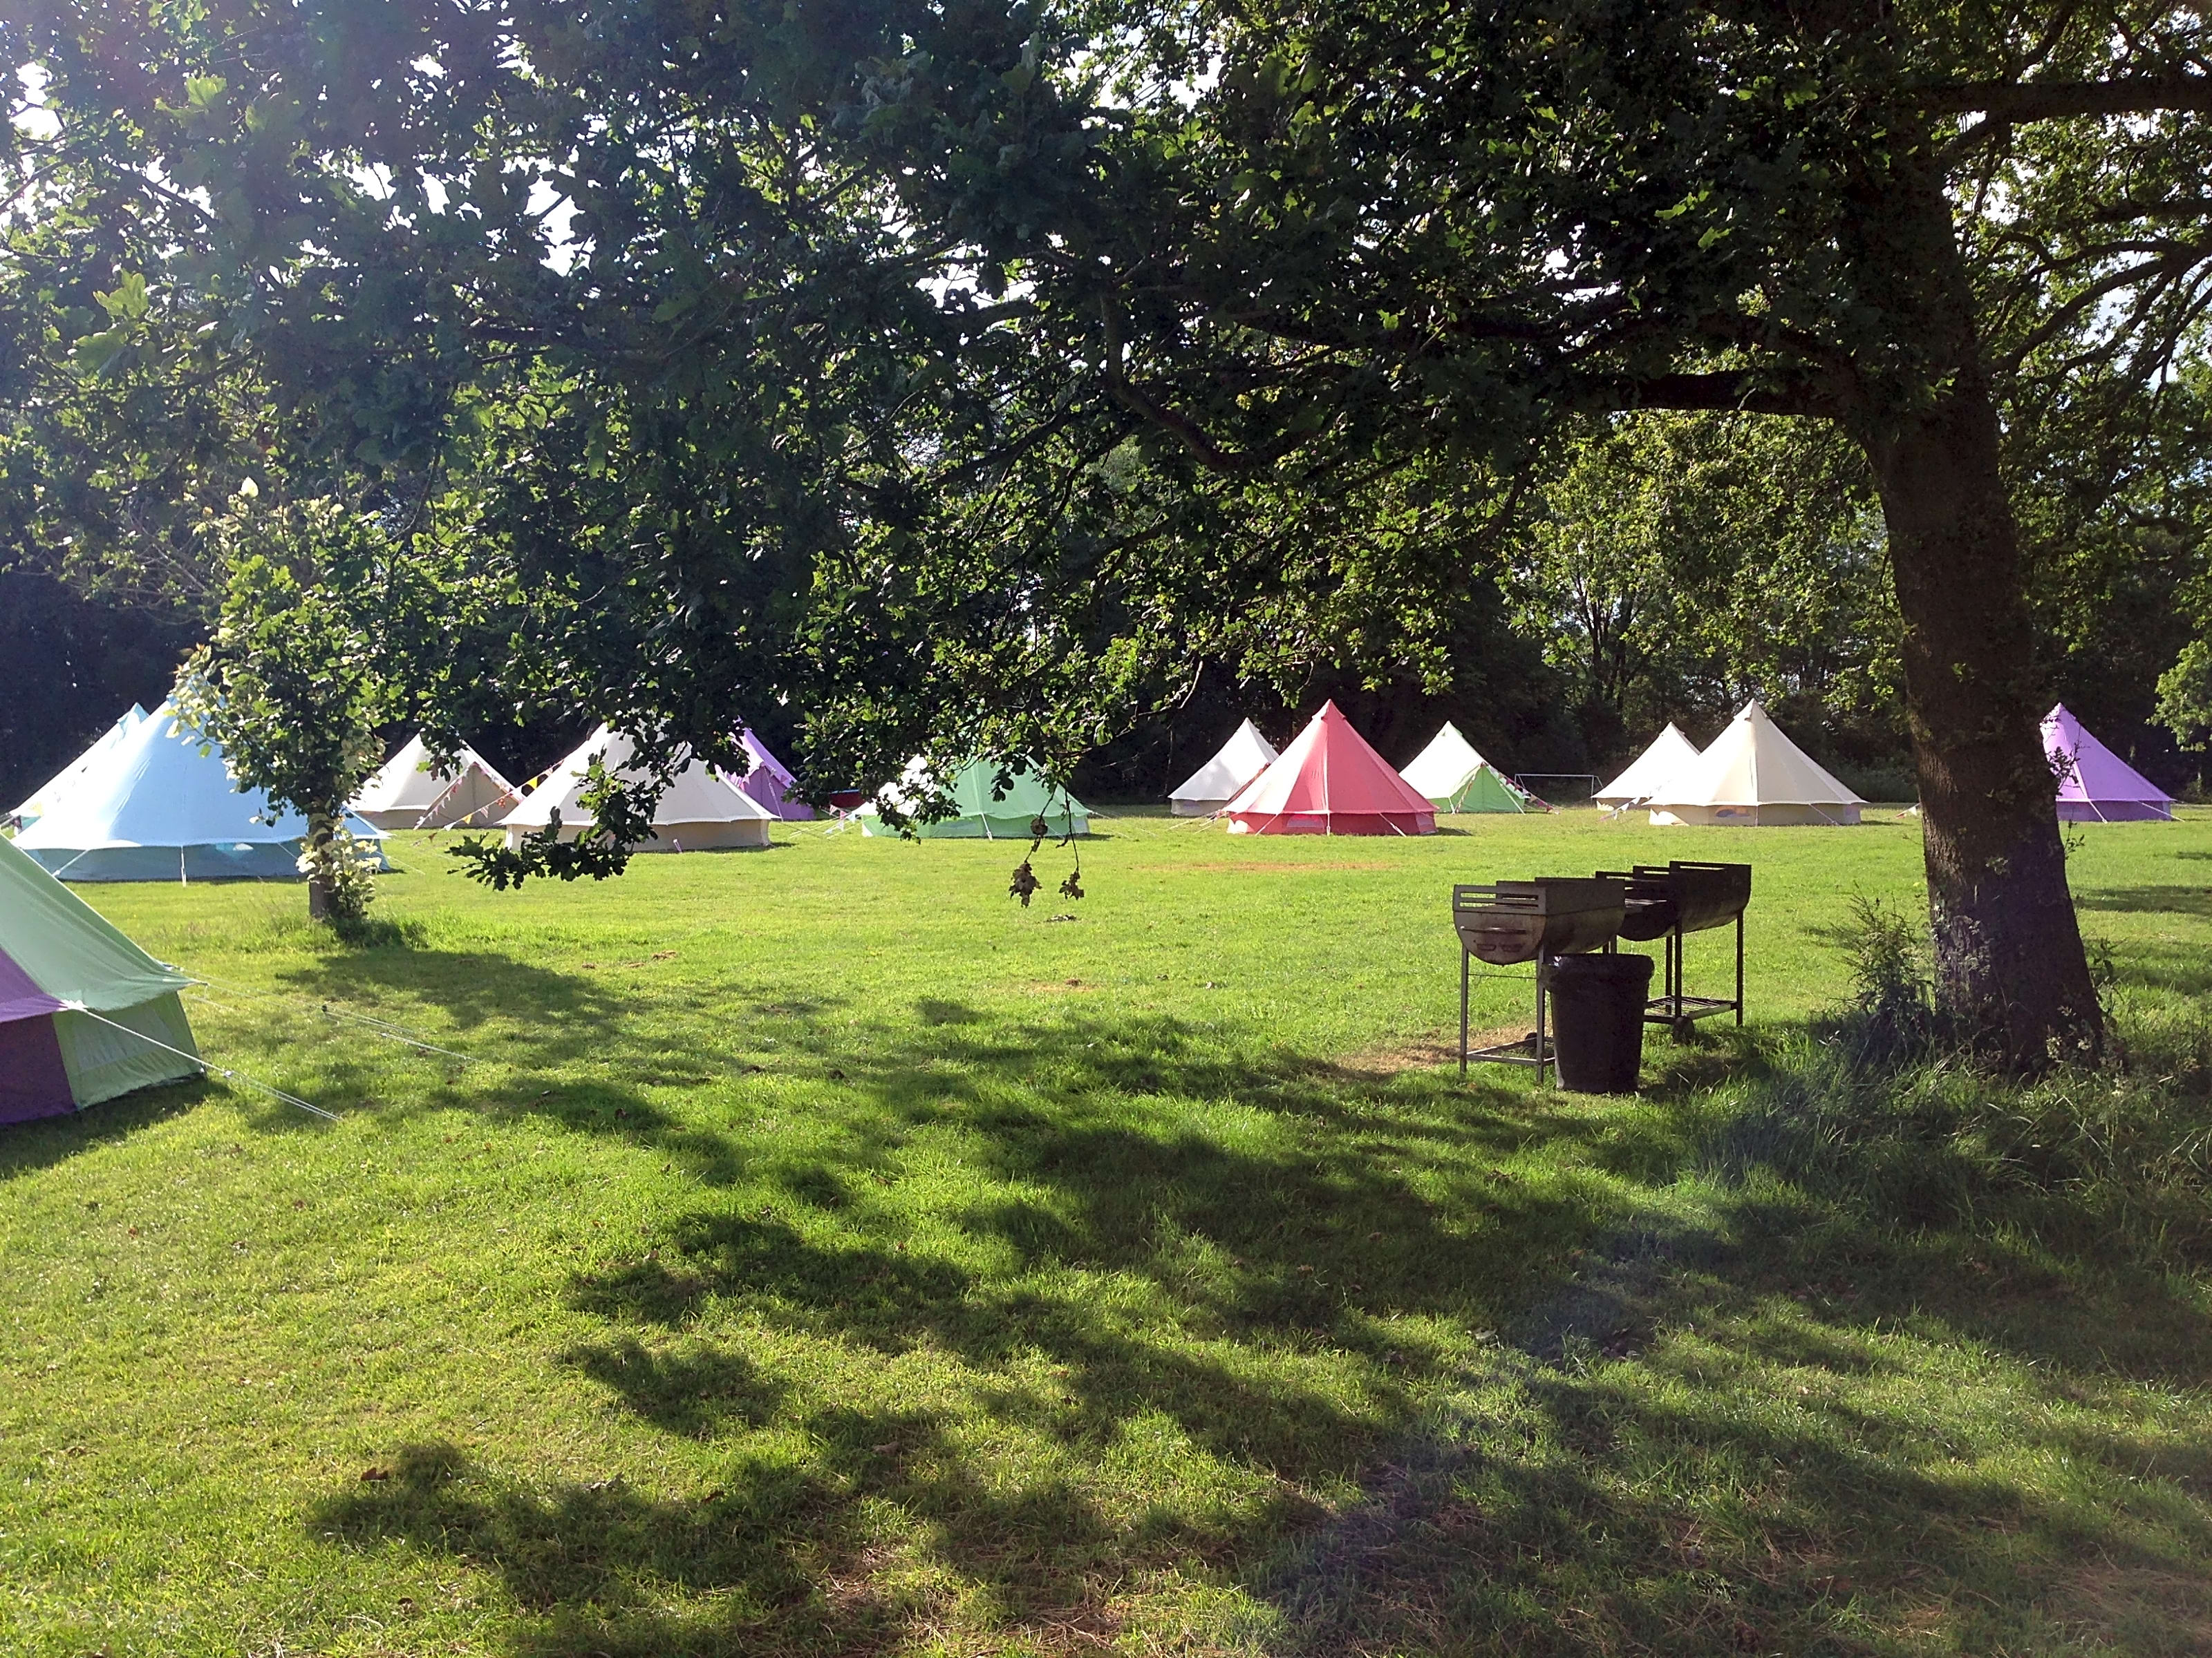
Year 7 Camp
Monday to Wednesday
Itinerary
Venue
Kit List
Medical & Dietary Requirements
Spending money
Rules
Phones
Groups/rooms

Slide 2
Staff
Mr Smith – Trip Leader
Mr Whitmore
Mr Hunnable
Mr Walker
Miss Paul
Miss Peake
Miss Basssett
Miss Hitchen
Mr Blasco
Miss Cambridge
Ms Read

Slide 3
EMERGENCY CONTACT
07592 491377 – Mr Smith
Please note the phone will not always be answered, it will be monitored throughout the day. Text messages may be easier and responded to when seen.

Slide 4
Wednesday 15th July | Thursday 16th July | Friday 17th July | Monday 20th July | Tuesday 21st July | Wednesday 22nd July
In school normal hours | In school normal hours | . In school normal hours | Depart for Year 7 Camp. Please meet at Downlands at 8:30am on the playground. Please park in the village or walk as our car park will be full | Y7 Camp | Return to Downlands between 1:00pm and 2:00pm. Students will be dismissed home at this time. A message will be sent with our rough ETA back at Downlands.

Slide 5
CLIMBING
ARCHERY
TEAM CHALLENGE
FIRE STARTING
BLIND TRAIL
HIGH ROPES
 | 9:30-11:00 | 11:00-11:15 | 11:15-12:45 | 12:45-13:45 | 13:45-15:15 | 15:15:15:00 | 15:30-17:00 | EVENING
Monday | JOURNEY TO FAIRTHORNE MANOR |  |  | LUNCH | ACTIVITY 1 | BREAK |  | WATER ACTIVITY
Tuesday | ACTIVITY 2 | BREAK | ACTIVITY 3 | LUNCH | ACTIVITY 4 | BREAK | ACTIVITY 5 | CAMPFIRE
Wednesday | ACTIVITY 6 | PACK UP TENTS | DEPART FAIRTHORNE MANOR
STAND-UP PADDLE BOARDING
CANOEING
KATU KANU
KAYAKING

Slide 6
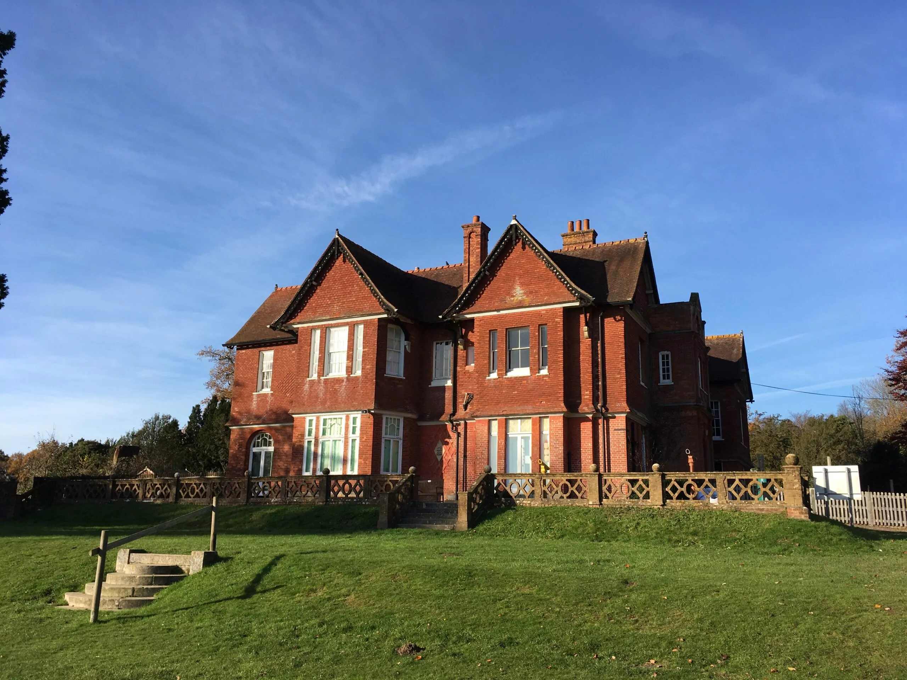
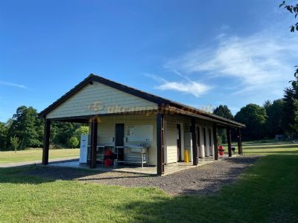
Venue
Fairthorne Manor, YMCA, Southampton SO30 2GH
Tents are semi-permanent, with solid floors. They sleep maximum of 6 and can be stood up in!
Purpose built shower and toilet blocks adjacent to our camp.
Meals served in their canteen.

Slide 7
Kit List
Clothing
Comfy trainers
Swimming gear and towel
Old shoes/water shoes
Waterproof jacket
Shorts/jeans/trousers
T-shirts/tops
Sun hat/sun glasses
A warm jumper
Change of socks/underwear
Torch
Other
Toiletries
Bath towel
Sun cream
Refillable water bottle
Sleeping bag
Roll mat
Snacks (no fizzy/energy drinks)
Spending money
Ear defenders (if sensitive to noise)

Slide 8
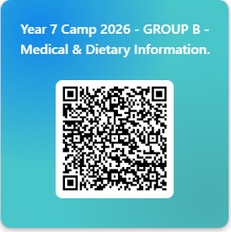
Medical & Dietary Requirements
All medical and dietary requirements must be up-to-date. If you do not think the school has the most up-to-date information, contact Ms Marinova (lmarinova@downlands.org) to update Reception.
Students should not travel with any medication on them.
Staff will be travelling with school stock of paracetamol, ibuprofen, antihistamine and Kwells Travel Sickness tablets.
If your child must take another prescription or over the counter medication, they you should have already alerted us to this via the survey sent out in May.
Staff will not be able to give any medication without this survey being completed. If you have not filled it in, please do so ASAP by the QR code below.

Slide 9
Money
Pupils may need a small amount of money for the trip as there is a tuck shop we may access in the evenings. Please note we will monitor the amount of sugar being brought and that students will be fed well and do not need to access the tuck shop!

Slide 10
Rules
School rules will apply
No alcohol is to be consumed on the trip
No smoking/use of vapes is allowed
Staff may be conducting bag searches using school policy
Students are expected to be punctual and polite – staff have worked hard to plan this trip and it is their own time too!
Students will be expected to treat the YMCA staffin the same way that they would treat a member of school staff.
We will hold detentions in the evenings if students do not conduct themselves correctly. We do also have spare tents to isolate students if needed.

Slide 11
Phones
Phones are banned for this trip.
Rationale:
Gives students the opportunity to ‘take a break’ from their smart phones.
There are no facilities to charge them, nor good signal.
Reduces safeguarding concerns around misuse.

Slide 12
Rooms and groups
I will not know our tent allocation until a few weeks before we travel. It is likely that rooming information will not be shared with students until we arrive at our accommodation. Please bare in mind, it is just two nights of your lives and you should just be sleeping!
Students are going to be put into activity groups by their tutors with a member of Downlands staff as the leader.

Slide 13
Any Questions?
Please e-mail myself msmith@downlands.org

