Slide 1

Year 9 – Character Passport Trip
France 2027

Slide 2
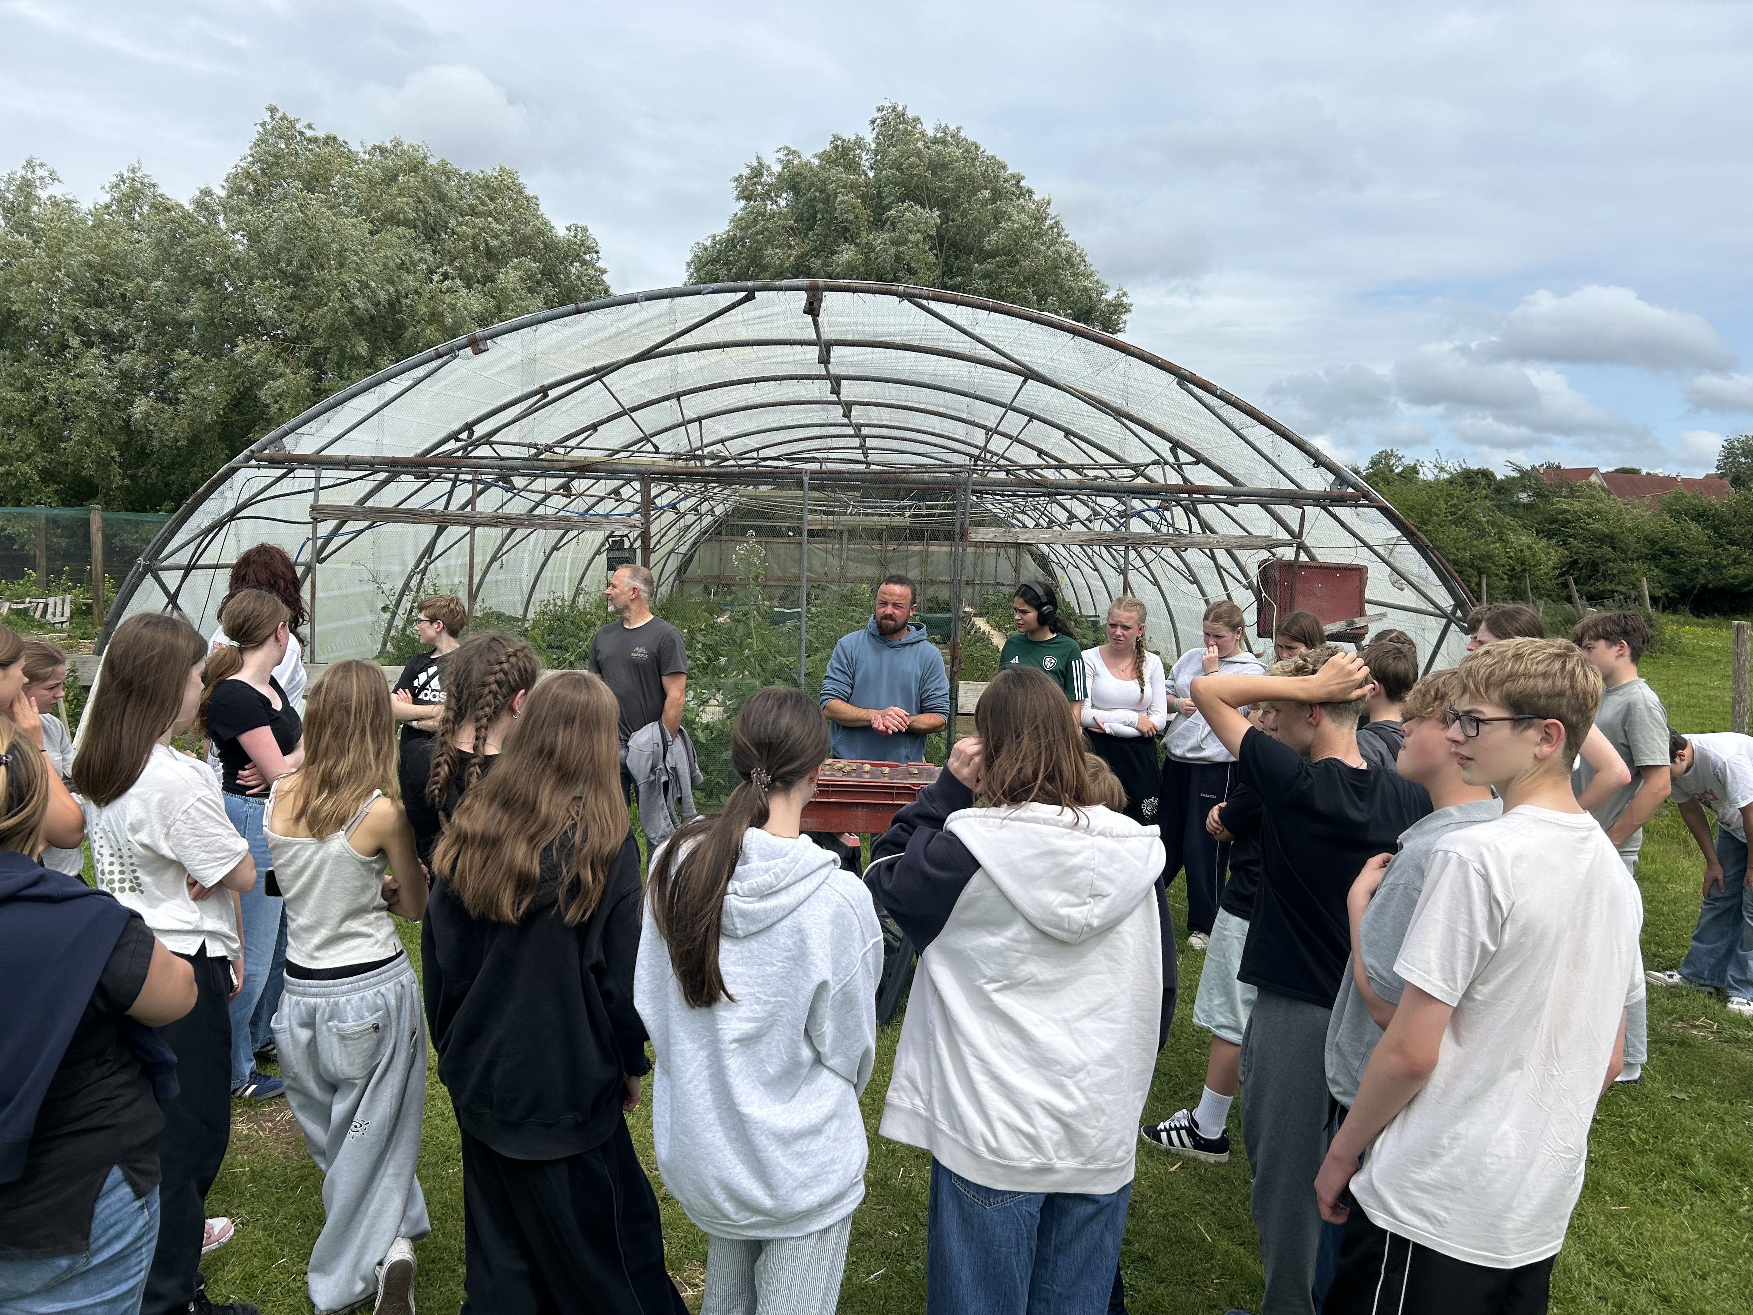
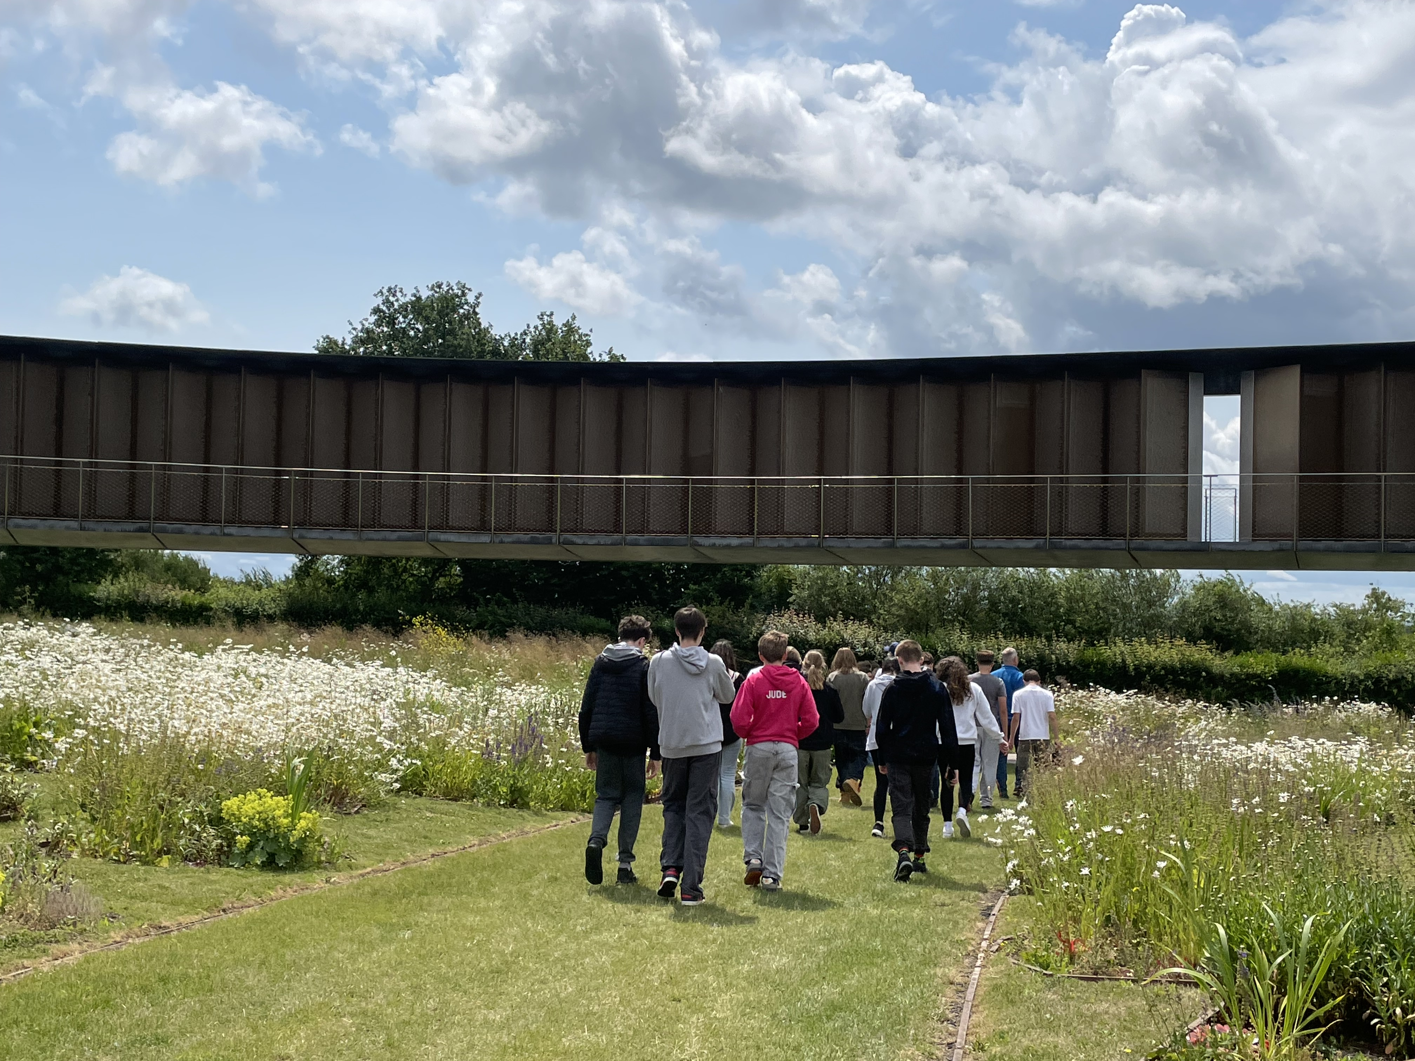
What?
Students will have a choice of either:
Opal Coast or Somme

Slide 3
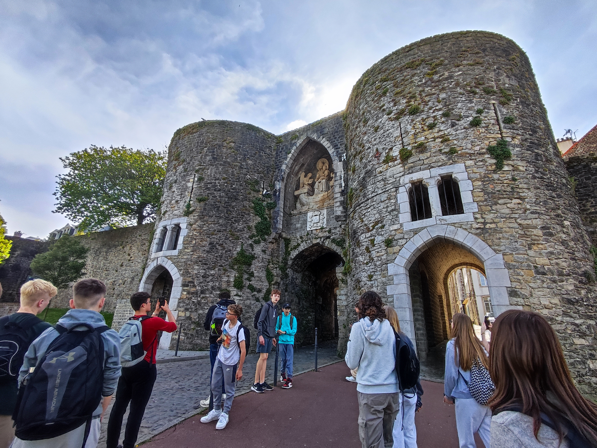
Opal Coast
A short hop across the channel The Opal Coast is an ideal region for first time visitors to France. Located between Calais and Boulogne-sur-Mer, in the north west of France, the Opal Coast is renowned for picture postcard settings that are rich in tradition and history.
Throughout the trip, students will be able to:
  Practice French at the Le Touquet Farmers Market;
  Discover how chocolates are made at a small manufacturer
  Visit a local snail farm, including tasting
  Visit the sea lions, penguins and other marine species at Nausicaa Sea Centre.
  Spend time in Boulogne Old Town and on the beach.

Slide 4
Opal Coast
This trip is perfect for:
Students who are studying French.
Students who are interested in different cuisines.
Students who are interested in marine life
Students who would like to explore a different culture.
I wasn’t sure what to expect from 48 hours in a part of France I’d never heard of. However this trip was so much fun and it was brilliant to spend time with everyone. A highlight was the huge aquarium tank with manta-rays and penguins. I also loved playing volley ball on the beach!
A current Year 10 student (2025)

Slide 5
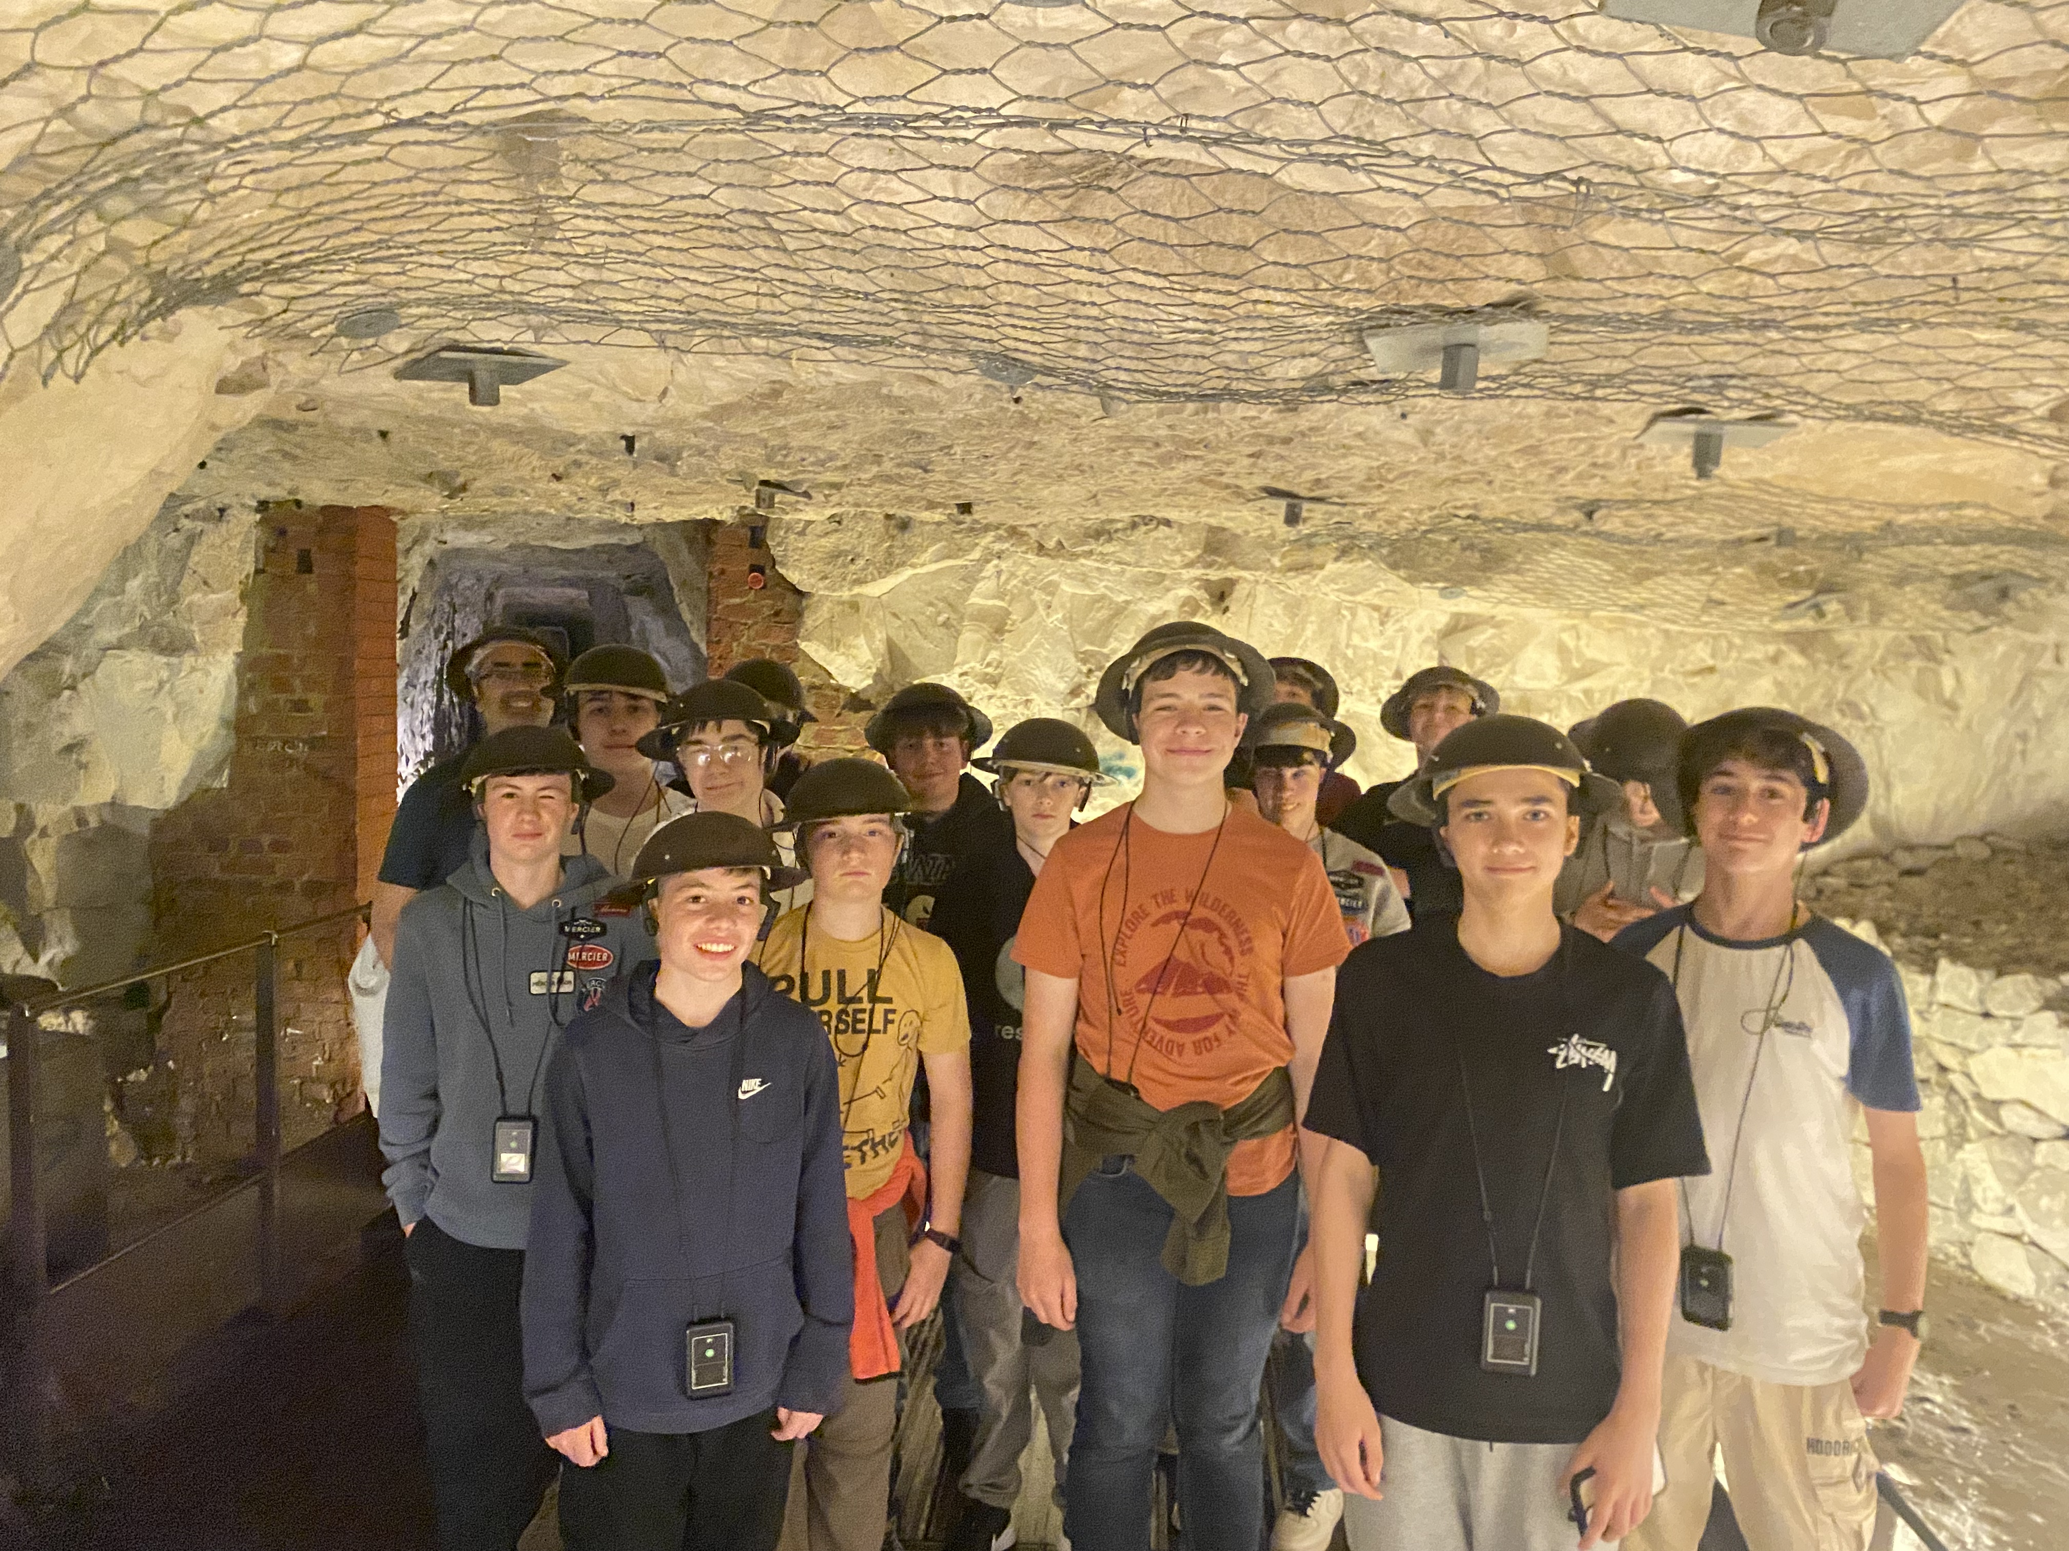
Somme
Students will have the opportunity to see many different exciting aspects of the First World War.
They will be able to explore and walk through actual trenches to get a sense of the conditions.
Students will put on their steel 'Tommy' helmets and go underground into the Arras Tunnels which were built and used by the soldiers. We will walk around the Lochnager Crater the biggest, manmade explosion in human history up to that point!
There will also be an opportunity to explore French culture through a shopping visit to a farmers market or supermarket.

Slide 6
The Somme
This trip is perfect for:
Students who are considering studying GCSE History.
Students who are interested in different cuisines.
Students who are interested in real life stories.
Students who would like to explore a different culture.
As someone who didn’t go on to study GCSE History, I still found this trip so interesting and fun! Our guide was brilliant and told us lots of real-life stories. A highlight was travelling through the French countryside and exploring the different trench systems.
A current Year 10 student (2025)

Slide 7
Quotes from the 2026 Students on France Trips
The farmers market was brilliant, I tried to speak French which wasn’t great but we all got there in the end, the food was great and I bought macaroons!
We were sure that we wouldn’t try snails but made an agreement we would try together and we did- they weren’t that bad I ate 10 in the end!!
I was nervous about going but I loved it all, the ferry, being with my friends, and playing on the beach and trying on the war unforms
I had never been abroad before and I was worried, it was an early morning but the trip was brilliant, I shared a room with 3 friends, we had chicken and chips for dinner and I tried loads of new stuff, my favourite thing was the chocolate tasting!
The aquarium blew my mind, the sharks and manta rays were epic and the penguins sooooo cute
The tunnels on the Somme trip were amazing- I loved all the stories about the soldiers

Slide 8
When?
Friday 18th to Saturday 19th June 2027.
We will depart between 3am and 4am on Friday and return around 8pm on Saturday
But don’t worry about the early start…. It’s a jam packed 48 hours and there is time for naps on the coach!

Slide 9
Who?
Opal Coast:
Students will be travelling on mixed coaches for this trip. We stay at two different hostels. Two coaches will be staying at each hostel and students will be able to request friends they wish to share with for their rooms (bearing in mind not everyone is in the same hostel).
The Somme:
Students will be travelling on a mixed coach/es for this trip.
All students will be staying in the same hotel so can request to share with whomever they like.

Slide 10
How?
Sign up at this link by 9am Friday 11th September.
Once you have submitted your response, please log on to SCOPAY and pay the non-refundable deposit.
REMEMBER TO SIGN UP AND PAY THE DEPOSIT IN ORDER TO CONFIRM YOUR CHILD’S PLACE
The total cost of these trips are £295. (£75 for pupil premium students)
However, we do not want cost to be barrier.
Last year we had 90% of the year group on one of these trips and we would like to be able to do the same again. If cost is a problem, please contact Mr M Smith on msmith@downlands.org in confidence. Mr Smith will respond once term has begun.

